Slide 1


LEADERSHIP

Slide 2


Slide 3
























Slide 4



We all need leaders. And, eventually we all need to BE leaders. But the quality of the leader really matters.
  A bad leader will make things harder for everyone.
  An okay leader won't make much of a difference.
  But, a great leader can help a lot of people.
  And we can all become great leaders.

Slide 5



WHAT MAKES A GREAT LEADER?
1. A hurting heart, and
2. A multiplying mind

Slide 7


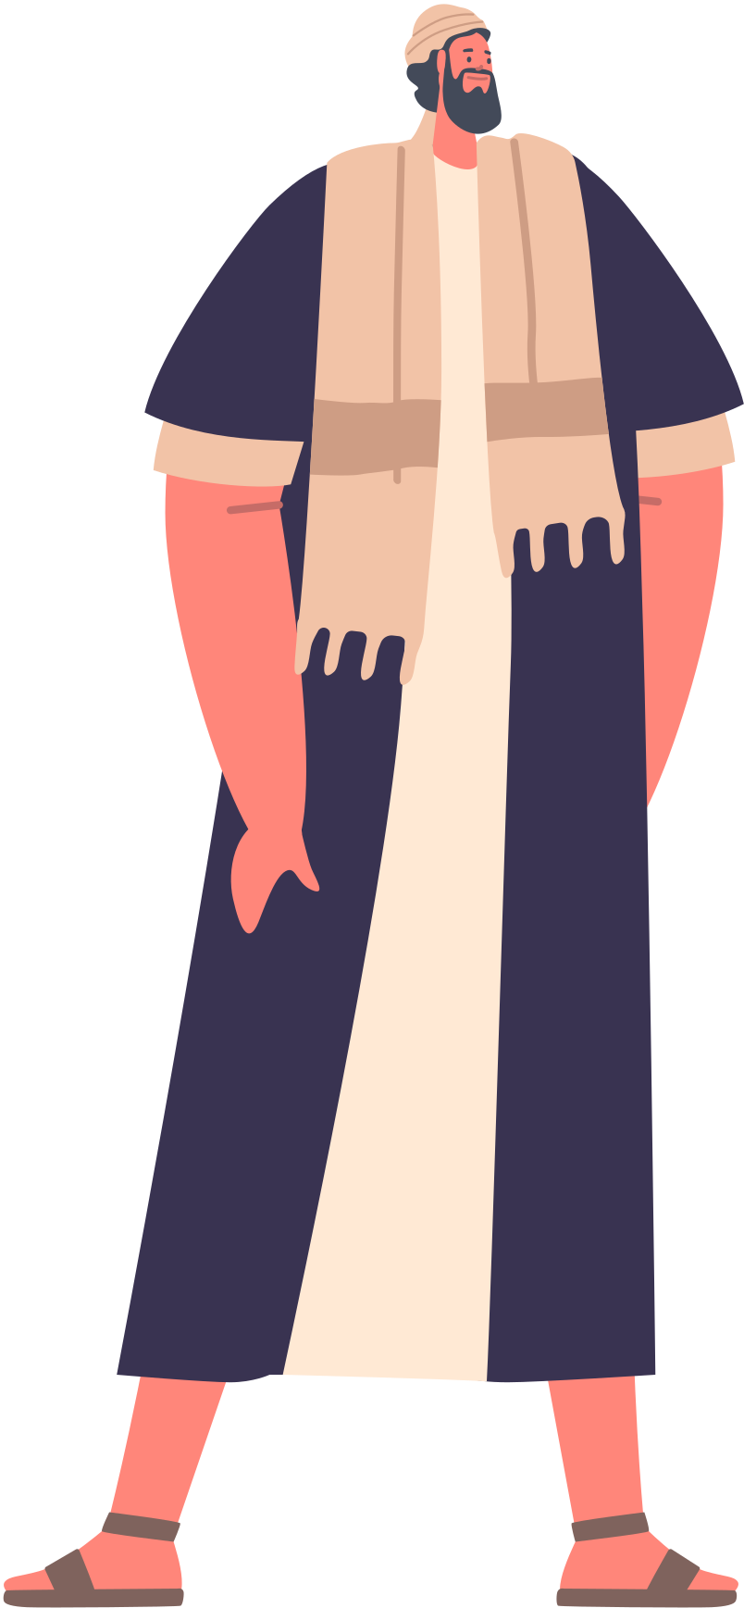
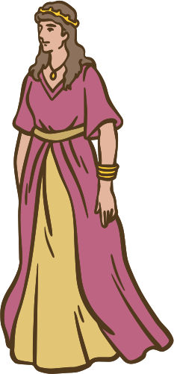
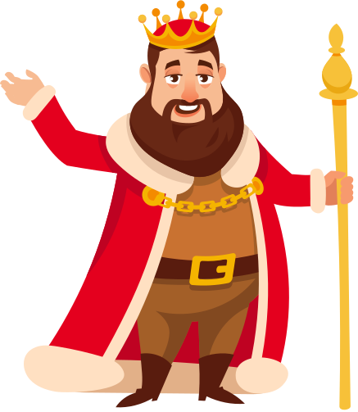
ESTHER 8:1-8 (CEV)
1 Before the end of the day, King Xerxes gave Esther everything that had belonged to Haman, the enemy of the Jews. Esther told the king that Mordecai was her cousin. So the king made Mordecai one of his highest officials 2 and gave him the royal ring that Haman had worn. Then Esther put Mordecai in charge of Haman’s property.

Slide 8

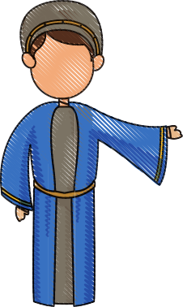


ESTHER 8:1-8 (CEV)
3 Once again Esther went to speak to the king. This time she fell down at his feet, crying and begging, “Please stop Haman’s evil plan to have the Jews killed!” 4 King Xerxes held out the golden scepter to Esther, 5 and she got up and said, “Your Majesty, I know that you will do the right thing and that you really love me. Please stop what Haman has planned. He has already sent letters demanding that the Jews in all your provinces be killed, 6 and I can’t bear to see my people and my own relatives destroyed.”

Slide 9



ESTHER 8:1-8 (CEV)
7 King Xerxes then said to Esther and Mordecai, “I have already ordered Haman to be hanged and his house given to Esther, because of his evil plans to kill the Jews. 8 I now give you permission to make a law that will save the lives of your people. You may use my ring to seal the law, so that it can never be changed.”

Slide 11
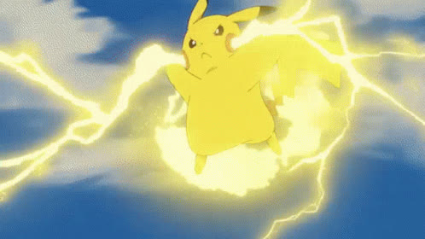








Slide 12



we're all part of a team. And, we have to do our best for each other. Because, if we don't do our job, our whole team will lose.

Slide 13
ESTHER 8:1-8 (CEV)
1 Before the end of the day, King Xerxes gave Esther everything that had belonged to Haman, the enemy of the Jews. Esther told the king that Mordecai was her cousin. So the king made Mordecai one of his highest officials 2 and gave him the royal ring that Haman had worn. Then Esther put Mordecai in charge of Haman’s property.

Slide 14
ESTHER 8:1-8 (CEV)
3 Once again Esther went to speak to the king. This time she fell down at his feet, crying and begging, “Please stop Haman’s evil plan to have the Jews killed!”

Slide 15




Slide 16


Slide 17


Slide 18


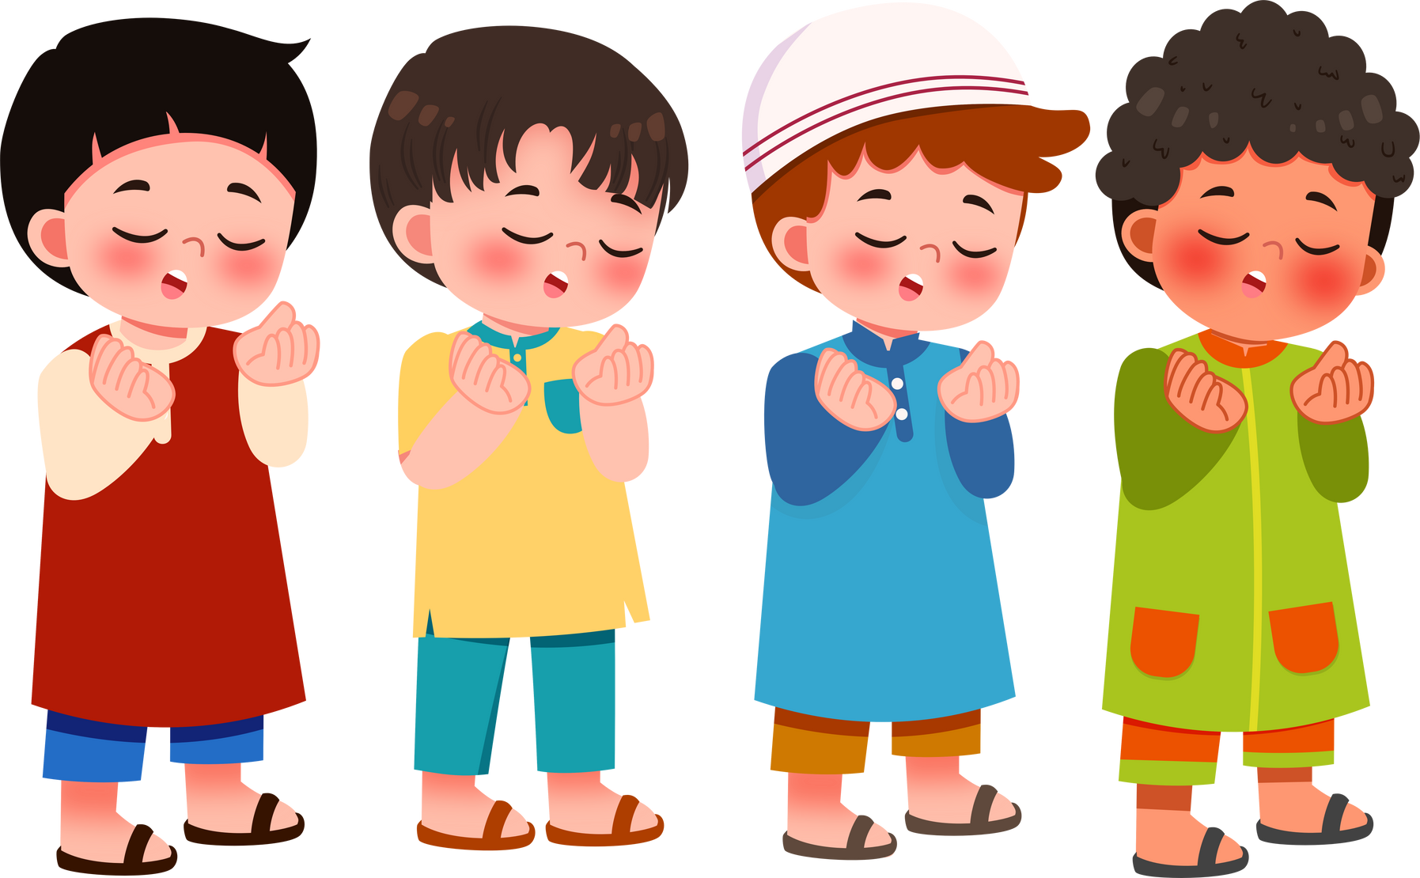
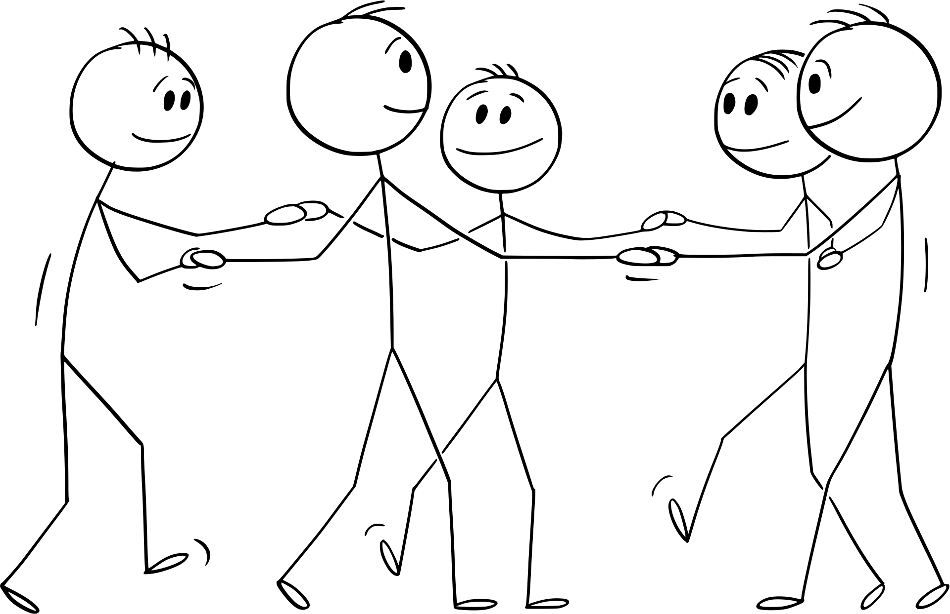
Sometimes in life we find ourselves in a spot like Esther was in. We have to pick between helping ourselves and helping other people. Sometimes if you want to help other people, you could get hurt yourself. But great leaders will take a risk to help other people.

Slide 19
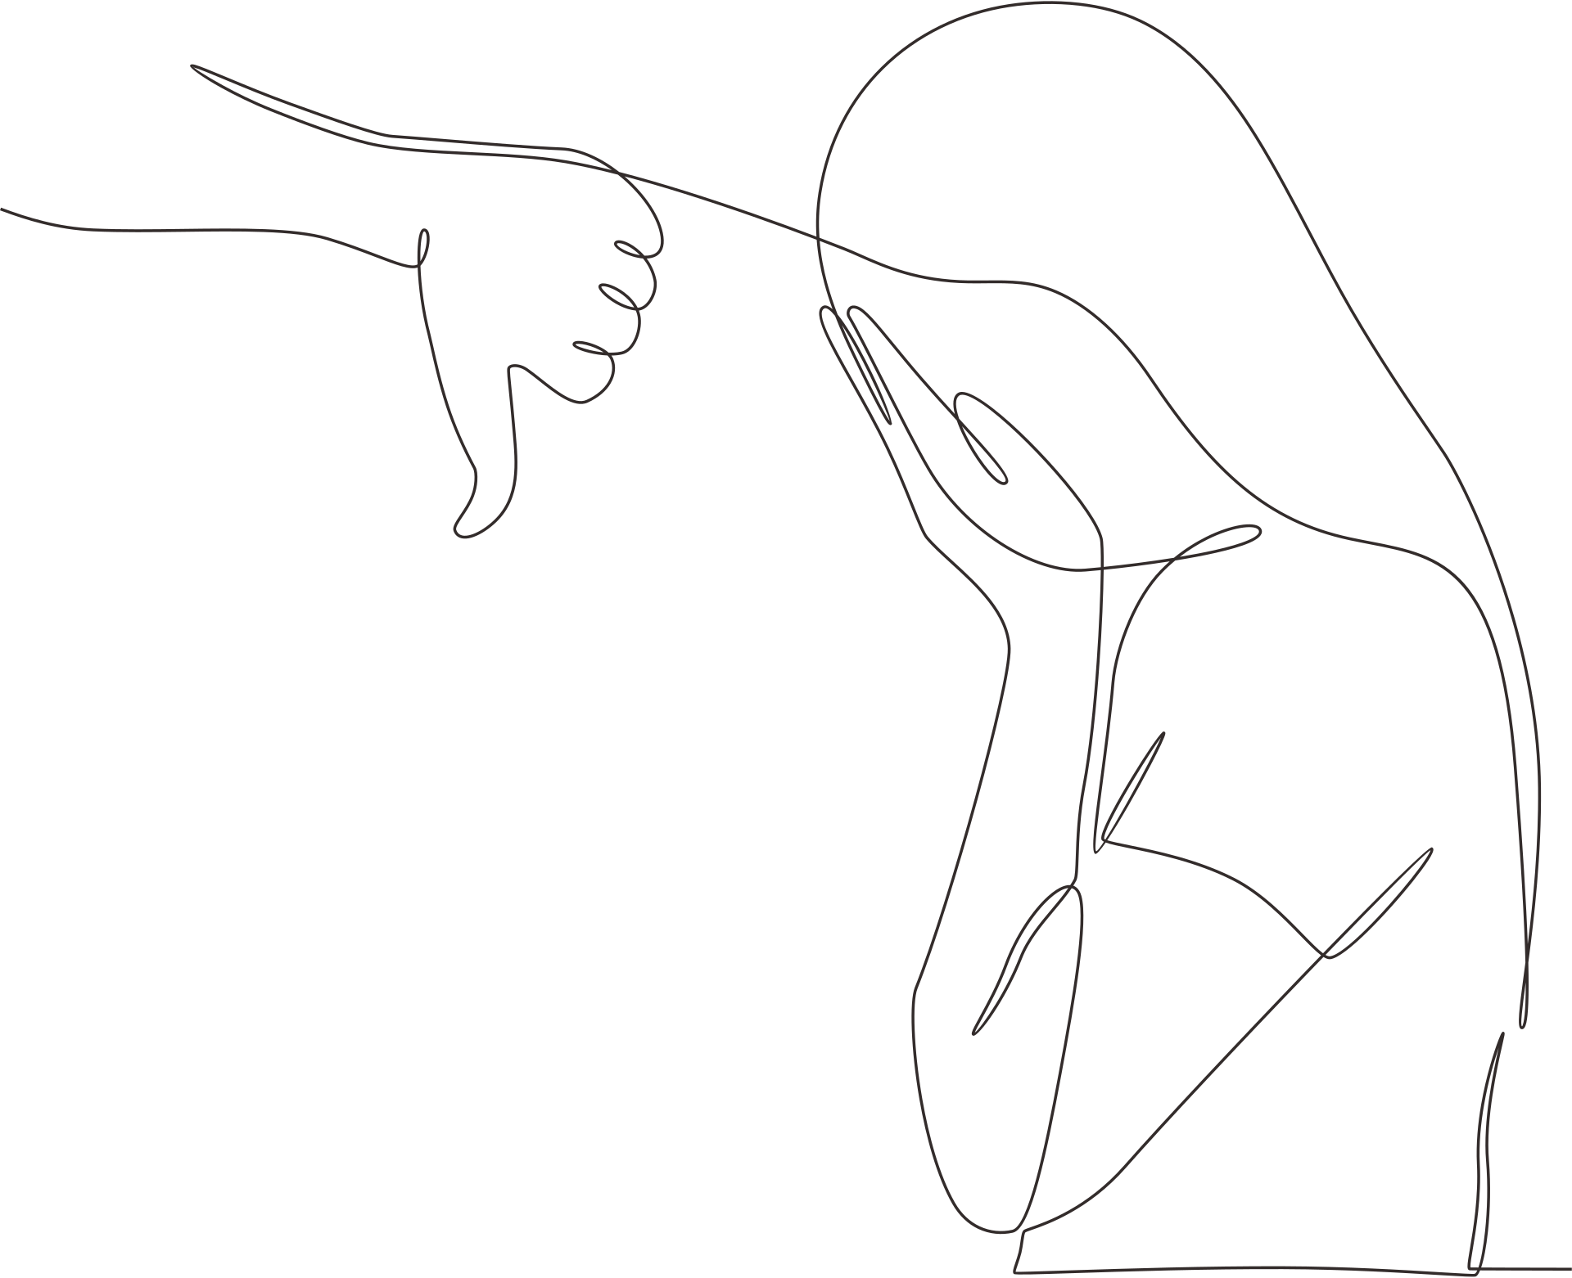
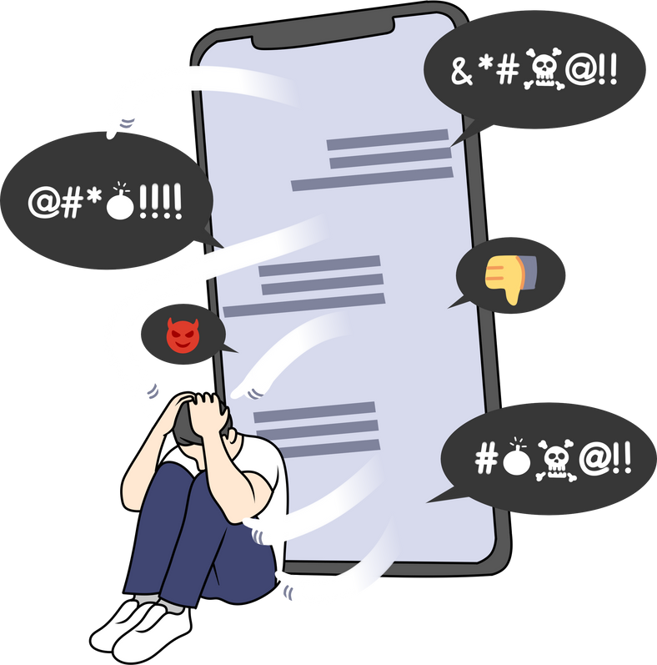
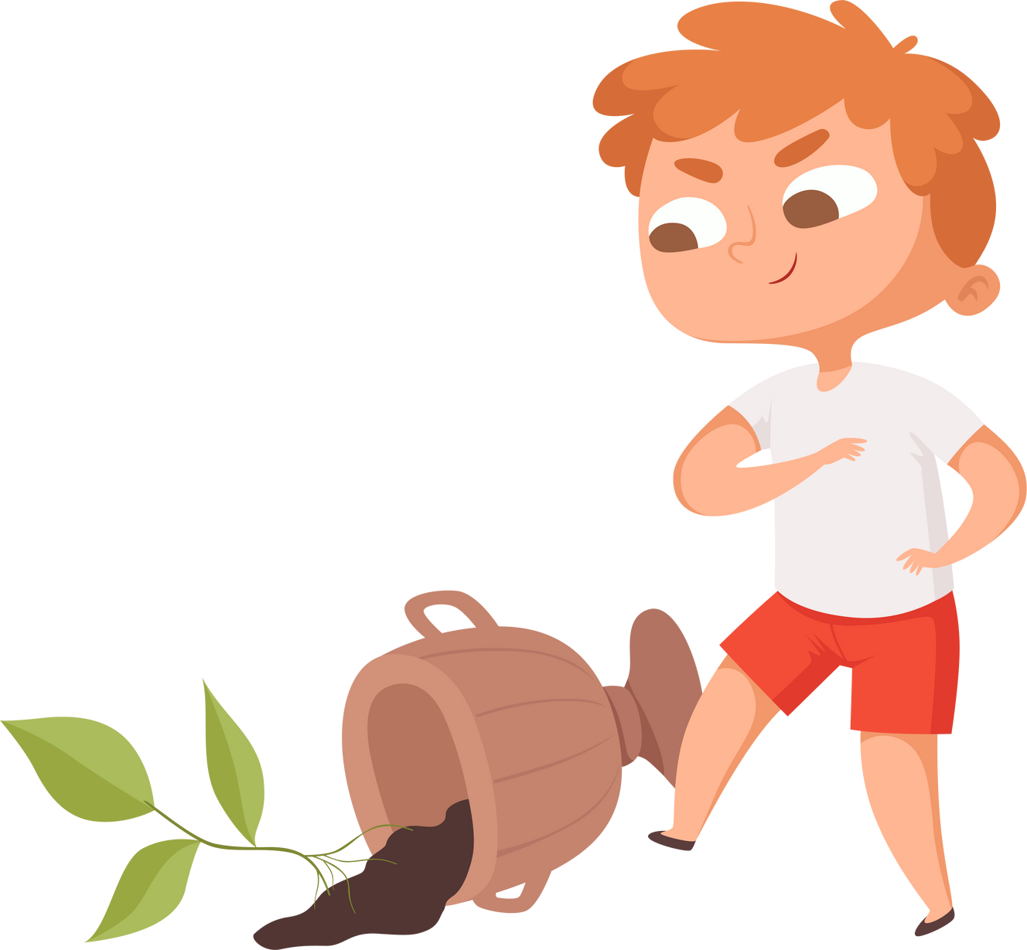
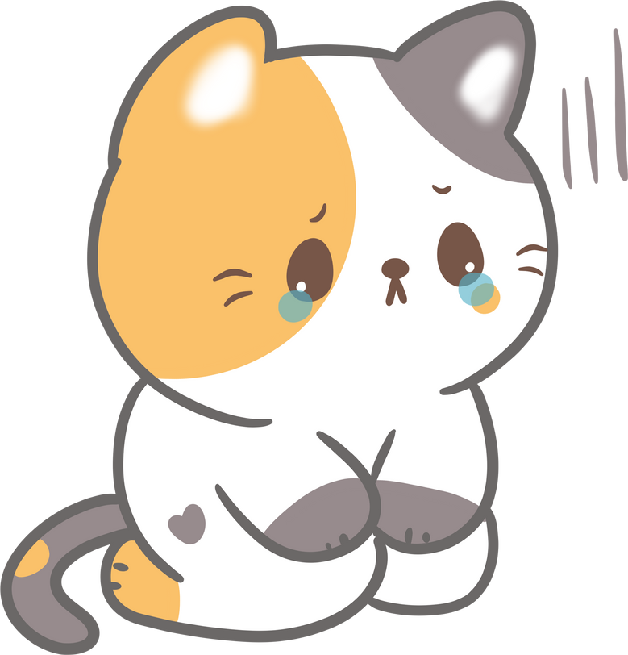
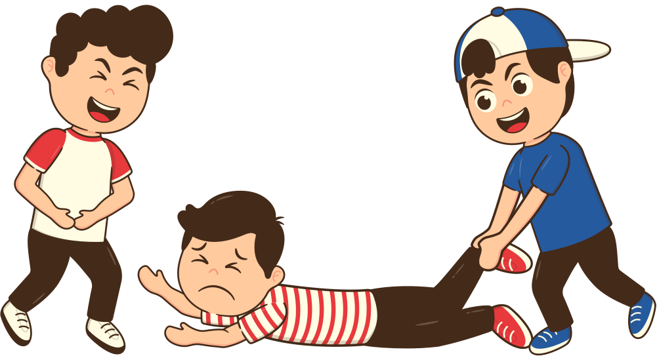
3
WHAT’S SOMETHING THAT HAPPENS TO OTHER PEOPLE THAT MAKES YOU SAD?

Slide 20

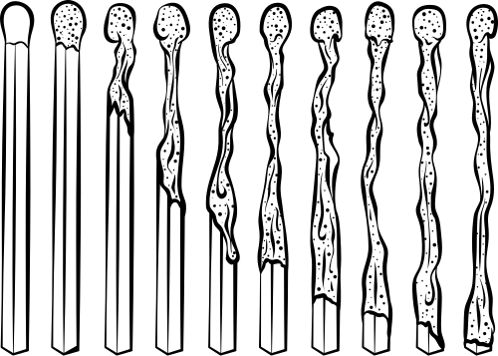






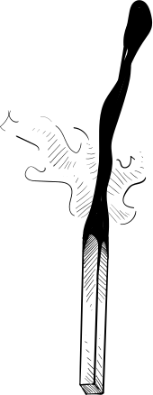






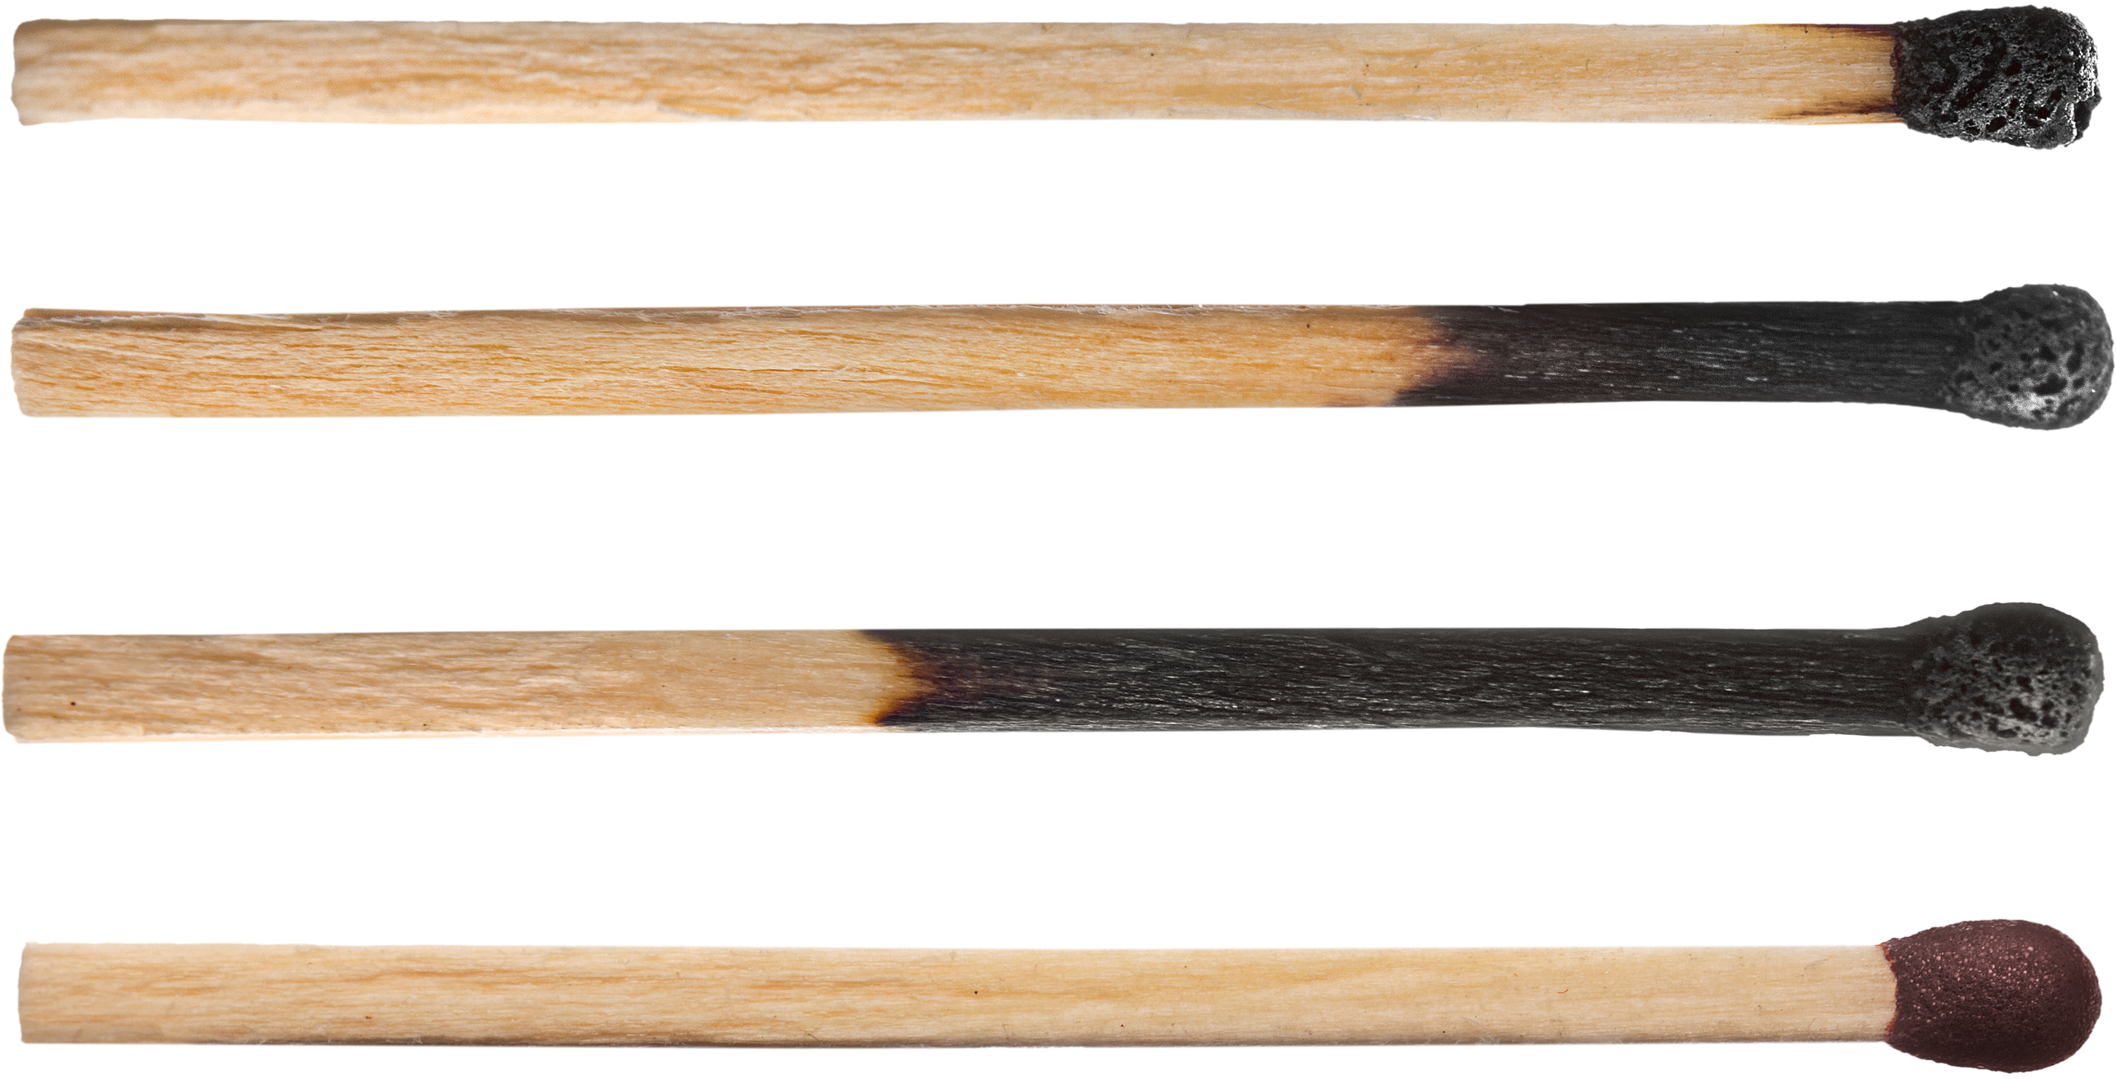
MATCHSTICK
PUZZLES

Slide 21
ESTHER 8:1-8 (CEV)
I now give you permission to make a law that will save the lives of your people. You may use my ring to seal the law, so that it can never be changed.”

Slide 22

We will have to do that too when we become leaders. Sooner or later, we will have to share the work. Great leaders don't just do all the work by themselves. But, they split up the work so that everyone can do their part.

Slide 23

What's your favorite game?
What real-life skills can we learn from the games we play?

Slide 24
GREAT LEADERS HAVE A HURTING HEART. THAT MEANS WE CARE ABOUT OTHER PEOPLE AND IT REALLY BOTHERS US WHEN OTHER PEOPLE ARE IN TROUBLE.

Slide 25
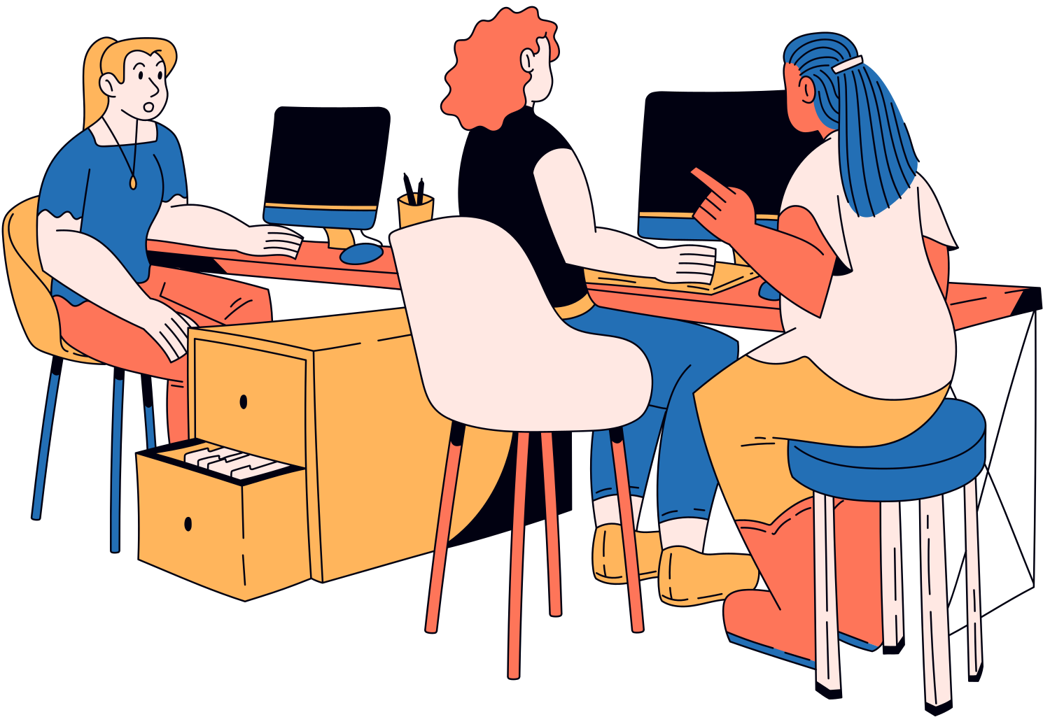
GREAT LEADERS HAVE A MULTIPLYING MIND. THAT MEANS WE SPREAD OUT THE WORK, AND WE HELP OTHER PEOPLE TO DO THEIR PART.

Slide 26

