Slide 1










Evangelism

Slide 2




Toothpick Puzzle
Your goal is to solve as many puzzles as you can.

Slide 3



Debrief
That’s what it’s like if we are helping someone to become a Christian.
  If a person is not a Christian, they normally have a bunch of questions and a bunch of problems that they need to work through before they become a Christian. It can be really hard for them to figure it all out by themselves.

Slide 4




Big Question:
How can we help someone to become a Christian?

Slide 5




Big Ideas:
Our Bible passage today teaches us how to give people the best chance to know God.
Our big idea today is, we need to serve people and serve God.
That means we need to put people ahead of us, and we need to put God ahead of us.

Slide 6





Bible Reference:
19 I am not anyone's slave. But I have become a slave to everyone, so I can win as many people as possible. 20 When I am with the Jews, I live like a Jew to win Jews. They are ruled by the Law of Moses, and I am not. But I live by the Law to win them. 21 And when I am with people who are not ruled by the Law, I forget about the Law to win them. Of course, I never really forget about the law of God. In fact, I am ruled by the law of Christ. 22 When I am with people whose faith is weak, I live as they do to win them. I do everything I can to win everyone I possibly can. 23 I do all this for the good news because I want to share in its blessings.
1 Corinthians 9:19-23 (CEV)

Slide 7
1
We need to serve people
We need to put people ahead of us

Slide 8
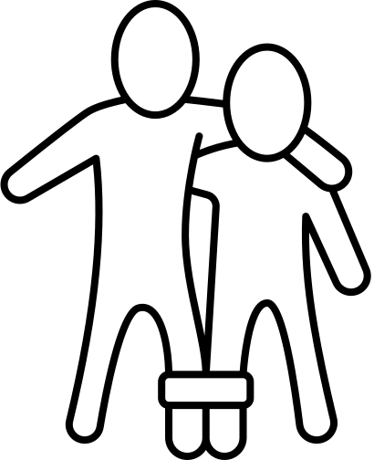
Activity: 3 Legged Race

Slide 9




Debrief
  We played this game because it's about being stuck with someone, and walking with them. Sticking with someone like that is really hard!
  Sometimes that's what it's like to help people to find the truth about God.

Slide 10
Bible Reference:
19 I am not anyone's slave. But I have become a slave to everyone, so I can win as many people as possible. 20 When I am with the Jews, I live like a Jew to win Jews. They are ruled by the Law of Moses, and I am not. But I live by the Law to win them.
1 Corinthians 9:19-20 (CEV)

Slide 11



Explanation
  Paul really wanted to help people to know about Jesus.
  He wanted to help as many people as possible, so he became like the people he was trying to help.
  He really cared about the Jewish people, so he followed their rules. He did things that weren't comfortable, and he said it was like becoming a slave, which is no fun. But Paul knew that if he could be a good friend and live like his neighbours, he would give them the best chance to know God.

Slide 12

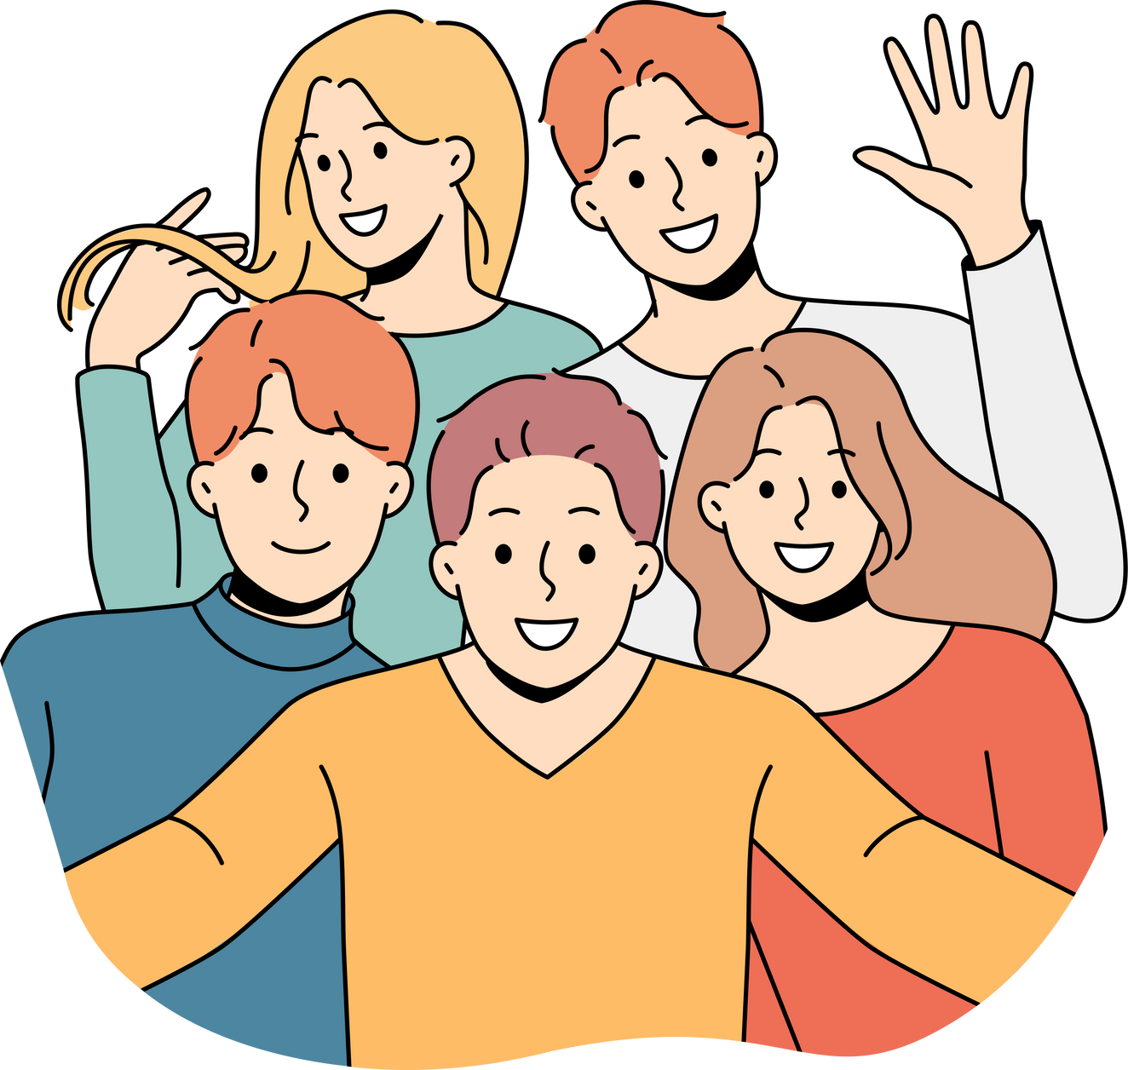
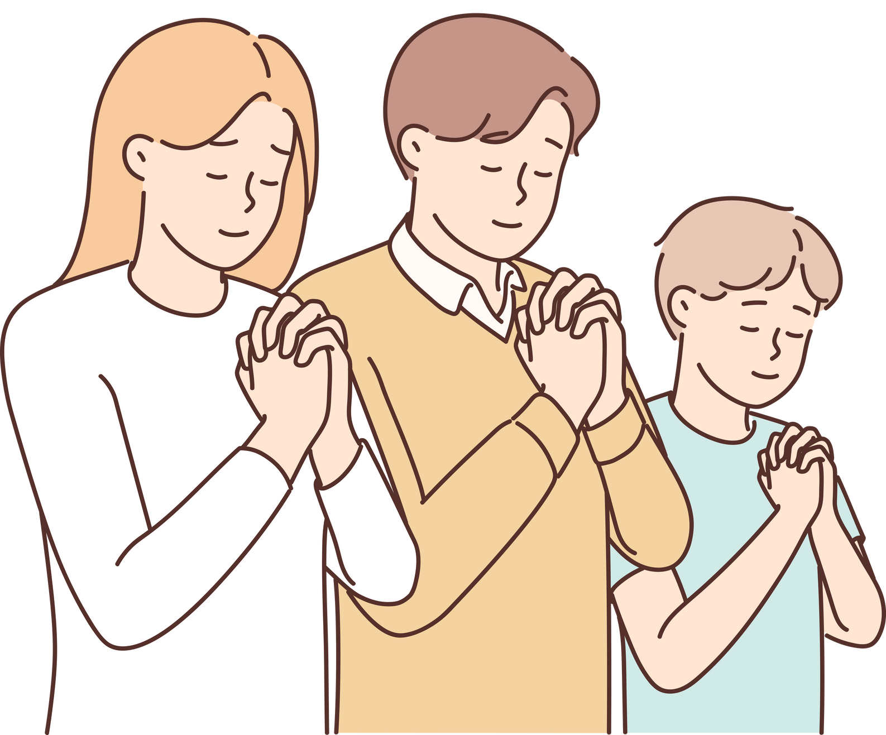

Slide 13
Discussion Questions:
  Do you have any ideas on how to be a good friend?
  Do you have any ideas for how to help your friends get to know God?

Slide 14

We need to serve God
2
Which means we need to put God ahead of ourselves.

Slide 15

Zoom In Game
  We'll be looking at a whole bunch of animals that are zoomed in, and then it will slowly zoom out. As a class, let's try to guess the right answer as quickly as we can.
  The catch is, you can only guess once for every picture, so if you're wrong, you'll have to wait for someone else to get the right answer.

Slide 16



Debrief
  We played this game because it reminds us there's always a bigger picture.
  When we are trying to help someone, we can get really focused on the little details. It can be discouraging when we see how hard it is to help them.
  We need to remember that there is a bigger picture, or else it won't make sense why we are trying so hard.
  The bigger picture is that we are serving God and doing his work, and it's worth it.

Slide 17

Bible Reference:
21 And when I am with people who are not ruled by the Law, I forget about the Law to win them. Of course, I never really forget about the law of God. In fact, I am ruled by the law of Christ. 22 When I am with people whose faith is weak, I live as they do to win them. I do everything I can to win everyone I possibly can. 23 I do all this for the good news because I want to share in its blessings.
1 Corinthians 9:21-23 (CEV)

Slide 18
How can we help someone to become a Christian?
We need to serve people, and we need to serve God.

Slide 19
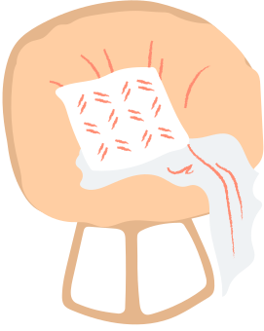


End Craft:
Air Cannon

