Slide 1



Welcome
How was your week?

Slide 2

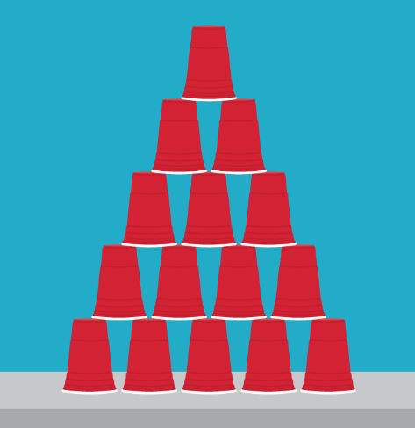
Game!
Cup Pyramid Challenge
Build the highest pyramid together with your team!

Slide 3

Why did we play this game?
This game is really hard! If we mess up or bump the pyramid, the whole thing could come down!
Mistakes is part of the fun! The challenge is to do your best even when things aren’t going your way.

Slide 4
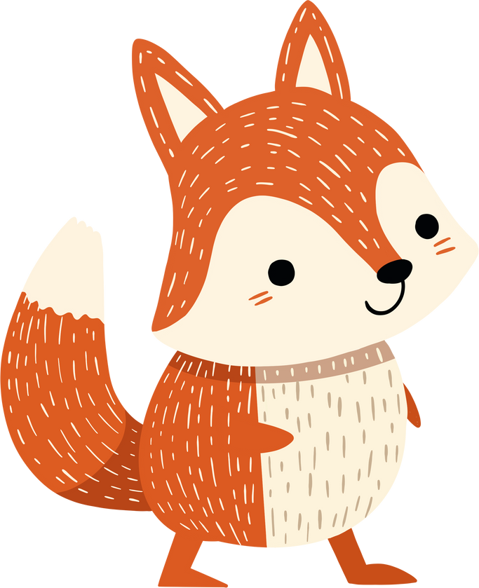



Relevance
This is the same as real life!
A lot of people get really upset at all the messed up things that others have done.
Jesus teaches us the best way to move on when we mess up, and when other people mess up.

Slide 5

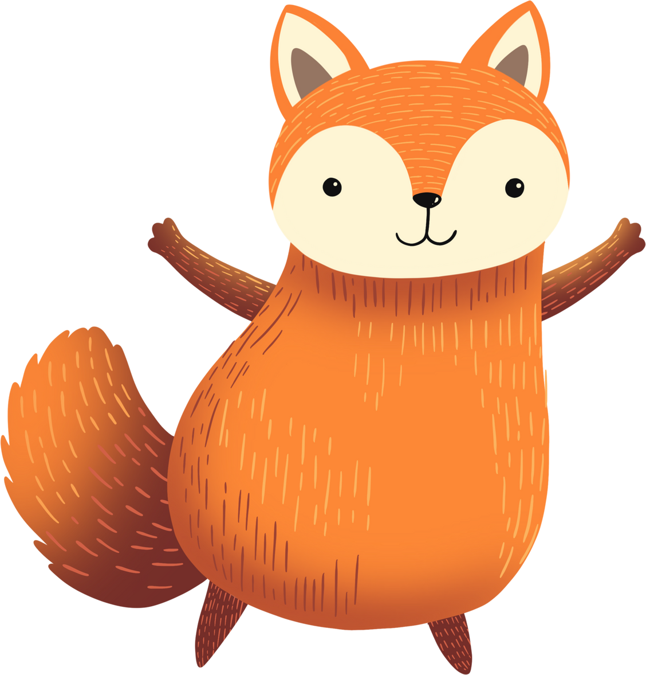
What can we do about all the messed up things around us?

Slide 6


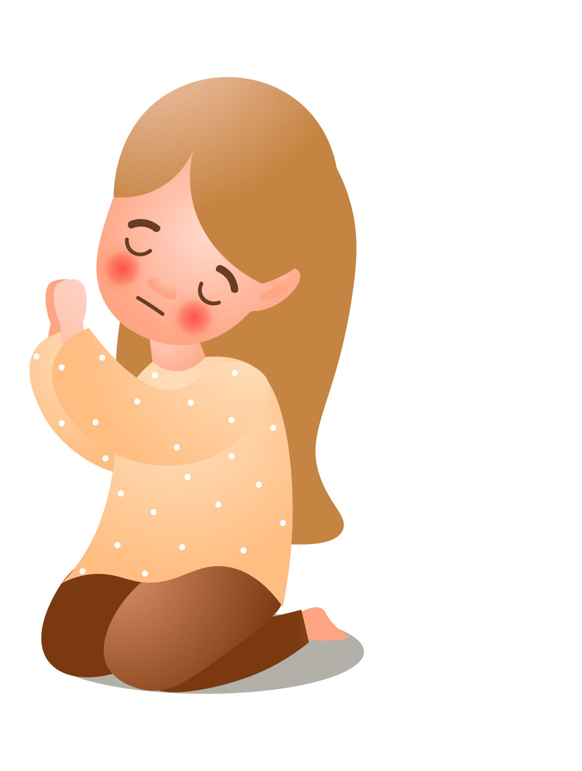
Big Idea
What can we do about all the messed up things around us?
We can pray for forgiveness
We can pray for help against evil.

Slide 7
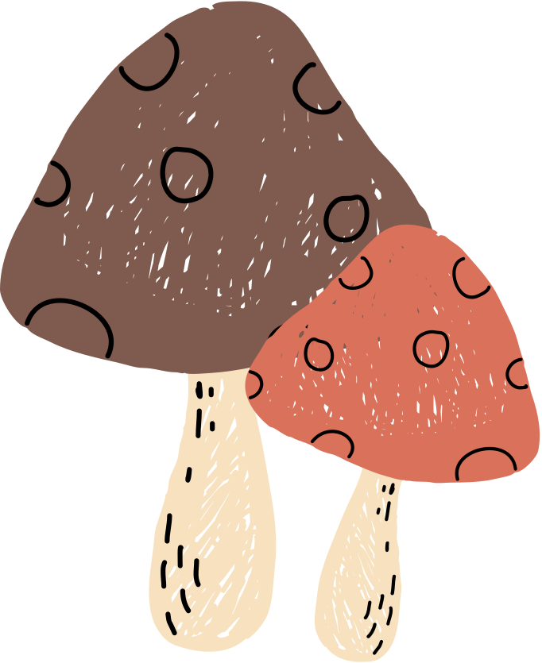
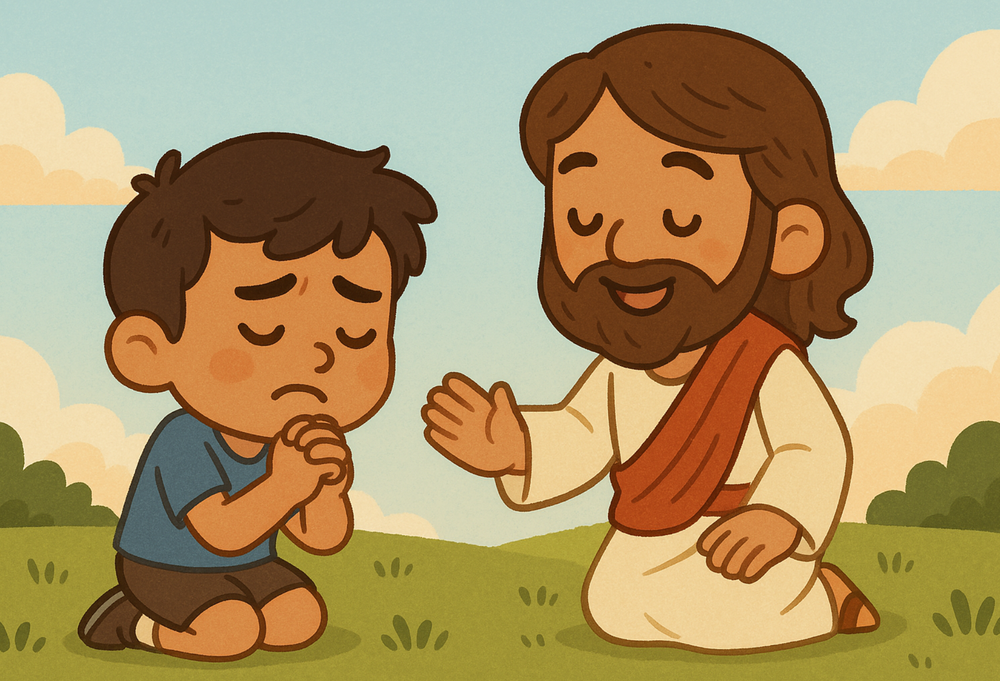
Bible Reference
Matthew 6:12-14 (CEV)
12 Forgive us for doing wrong, as we forgive others. 13 Keep us from being tempted and protect us from evil. 14 If you forgive others for the wrongs they do to you, your Father in heaven will forgive you. 15 But if you don't forgive others, your Father will not forgive your sins.

Slide 8
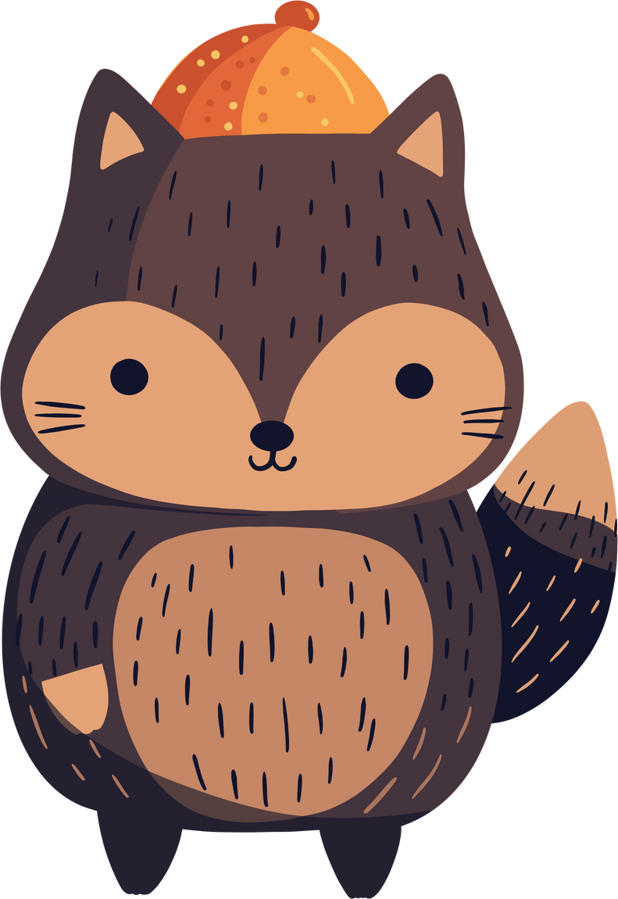
Our first point is….
We can pray for forgiveness.

Slide 9
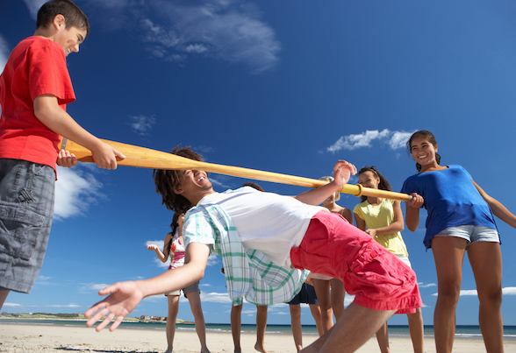
Game!
Limbo
Don’t touch the stick!
Only your feet can touch the floor.

Slide 10
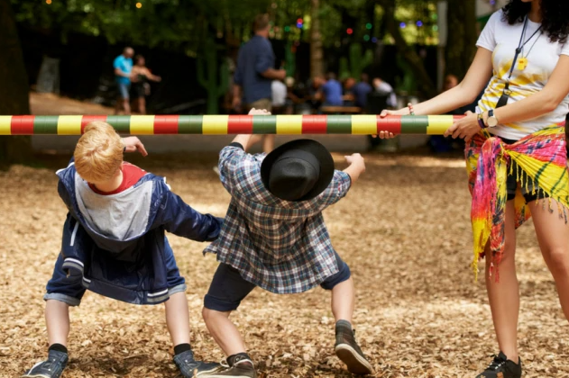
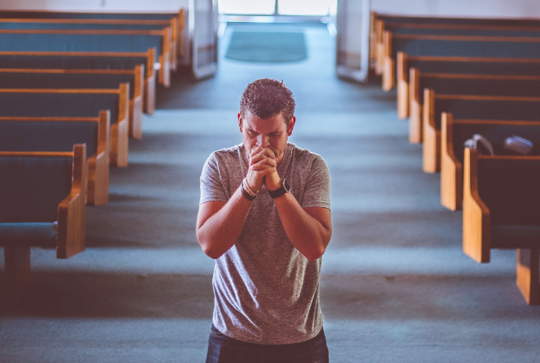
Why did we play this game?
It reminds us that we all mess up sooner or later. That's what it's like in Limbo, and that's what it's like in real life.
We all mess up, and we need to ask God for forgiveness.

Slide 11
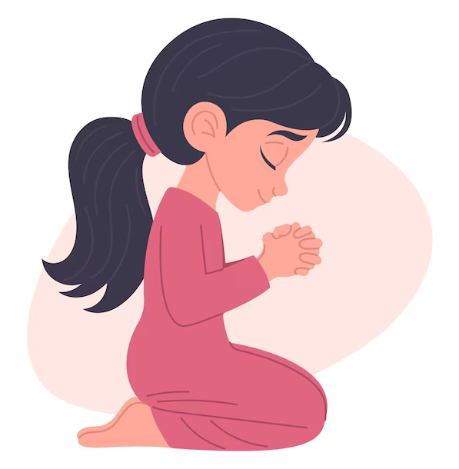
Let’s Go Back to our Passage
Matthew 6:12 (CEV)
12 Forgive us for doing wrong, as we forgive others
Matthew 6:14-15 (CEV)
14 If you forgive others for the wrongs they do to you, your Father in heaven will forgive you. 15 But if you don't forgive others, your Father will not forgive your sins.

Slide 12
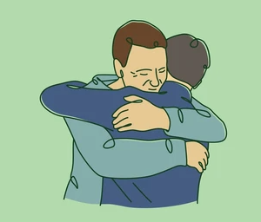
Explanation
Who here has ever prayed, and God didn’t give you what you asked for?
This prayer that Jesus taught us is special, because God always answers this prayer. If we pray for forgiveness, Jesus promises that God will forgive us, as long as we are ready to forgive others the same way.

Slide 13
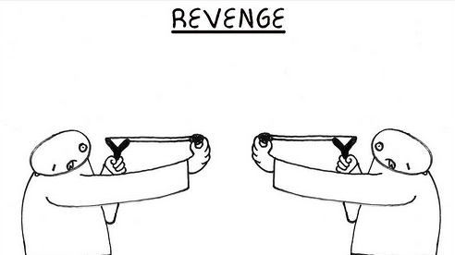
Explanation
How forgiveness works
Imagine if you got angry and said some really mean things to someone, and your words really hurt them. If they forgive you, it means they won't try to hurt you back.

Slide 14
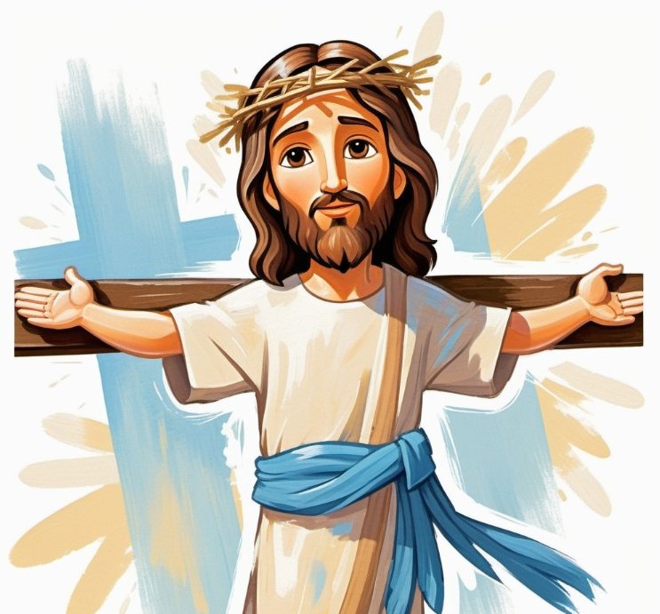
Explanation
How forgiveness works
This sounds a bit unfair, but God made things fair by sending His son Jesus. Jesus took all of our sins from us, and He died with them on the cross. He wants us to forgive everyone the same way.

Slide 15
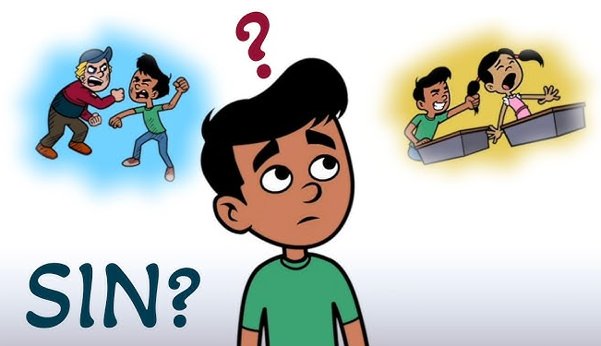
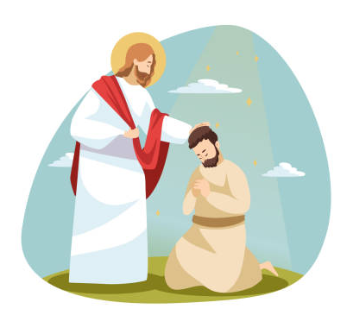
Application
We get to go free!
Whenever we do something wrong, and we think we should be punished for it, we remember Jesus was punished for us.
All the bad things that happened to us happened to Jesus, and we get to go free.

Slide 16
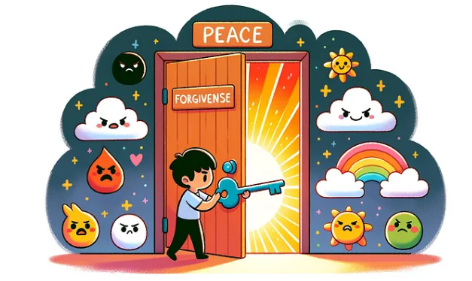
Application
They get to go free!
Whenever someone else does something wrong, and they should get punished for it, we remember, Jesus was punished for THEM! All the bad things that should happen to other people, they happened to Jesus, and now someone else gets to go free. That’s forgiveness.

Slide 17
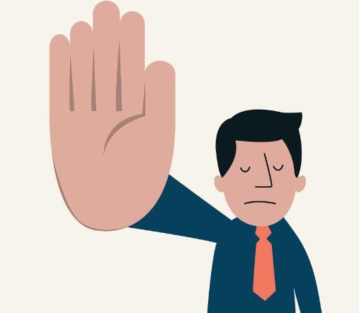

Application
Set Boundaries
If someone hurts us, we shouldn’t just let them keep hurting us. If they hurt us in the past, we forgive them, but we should stop them from hurting us again next time.
REMINDERS

Slide 18
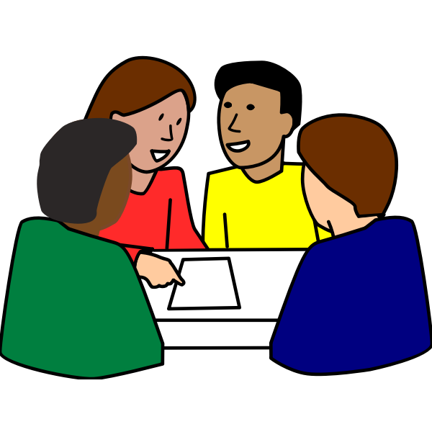
Discussion Questions
In your groups…
What is something you need forgiveness for?
What is something that you could forgive someone else for?

Slide 19
Our second point is….
We can pray against evil.

Slide 20
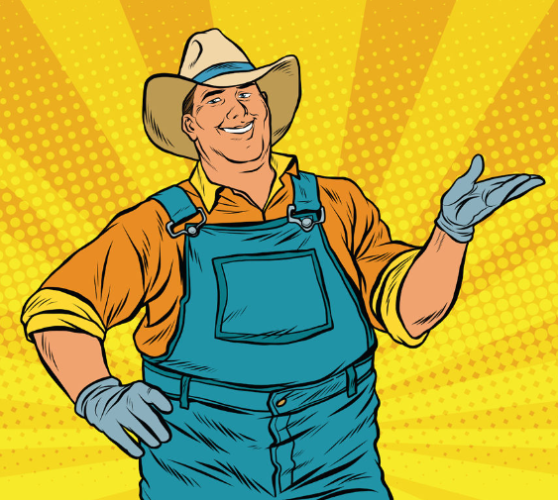
Game!
Pin the Hat on the Farmer
Get your hat to the closest place where you have to go!

Slide 21

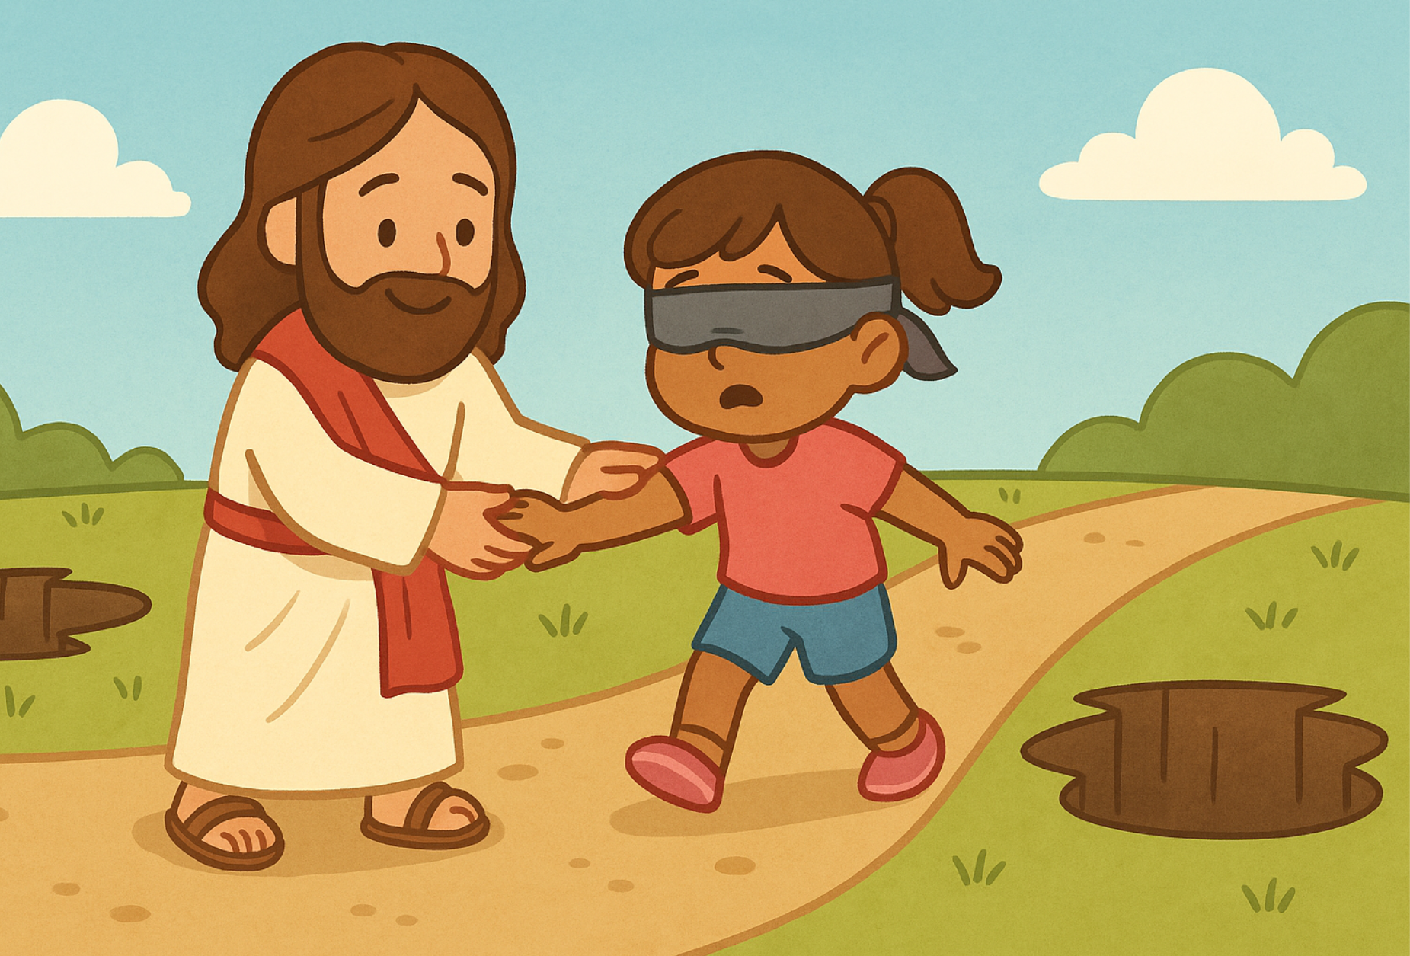
Why did we play this game?
It's really hard to know where to go sometimes. However, you have someone guiding you away from all the wrong places. That's how it's like with us and God. In our friendship with God, we are like the blindfolded person. We really need God to lead us away from all the wrong places, and we need God to take us to the right places.

Slide 22
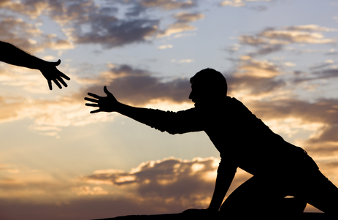
Bible Reference
Matthew 6:13 (CEV)
13 And lead us not into temptation,
but deliver us from the evil one.’

Slide 23
Explanation
Lead us away from sin
It's a prayer that says to God, we want to stay out of sin and we want to stay away from Satan.
That's what the big words mean in this verse. In the Bible, “the evil one” is just another name for Satan. Satan has plans to mess up the great things that God is doing.

Slide 24
Explanation
Lead us away from sin
God has a great plan for you. God wants you to make great friendships and help people, and God wants you to show your friends how to enter His family and live forever.
One of Satan's most important tools is called temptation. Temptation is that feeling you get when you want to do the wrong thing. You know it's wrong, but you want it so much. That's how Satan gets us into trouble.

Slide 25
Application
Prayer
We ask God to lead us away from temptation and to save us from Satan. This is a prayer that God always answers.
If we really want to honor Him, work for His kingdom, and win the fight against evil, God will always give us a way.
God will help us to get out of Satan’s traps, and He will do amazing things with us.

Slide 26
Discussion Questions
In your groups…
Take a guess: what might be God’s plan for you?
How might Satan be working against that plan?

Slide 27

Conclusion
what can we do about all the messed up things around us?
We can pray for forgiveness
We can pray for help against evil.

Slide 28
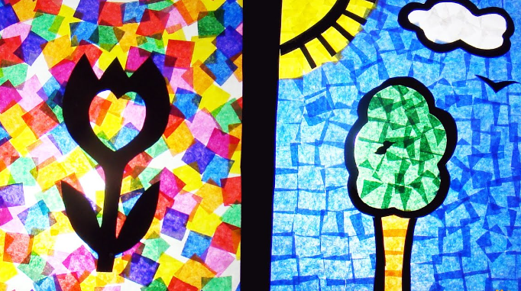
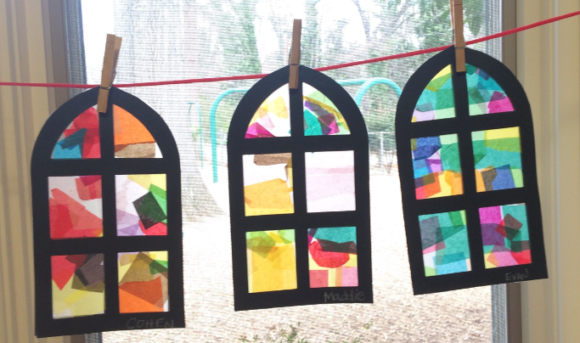
Activity
Stained Glass Windows

