Slide 1



Welcome

Slide 2

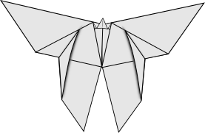

Introduction Activity:
  We'll start this lesson with some origami! Today we will be folding paper into butterflies!
  So we’ll watch a short video first, and then after the video we’ll try to make it step by step.

Slide 3

What Can We Learn?
  We started with this craft because it reminds us, there are some things we would never figure out by ourselves, unless someone gave us the instructions.
  We can make some really neat stuff if we follow the rules that someone else made.
  The problem is, a lot of people out there want to tell us what to do. There are so many people who want to tell us what to do that we can’t listen to everyone.

Slide 4


Question
Our big question is: whose rules should we follow?

Slide 5



Big Idea:
WE’LL SEE FROM OUR BIBLE STORY THAT:
We should follow God’s rules first, and
We should follow our parents’ rules

Slide 6

Bible Reference
Jesus in the Temple:
Luke 2

Slide 7

Point 1
WE SHOULD FOLLOW GOD’S RULES

Slide 8

Activity: Deal or No Deal
In this game, we have a whole bunch of suitcases, and each case has a different amount of money in it. We play the game by eliminating some suitcases, and every time we eliminate some suitcases, the bank will call and offer us money instead of a suitcase.
The goal is to walk away with an amount of money that you'd be really happy to have. We probably can't expect to end up with a million dollars, but hopefully, you won't end up with too little.

Slide 9
What Can We Learn?
We played this game because it reminds us that there are some things that we can't know. We can't know what's in each suitcase, we can only take a guess. But God knows what is in each suitcase, and He knows everything. If He tells us to do something, it's good to follow His rules, because He knows more than us and He loves us, so we can trust Him.

Slide 10
Bible Reference
41 Every year Jesus' parents went to Jerusalem for Passover. 42 And when Jesus was twelve years old, they all went there as usual for the celebration. 43 After Passover his parents left, but they did not know that Jesus had stayed on in the city. 44 They thought he was travelling with some other people, and they went a whole day before they started looking for him. 45 When they could not find him with their relatives and friends, they went back to Jerusalem and started looking for him there.
46 Three days later they found Jesus sitting in the temple, listening to the teachers and asking them questions. 47 Everyone who heard him was surprised at how much he knew and at the answers he gave.
48 When his parents found him, they were amazed. His mother said, “Son, why have you done this to us? Your father and I have been very worried, and we have been searching for you!”
49 Jesus answered, “Why did you have to look for me? Didn't you know that I would be in my Father's house?” 50 But they did not understand what he meant.
Luke 2:41-52 (CEV)

Slide 11

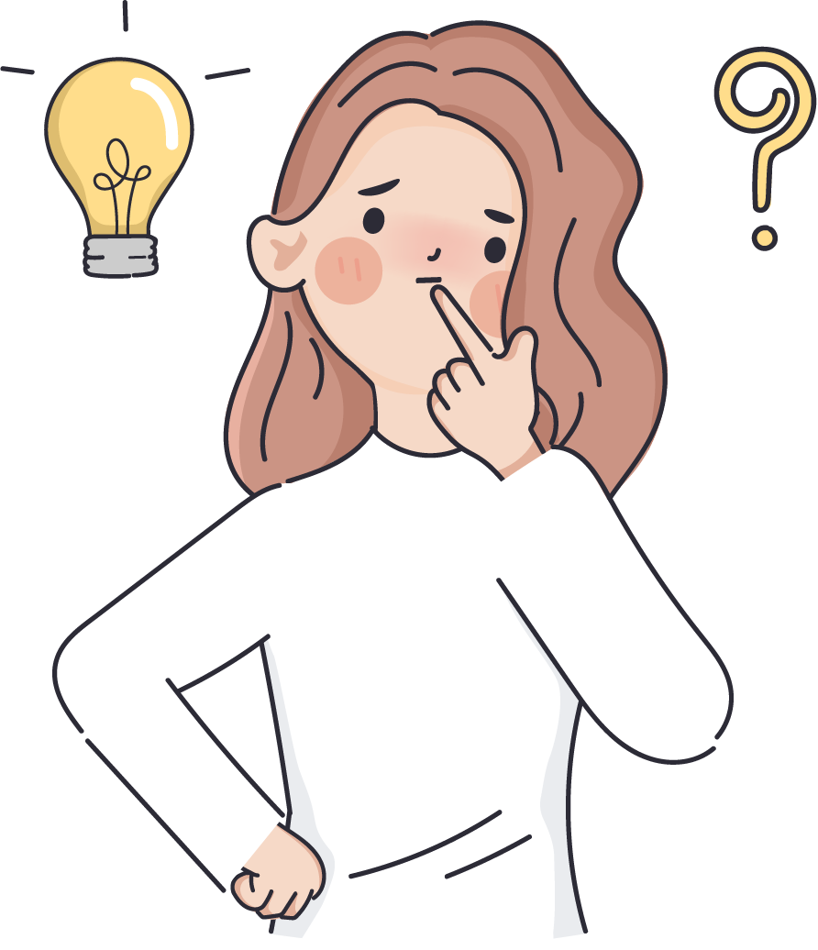


Slide 12
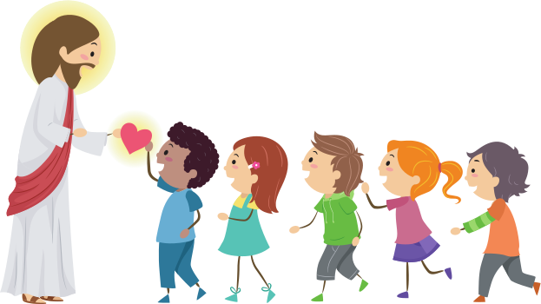
Application
Maybe you're more like Jesus than you might realize. If you're a Christian, you are God's son or daughter. That is the most important thing about you. God has also given you important work to do. He wants you to learn about Him and to help people know Him better. Even when you're young, you can do this work, and there's nothing more important to do than God’s work.

Slide 13

Discussion Questions
QUESTION 1:
QUESTION 2:
What is a question about God that you'd like an answer to?
What is something about God that you would love to teach to other people?

Slide 14
Point 2
After we finish following God’s rules, we should follow our parents’ rules.

Slide 15
Marshmallow Toothpick Tower
  We'll be making towers out of marshmallows and toothpicks. Some of you have done this before, but you can always get better, and you can always build higher.
  Your goal in this game is to build the highest tower you can in 10 minutes. (or 15 minutes)

Slide 16
What Can We Learn?
  We played this game because it's really hard. If we're going to do well, we need advice, and we need other people to show us the way.
  Now, you can get advice from a lot of people, but the best advice comes from people who know a lot of things, and who care about you a lot.
  That's why God has given us parents and guardians. Our parents and guardians are older than us, and they have seen a lot and they care about us a lot. So, it makes sense to listen to them. That's what Jesus did.

Slide 17

Bible Reference
51 Jesus went back to Nazareth with his parents and obeyed them. His mother kept on thinking about all that had happened.
52 Jesus became wise, and He grew strong. God was pleased with Him and so were the people.
Luke 2:51-52 (CEV)

Slide 18


Explanation
These verses tell us that Jesus obeyed His parents, and He became wise. In the original language, it says Jesus grew in wisdom. He still had things to learn.
He still had room to grow. And, his parents had things to teach him, and his parents could help him to grow.

Slide 19

Application
When we see that Jesus obeyed his parents, that's a clue to us that it's normally a good idea to obey our parents. This is because they are helping us to grow, and they have a lot of things to teach us.
The more we grow, the better we will be at doing God's work and making a difference

Slide 20

Discussion Questions
QUESTION 1:
What is something you'd like to learn from your parents?

Slide 21



Conclusion
WHOSE RULE SHOULD WE FOLLOW?
Follow God’s Rules
After we finish following God’s rules, we should follow our parents’ rules

Slide 22


