Slide 1
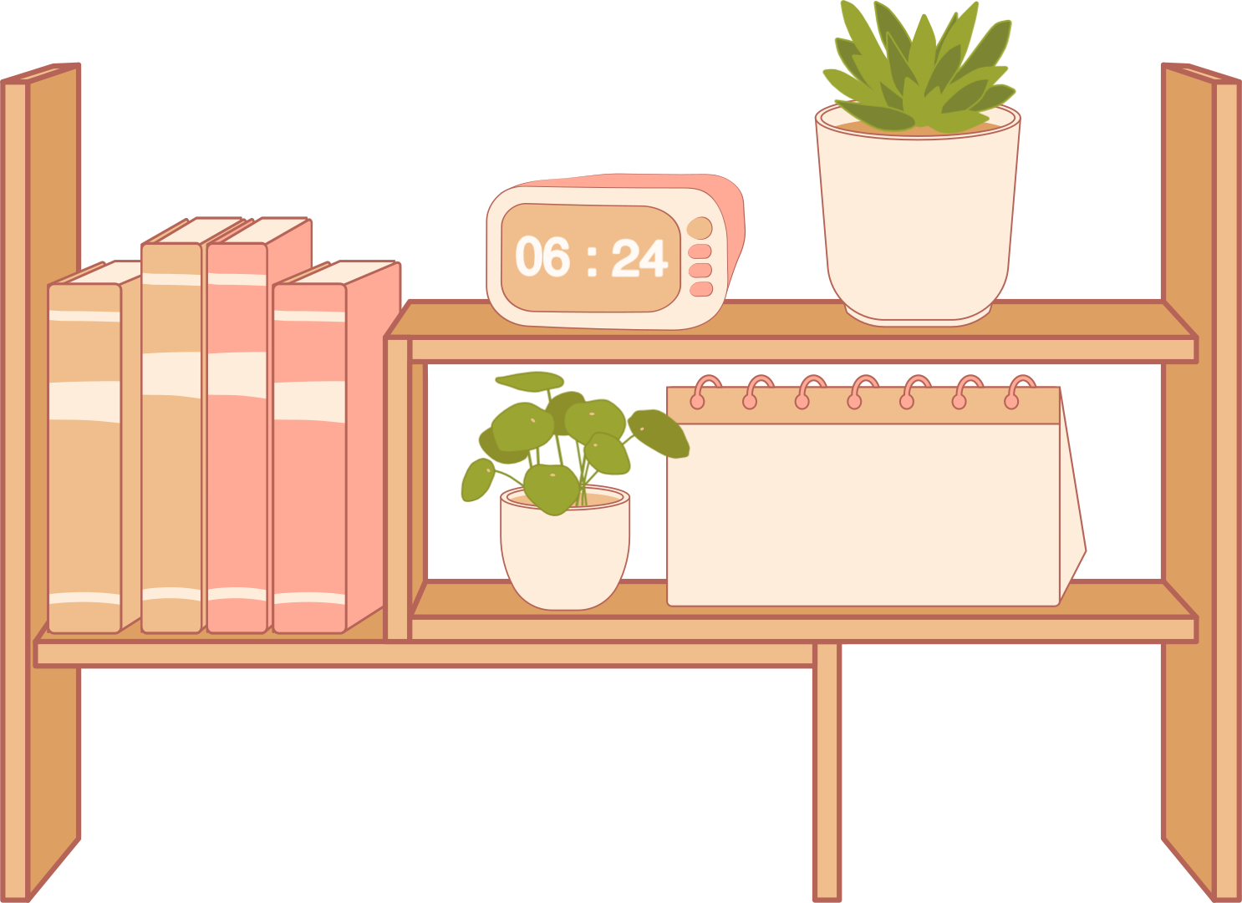
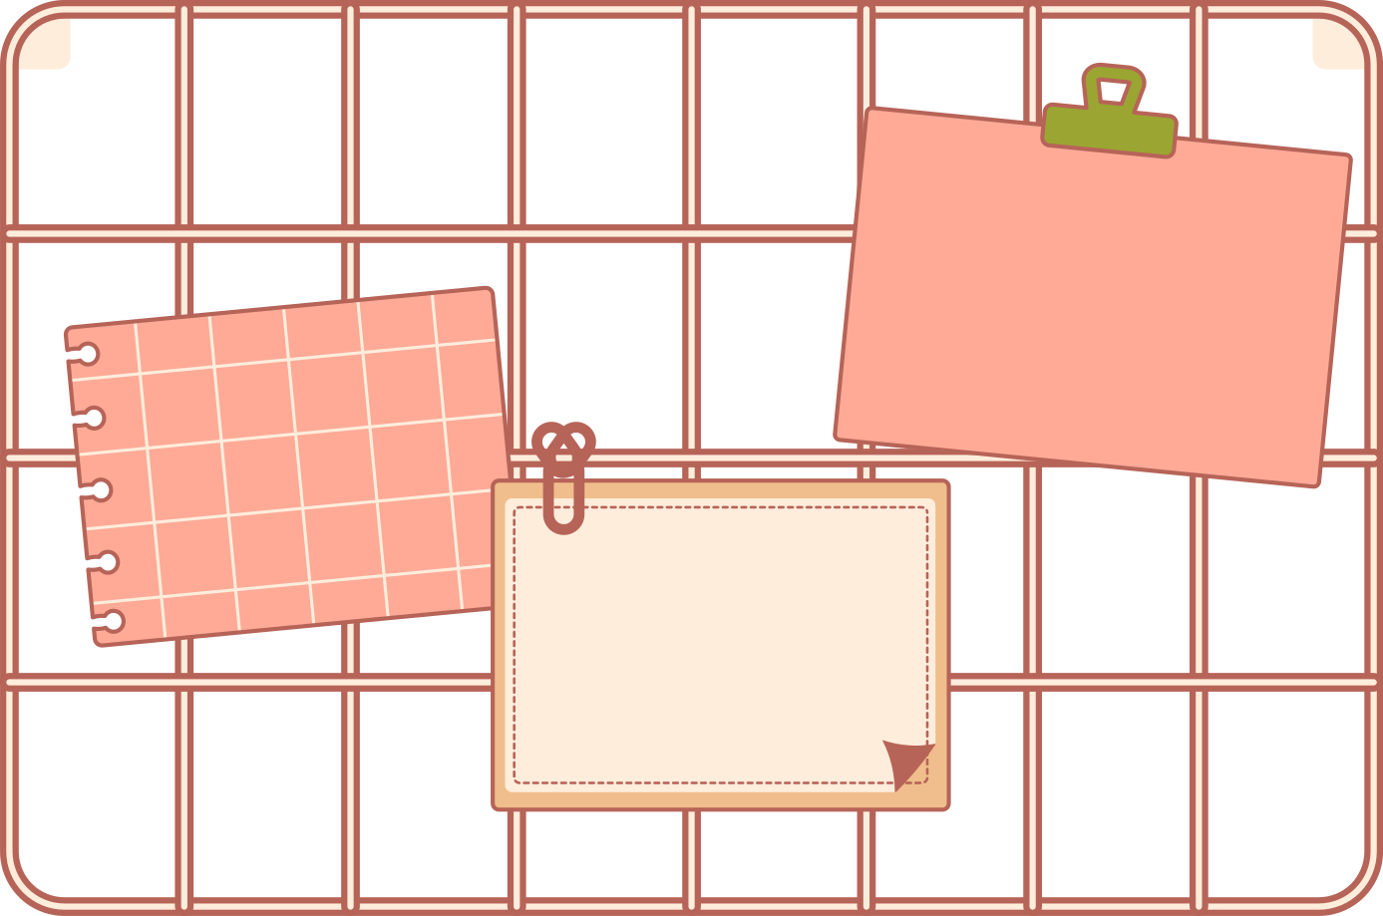
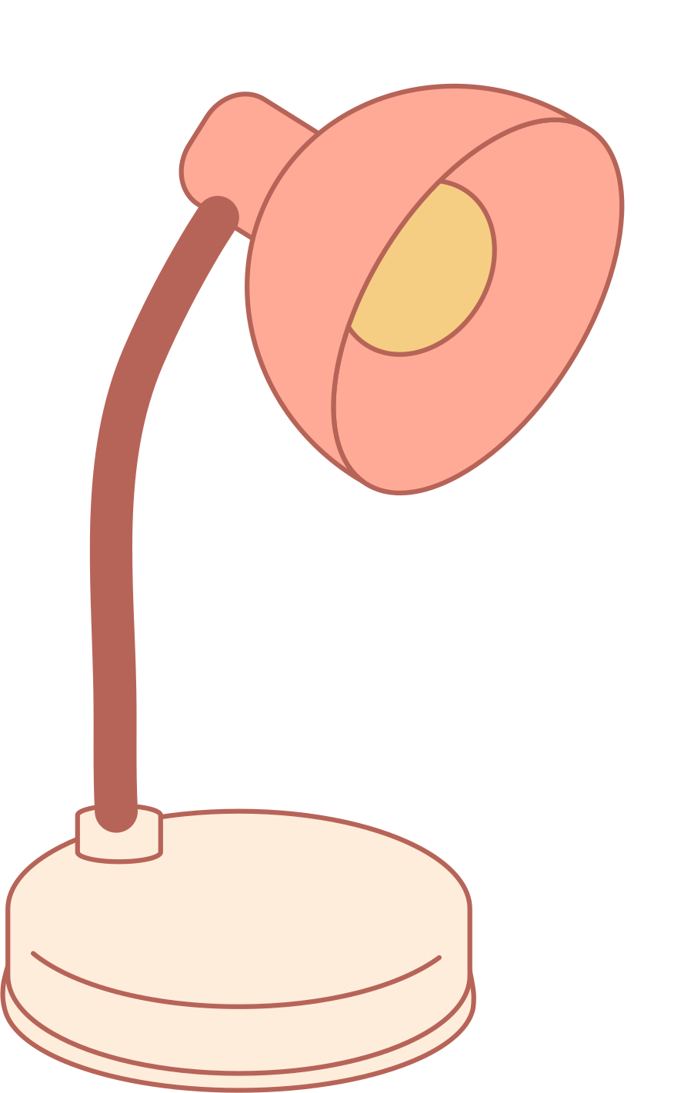
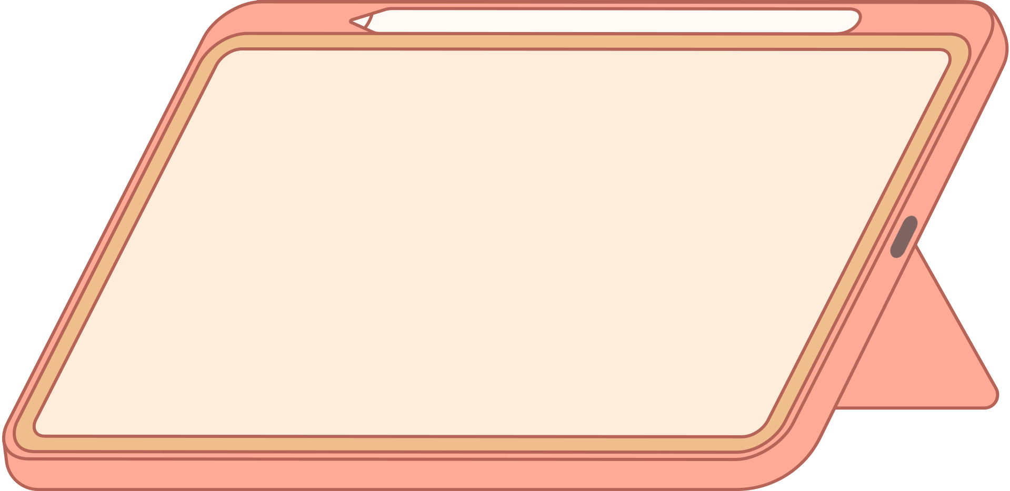
Why We
Go to School

Slide 2
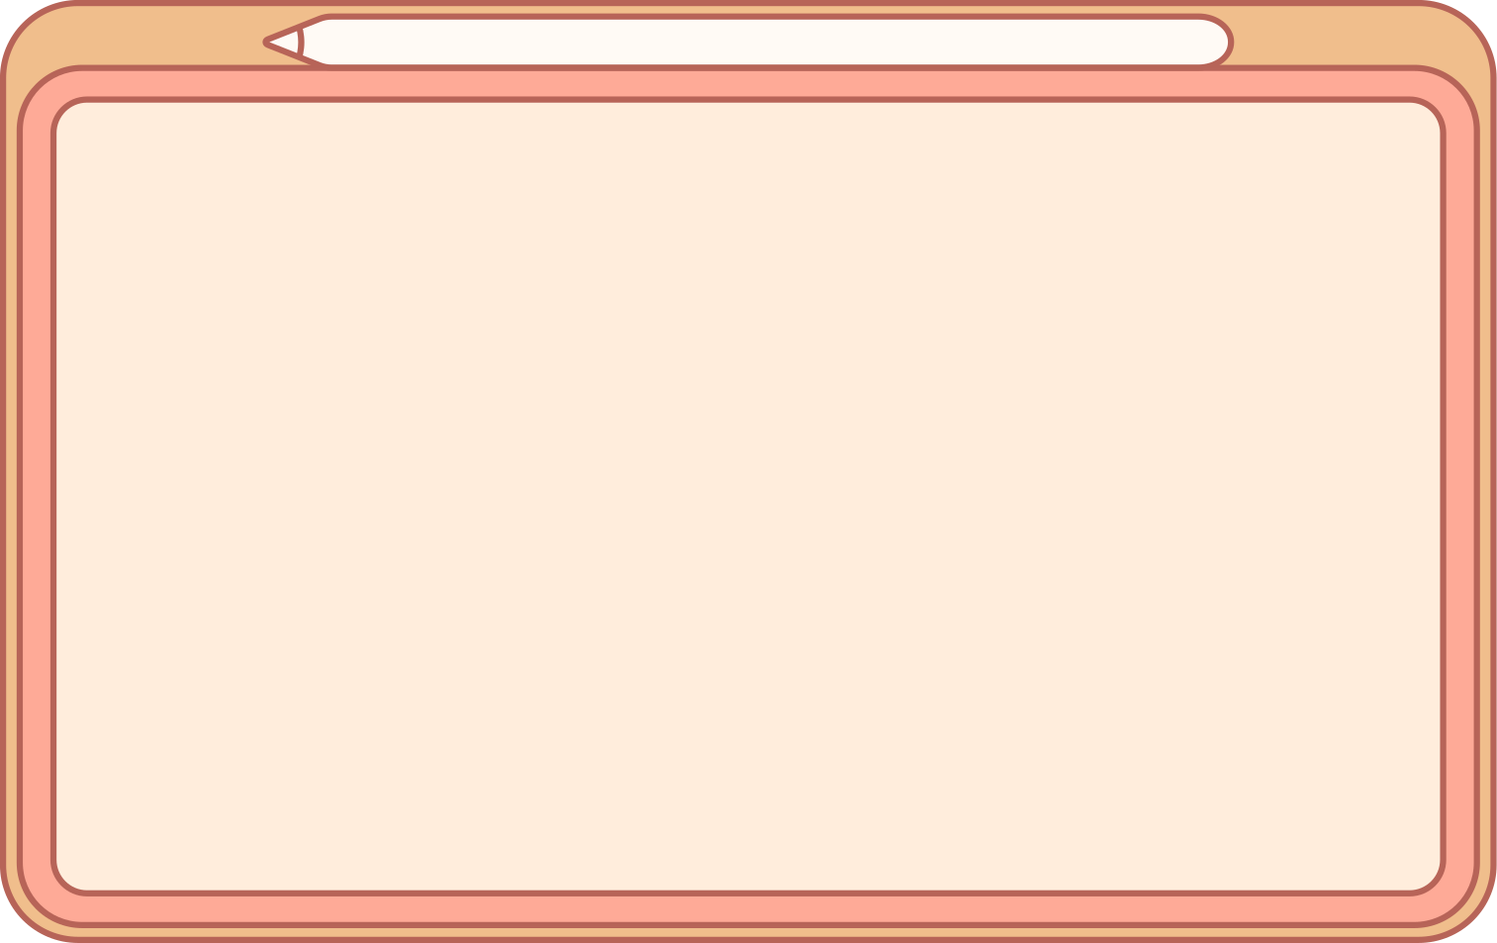

Game : Traffic Yam
Step 1
It's a relay race, so we will have two teams. Everyone on your team will take a turn moving a marshmallow across the floor of the room with just your nose!
Step 2
When it's your turn, you'll start touching the wall, and then you'll roll the marshmallow to the other side of the room. Touch the far wall and come back the same way. Then the next person goes.

Slide 3
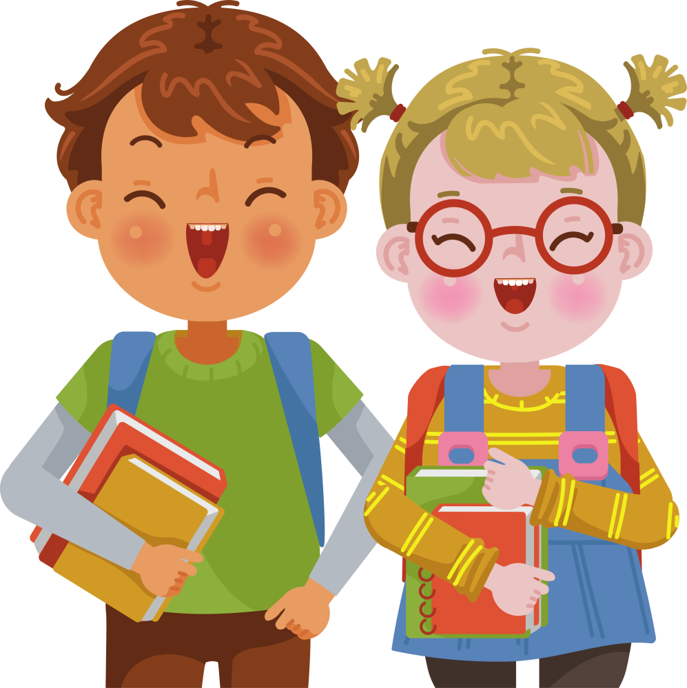
For the next few weeks, we’re going to be talking about being an awesome student.

Slide 4

Big Question
Why do we go to school?

Slide 5
Why do we go to school?
God uses our school to give us
WISDOM
wisdom
It's much better to be wise and sensible than to be rich.
Proverbs 16:16
bible verse
2 kinds of wisdom
We can get wisdom with things and we can get wisdom with people.

Slide 6

Bible reference
3 By wisdom a house is built,
and through understanding it is established;
4 through knowledge its rooms are filled with rare and beautiful treasures. The wise prevail through great power, and those who have knowledge muster their strength. 6 Surely you need guidance to wage war, and victory is won through many advisers.
Proverbs 24:3-6

Slide 7


Point 1
Game: Pictionary
We can get our wisdom with things

Slide 8
Why did we play this game?
It uses our knowledge of THINGS. We need to be able to figure out what things are. When we are drawing, we need to know how to draw. If we are good at working with things, we can have a lot of fun, and we can help our team.
The Bible teaches us there's a kind of wisdom that helps us to be good at things.

Slide 9
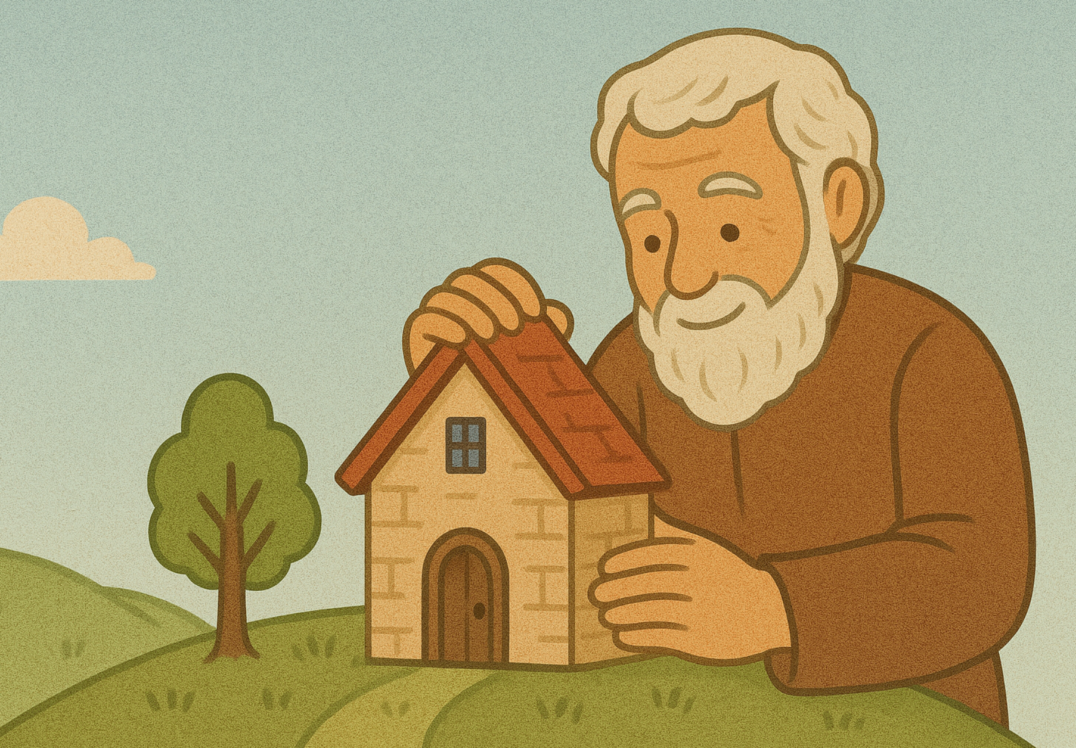
Bible reference
3 By wisdom a house is built,
and through understanding it is established;
4 through knowledge its rooms are filled with rare and beautiful treasures. The wise prevail through great power, and those who have knowledge muster their strength. 6 Surely you need guidance to wage war, and victory is won through many advisers.
Proverbs 24:3-6

Slide 10


We need skills for:

Slide 11
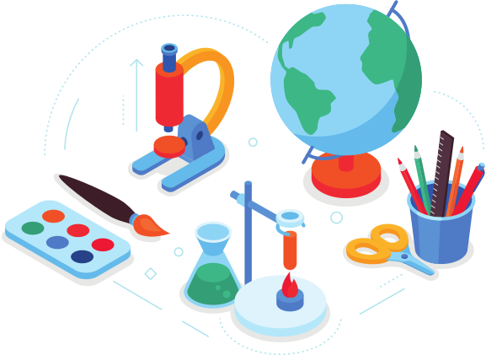
Discussion Question
What is your favourite subject at school? (Is there a reason why?)

Slide 12

Point 2
Game: Biathlon
We can get our wisdom with people

Slide 13

Why did we play this game?
It's about doing TWO things. You need to be fast on your feet AND be good at hitting your target.
With school, there are two things to work on, if you want to be the best student you can be. We want to become wise with THINGS, but we also want to be wise with PEOPLE.

Slide 14

Bible Reference
Surely you need guidance to wage war, and victory is won through many advisers.
Proverbs 24:6

Slide 15
Application
One of the greatest things about school is that we get to see a lot of people. We can learn how to be good friends. We can learn how to work with others. We can learn how to listen, how to help people, and how to communicate our ideas. We can also learn how to win against other people. Sometimes we need to know how to win against other people if we are fighting for what is right.
A lot of these skills won't get you good marks at school. But, if you get these skills and this wisdom, you'll have better friendships, and you'll be able to help a lot of people.

Slide 16
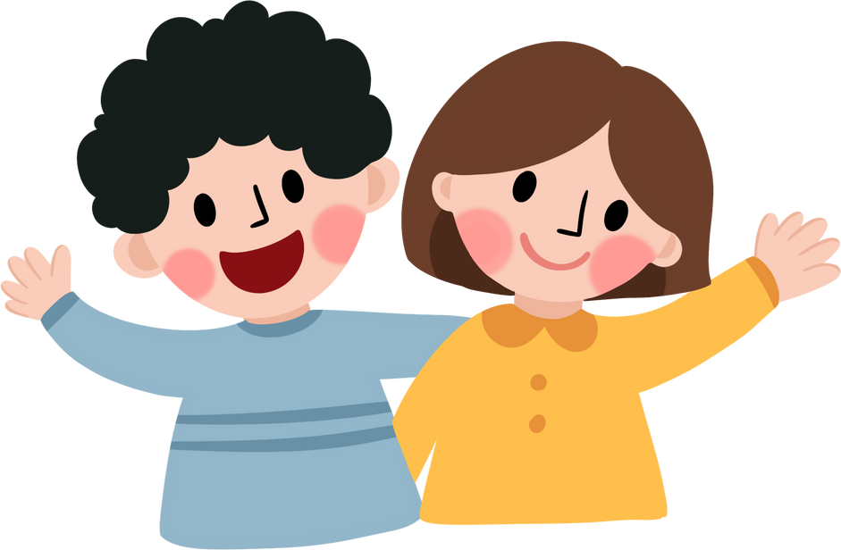
Discussion Question
Do you have any tips on how to be a good friend?

Slide 17

Conclusion
Why do we go to school?
God uses our school to give us WISDOM.
First, we should get wisdom with THINGS. We can learn skills with our hands, and we can get knowledge that will help us to do all kinds of useful stuff.
Second, we should get wisdom with PEOPLE. We can learn to make friends, communicate, get help, help others, and even fight for what is right. All of this takes practice, but it's worth the effort.

Slide 18

Ending Craft: Musical Instruments

