Slide 1


Slide 2


Slide 3
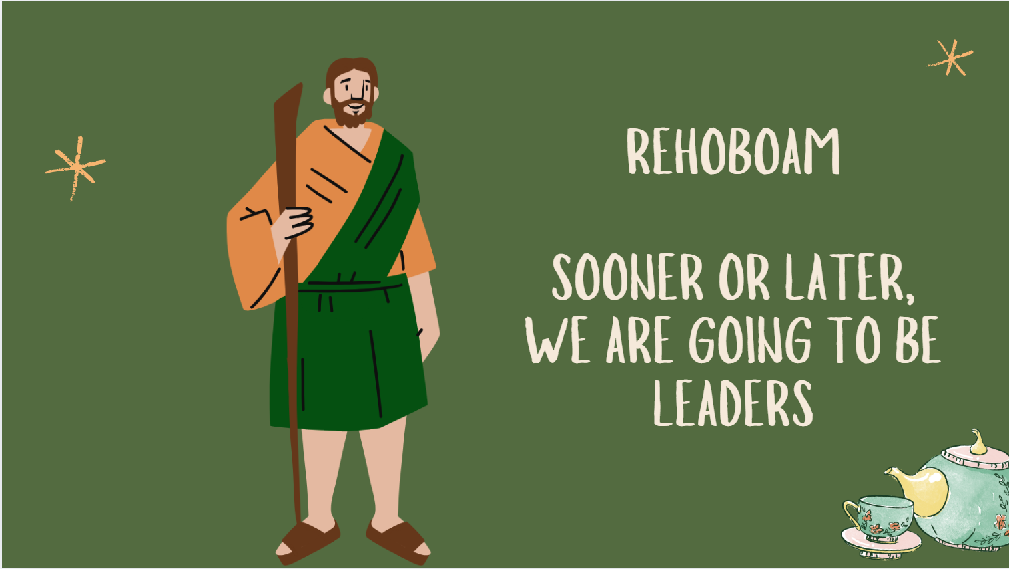

Slide 4
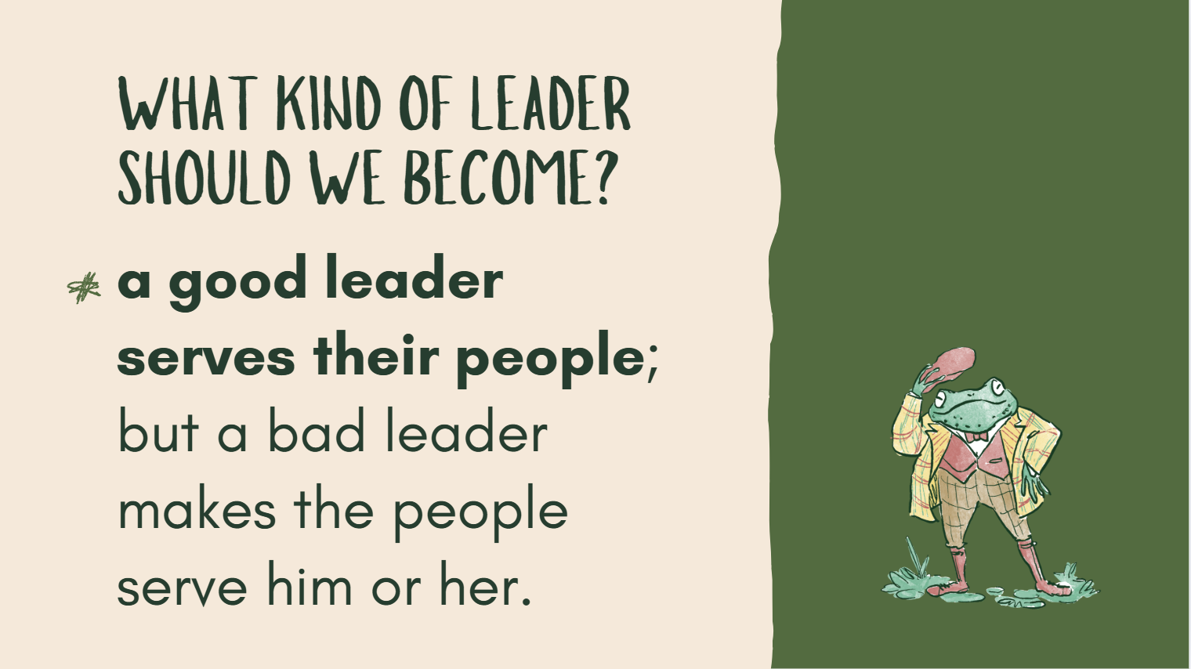

Slide 5


Slide 6


Slide 7
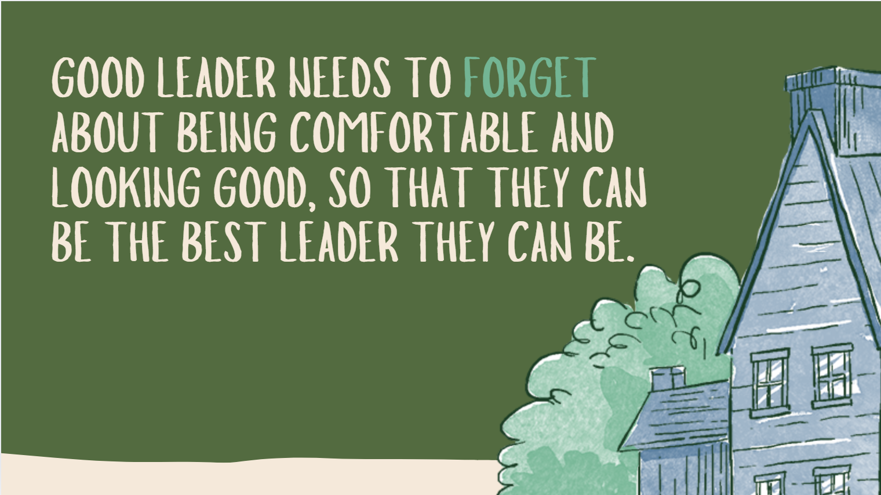

Slide 8

1 Kings 12:5-7 (CEV)
“Your father Solomon forced us to work very hard. But if you make our work easier, we will serve you and do whatever you ask.”

Slide 9

1 Kings 12:5-7 (CEV)
5 “Give me three days to think about it,” Rehoboam replied, “then come back for my answer.” So the people left.

Slide 10
1 Kings 12:5-7 (CEV)
6 Rehoboam went to some leaders who had been his father's senior officials, and he asked them, “What should I tell these people?”

Slide 11
1 Kings 12:5-7 (CEV)
7 They answered, “If you want them to serve and obey you, then you should do what they ask today. Tell them you will make their work easier.”

Slide 12


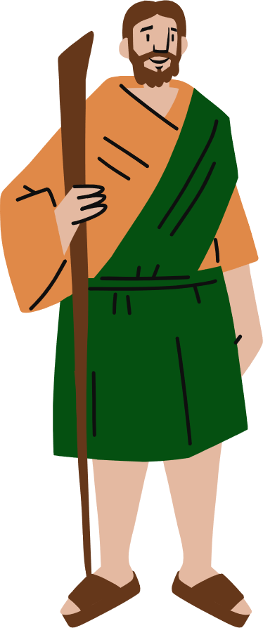

Slide 13

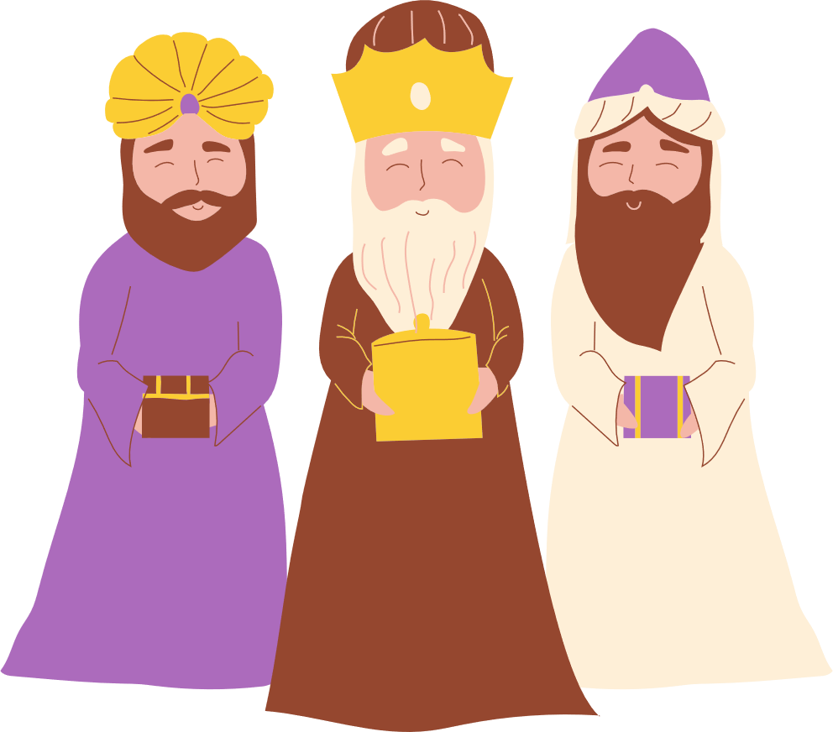

Slide 14
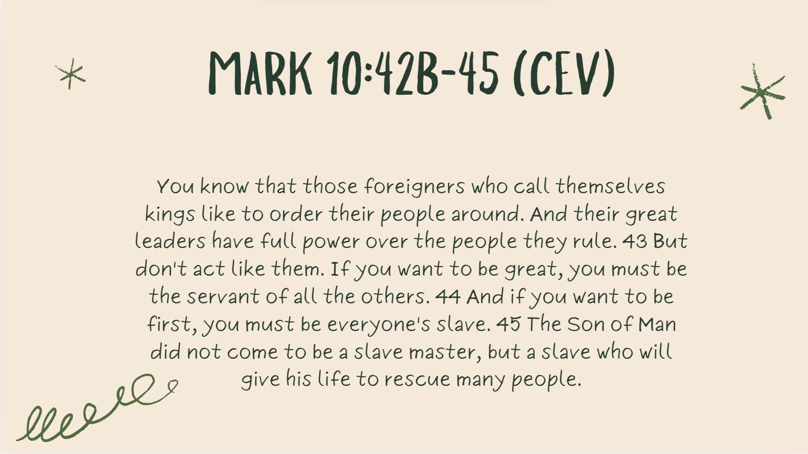

Slide 15


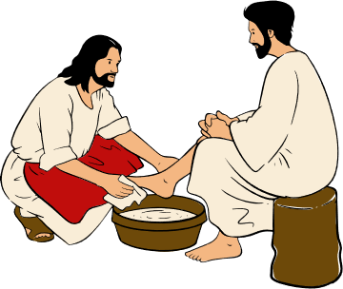
There's the kind of leader that bosses everyone around and makes themselves great,
there's the kind of leader that serves everyone. The leader who serves everyone is the most like Jesus.

Slide 16
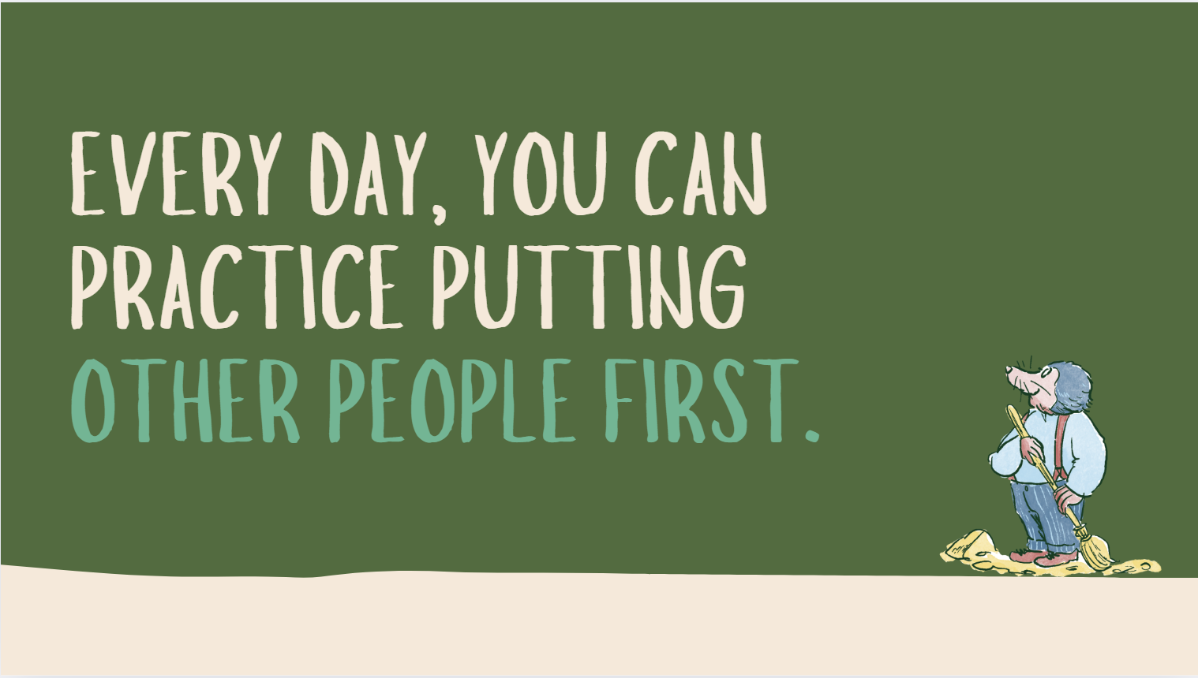

Slide 17
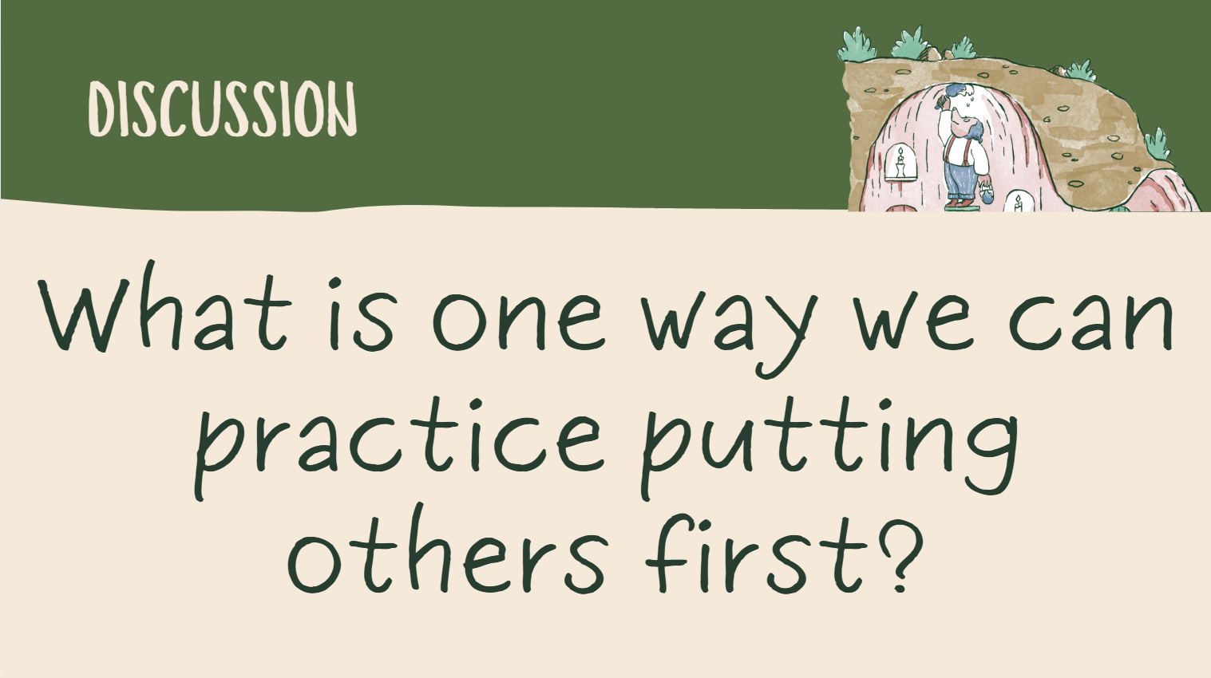

Slide 18








FACE THE

Slide 19
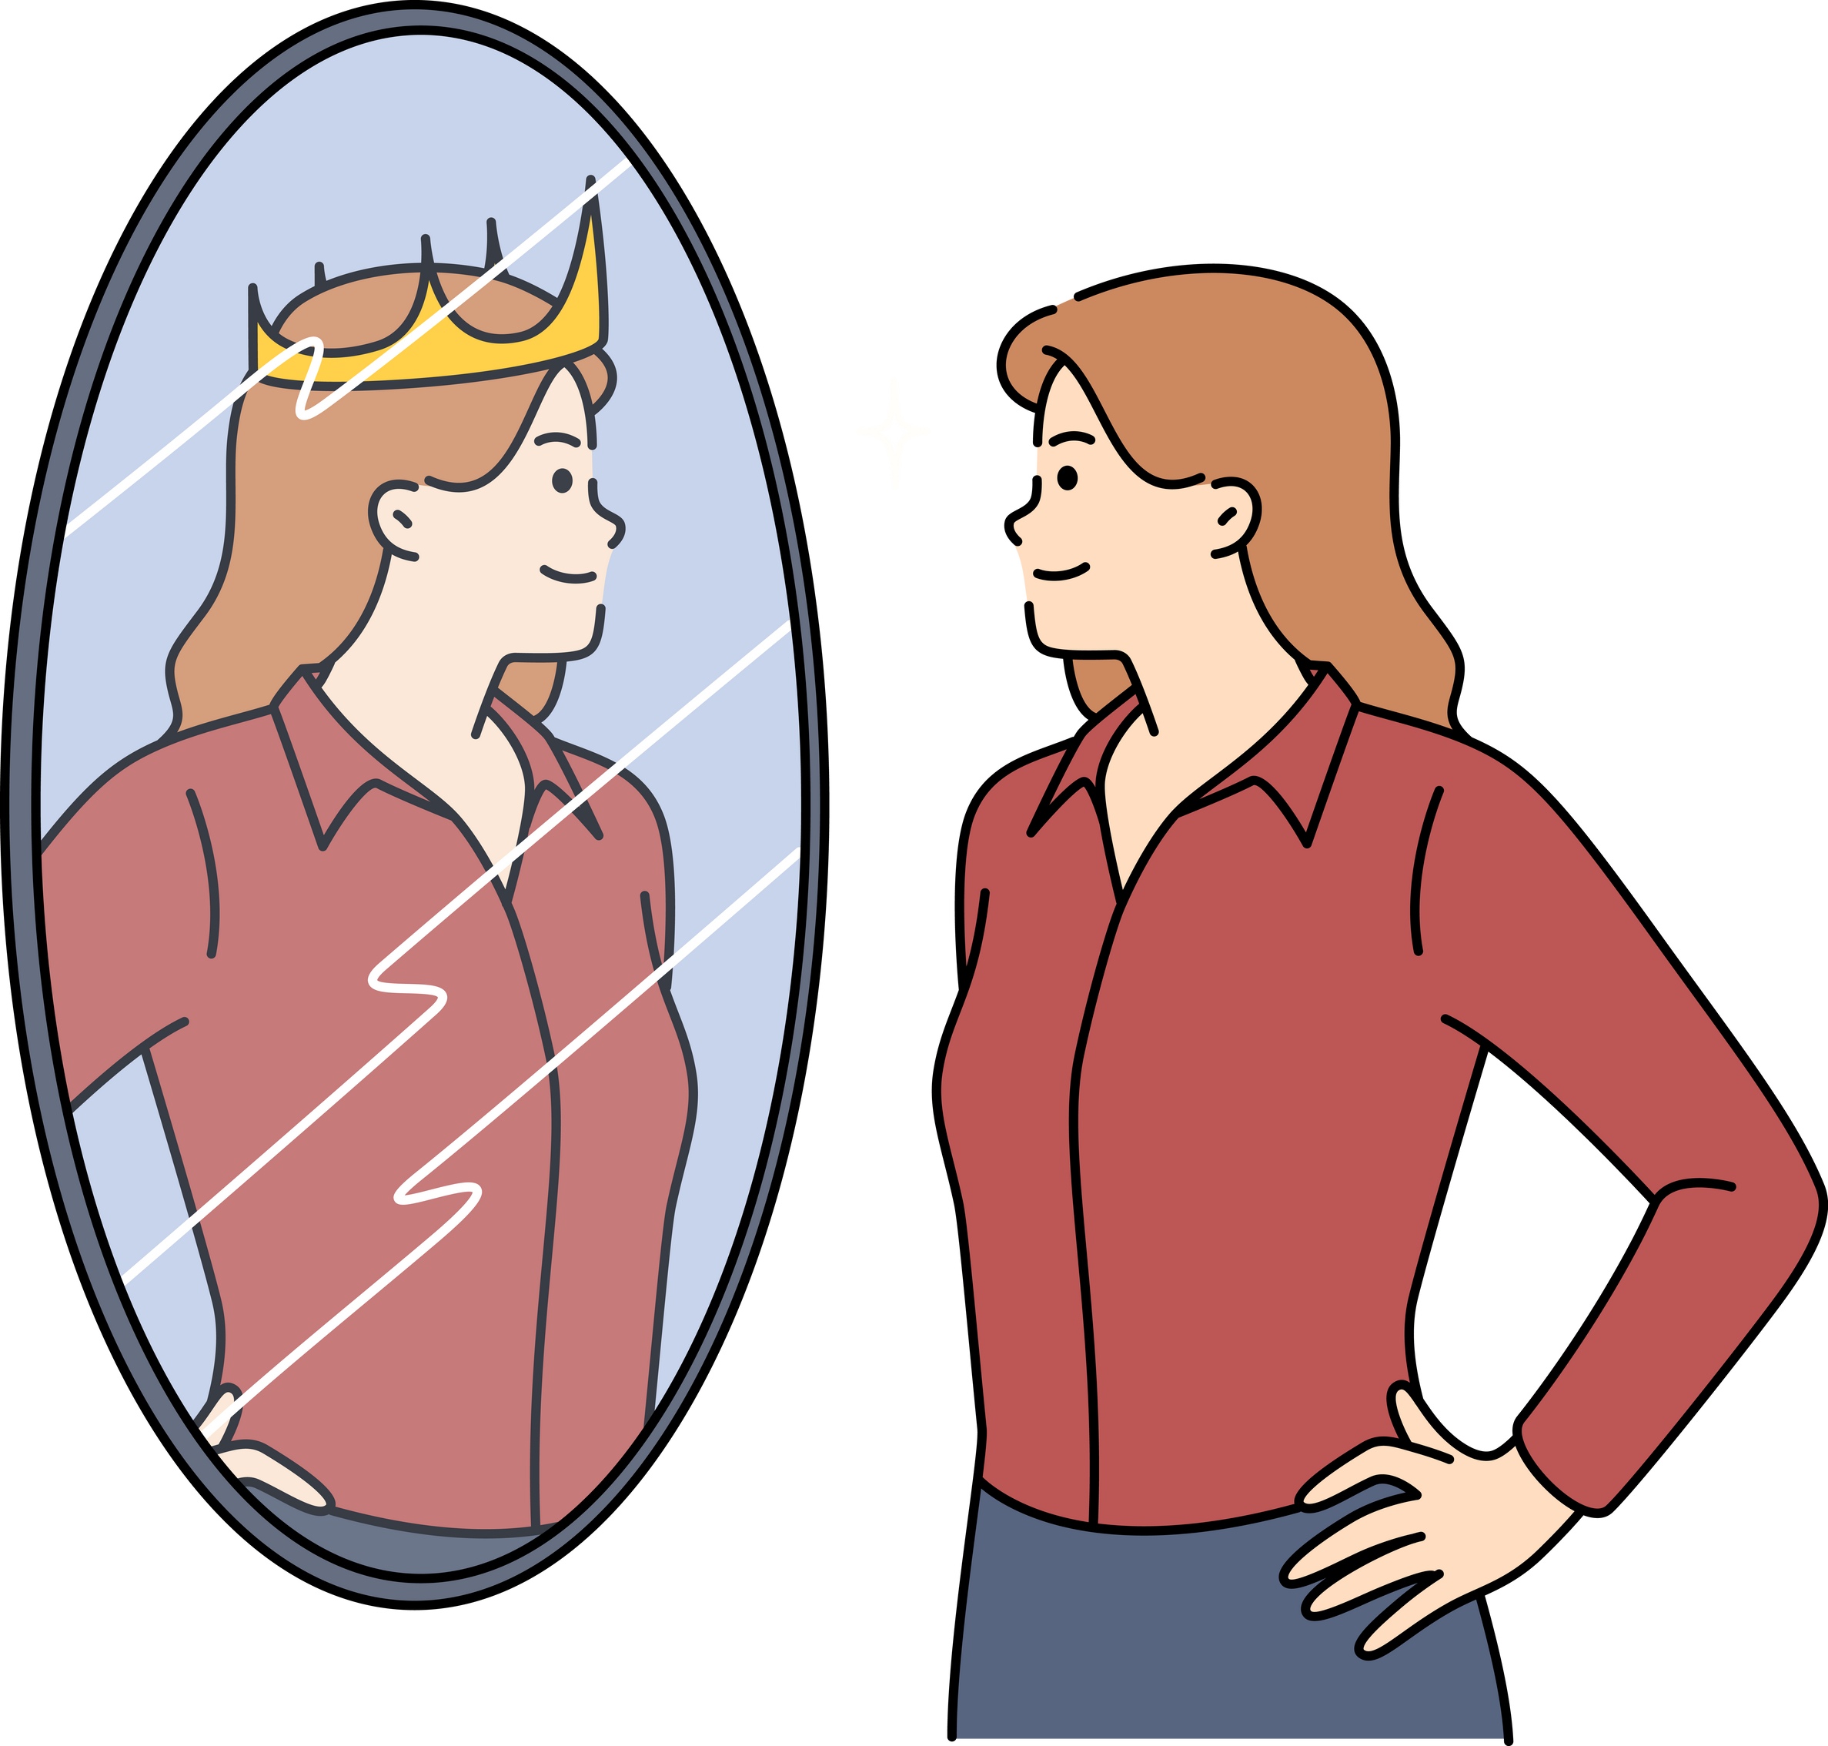
But, if you want to be a leader, you'll get into big trouble if you just think about yourself.

Slide 21

8 But Rehoboam refused their advice and went to the younger men who had grown up with him and were now his officials.
1 Kings 12:8-11

Slide 22

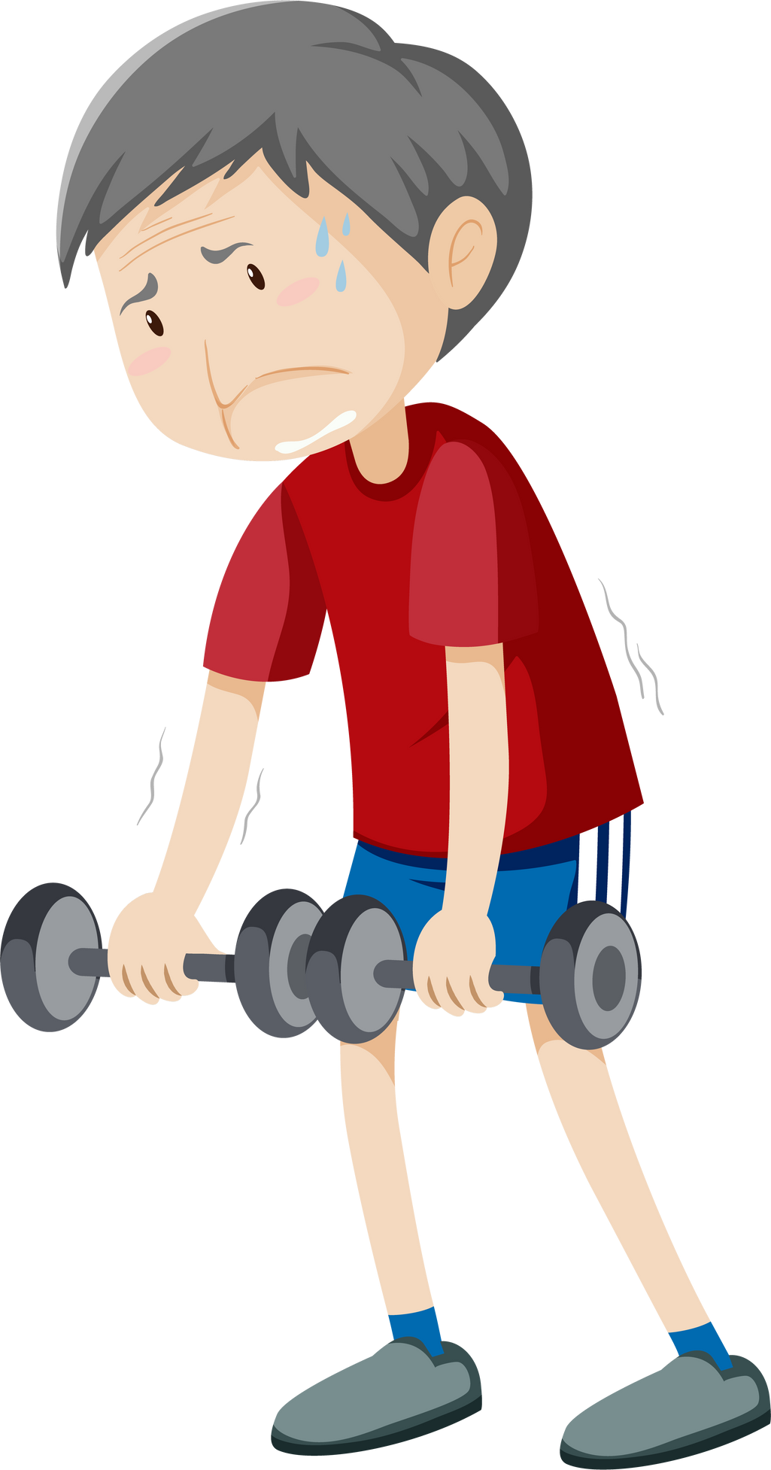
1 Kings 12:8-11
9 He asked, “What do you think I should say to these people who asked me to make their work easier?” 10 His younger advisors said: Here's what we think you should say to them: “Compared to me, my father was weak.

Slide 23
1 Kings 12:8-11
11 He made you work hard, but I'll make you work even harder. He punished you with whips, but I'll use whips with pieces of sharp metal!”

Slide 24


Slide 25






Slide 26

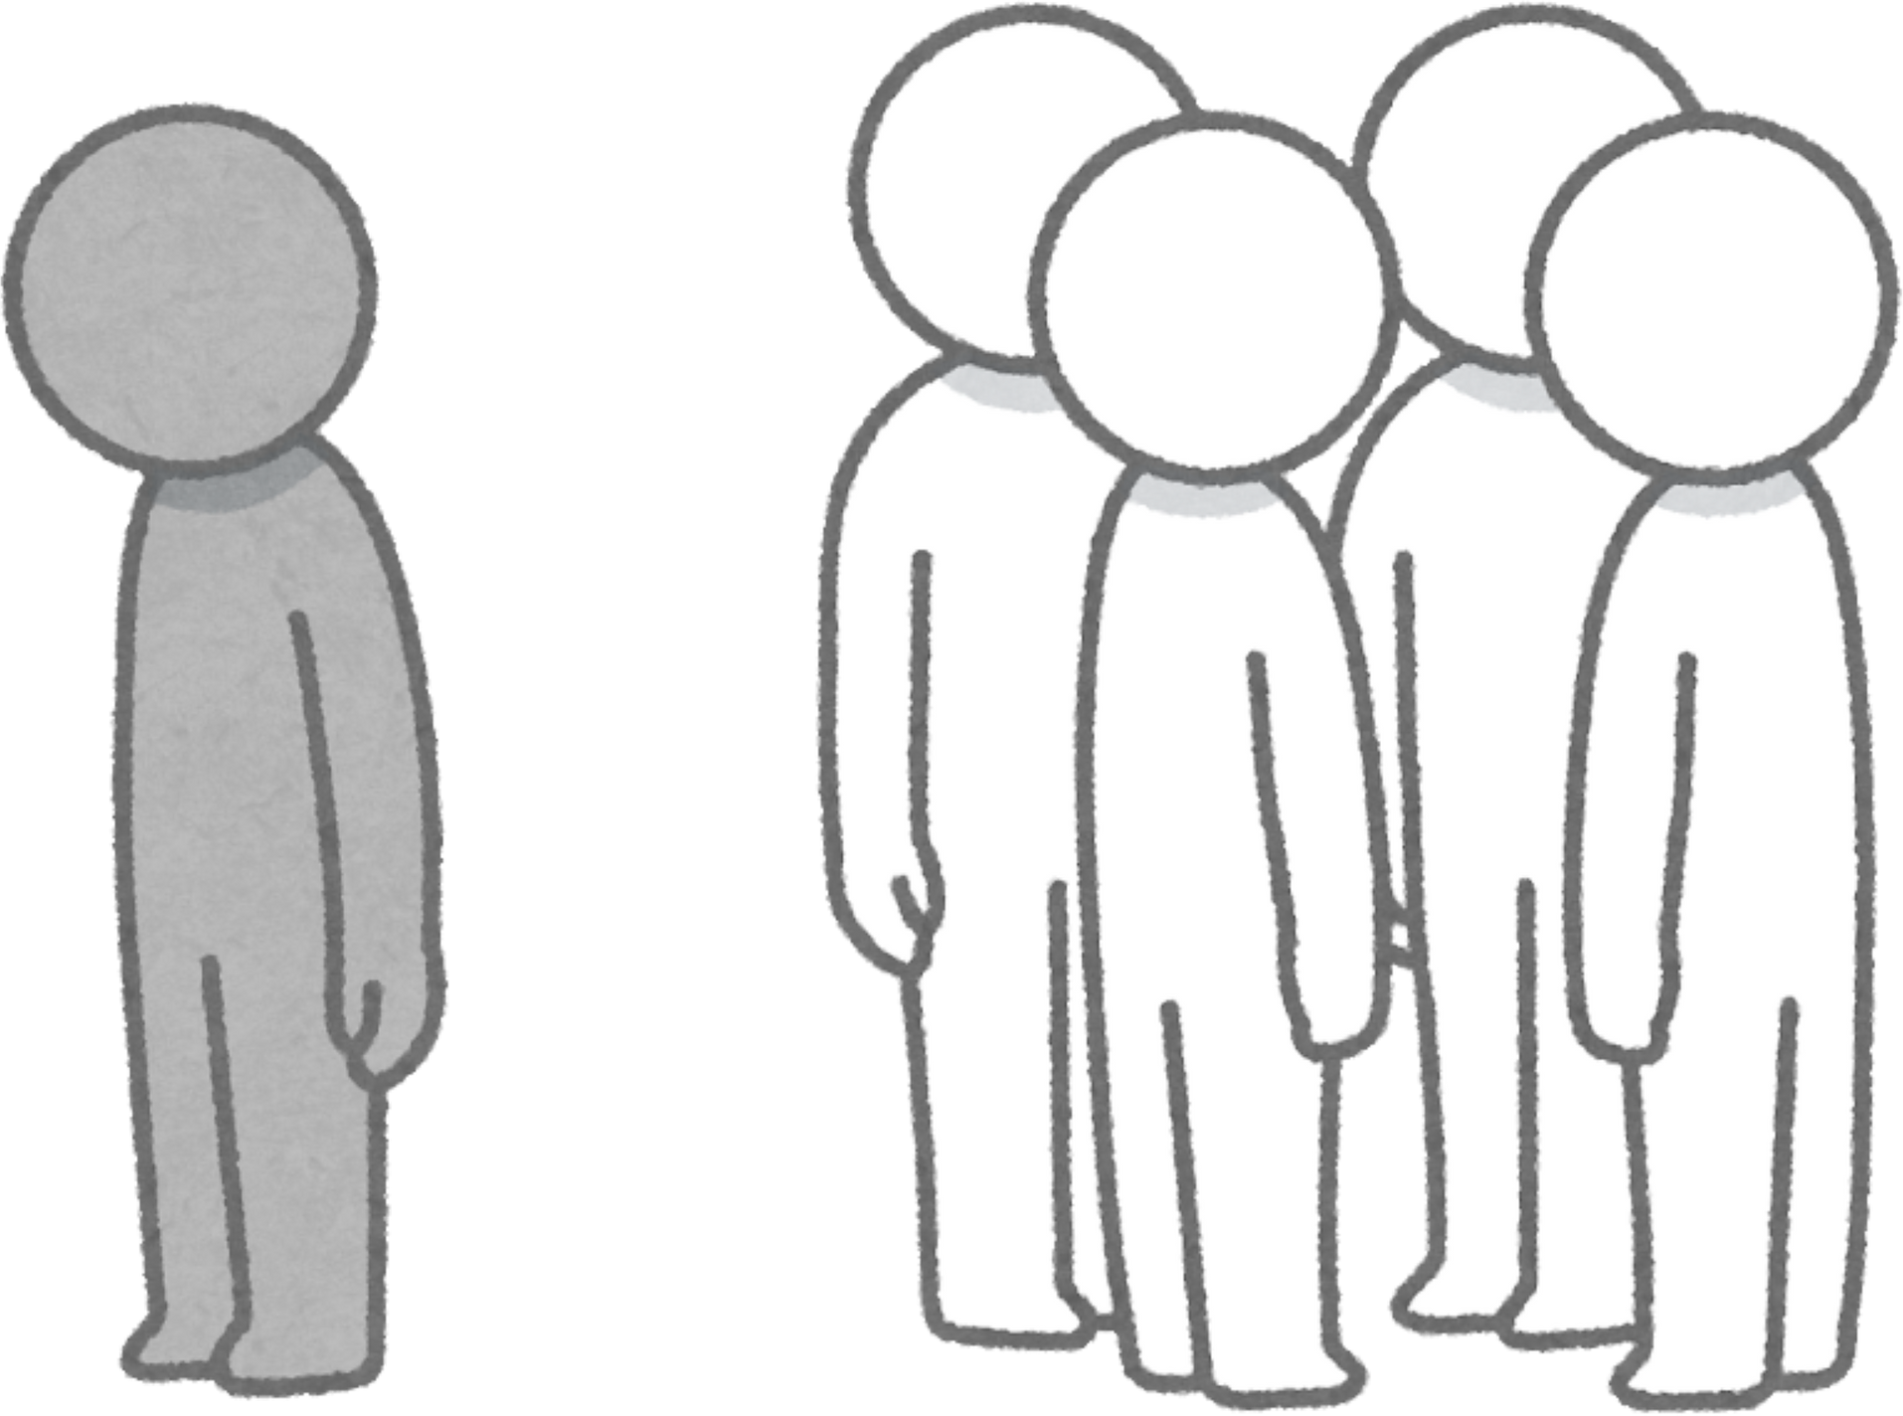

Slide 27
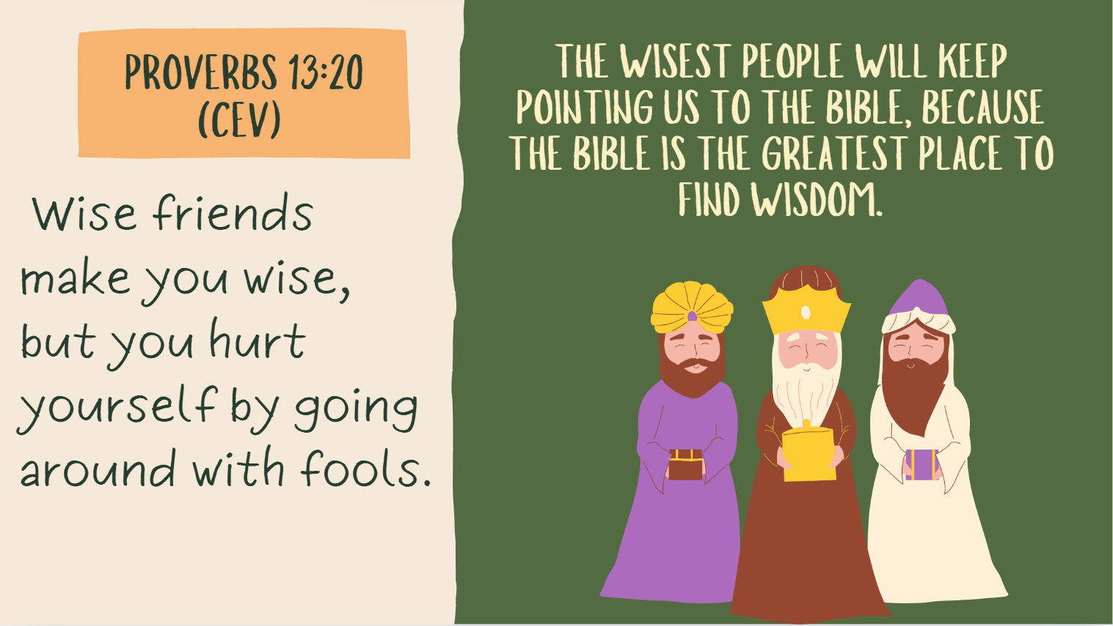

Slide 28
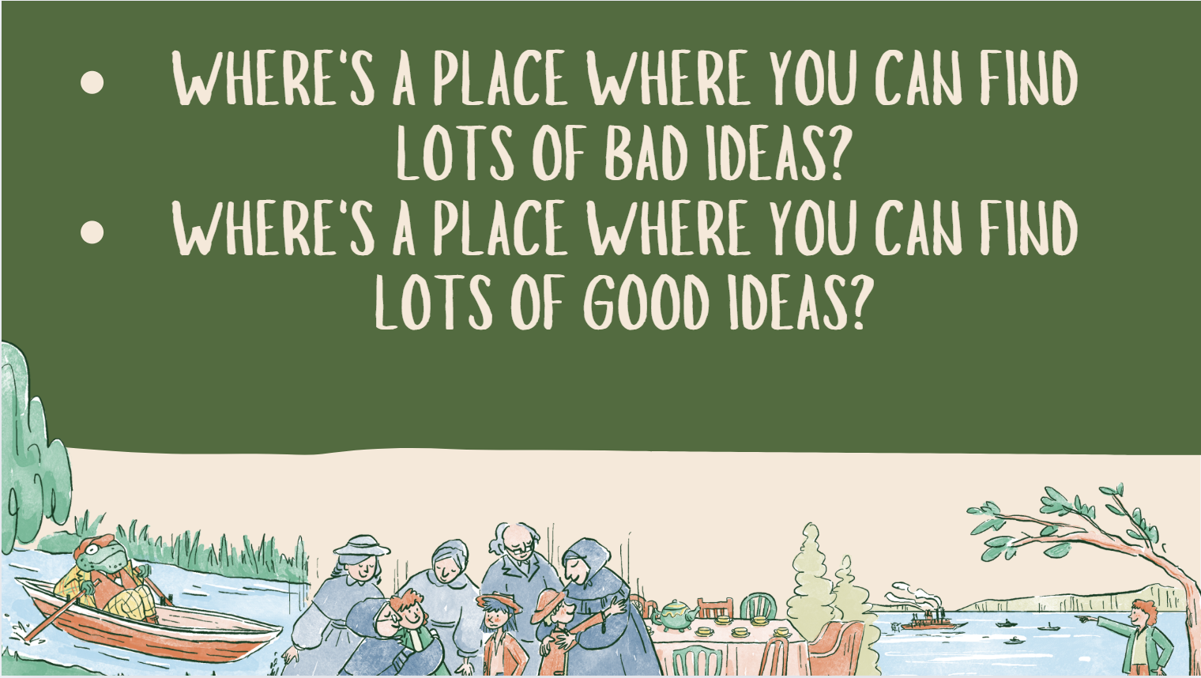

Slide 29


Slide 30
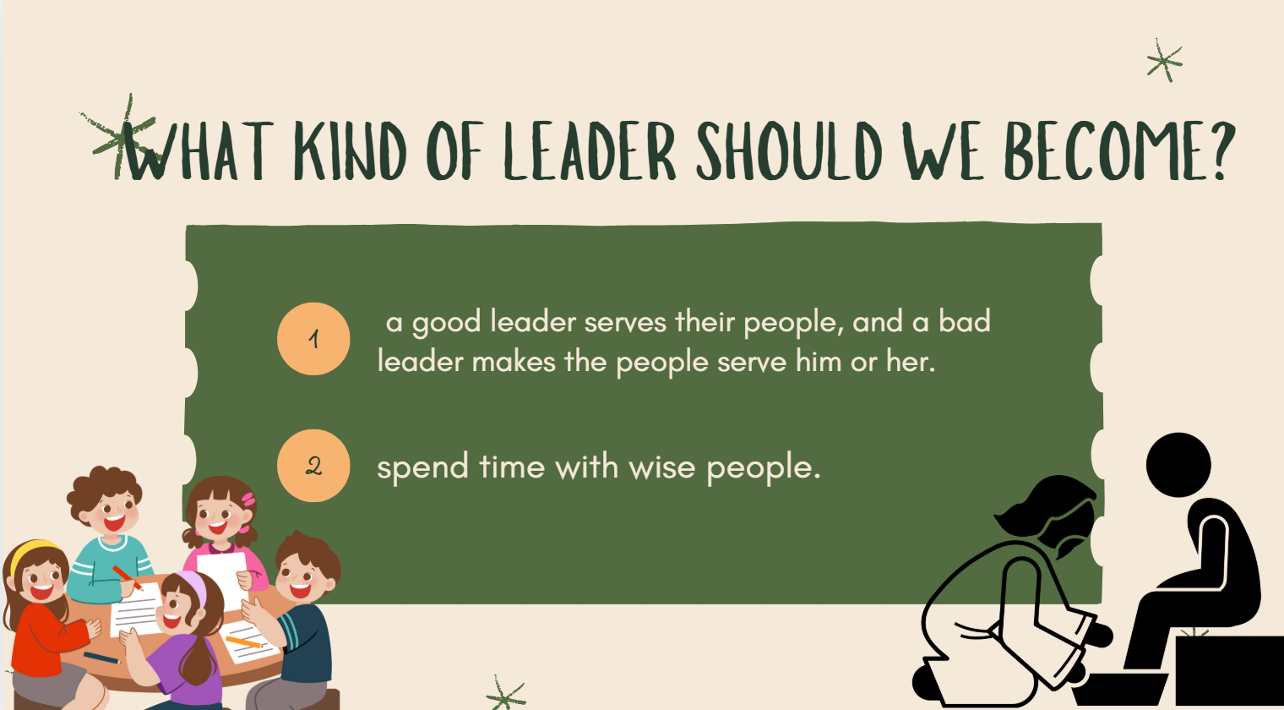

Slide 31




