Slide 1













The First Thing To Know About God

Slide 2

Activity: Trust Fall
  We will start this point by doing a trust fall!
  The idea is to stand in front of a GROUP of your friends. They'll all have their arms out to catch you, and then you need to tip backwards like a board without bending your knees.
  Now you all have a choice. You can do the trust fall if you want, or you can watch and maybe help catch people.

Slide 3

What Can We Learn?
  We did the trust fall because it helps us to think about our lesson. A trust fall is fun if we know someone will catch us. If you're falling on someone you really trust, and they're really strong, then you have nothing to worry about. However, if you don't know if the person will catch you or not, you probably won't want to play the game.
  The trust fall is scary because you can’t see the people who are supposed to catch you. Life is like that. We’re supposed to trust God, but we can’t see Him. Because of that, some people have a really hard time trusting Him.
  The key to trusting God is to know what He is like. This brings us to our big question today.

Slide 4
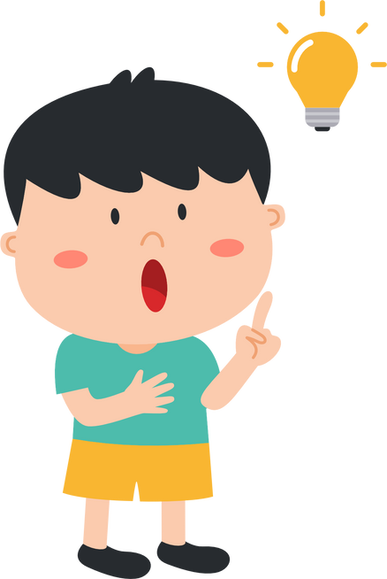

Question
Our big question is: what is the first thing we should know about God?

Slide 5


Big Ideas
Our big idea is, we should know that God is really good for us.
01
We all have needs, but
02
God meets our needs in the best way.

Slide 6
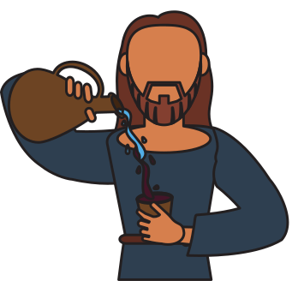

Bible Reference
Jesus turns water into wine

Slide 7

Point 1
We all have needs

Slide 8
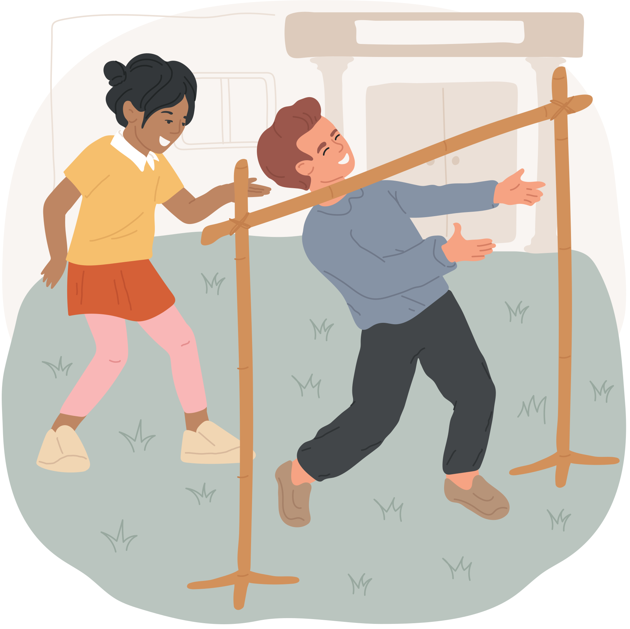
Limbo
  We'll start our point with a game of Limbo! It's a really simple game. We'll have two people holding a stick, and we'll all take turns walking under the stick.
  The tricky part is, the stick will keep getting lower, so, you'll need to walk lower.
  The way to walk lower is to bend your knees and lean back.
  You can't touch the floor with your hands. If you touch the floor with your hands, or if you fall, you're out, and you can stand to the side and watch your friends to see how low they can go.
  Teacher: do a demonstration with two volunteers to the side holding the stick.
  Let's all form a line, and let's give it a try!

Slide 9


What Can We Learn?
Let's gather back into a circle.
We played this game because it reminded us we all have a limit.
Sooner or later we all face challenges that are too much for us to handle.
That's what we see in our Bible story. Let’s read the first part of the story.

Slide 10


Bible Reference
1 Three days later Mary, the mother of Jesus, was at a wedding feast in the village of Cana in Galilee. 2 Jesus and his disciples had also been invited and were there. 3 When the wine was all gone, Mary said to Jesus, “They don't have any more wine.”
John 2:1-3 (CEV)

Slide 11



Slide 12

Application
  We all have problems. Maybe you have a problem at school. Maybe there are people you can't get along with, or maybe you keep doing things you regret.
  No matter what your problem is, God cares about you, and He is powerful enough to help you.

Slide 13

Discussion Question
  What is a problem in your life?

Slide 14
Point 2
God meets our needs in the best way.

Slide 15
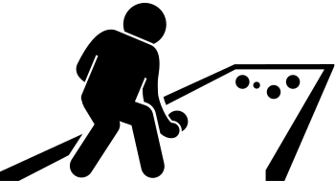
Paper Bocce
  Let's go over the rules again. For this game, you'll all be standing at the edge of the room (let's all go to the edge of the room and touch the wall).
  You will all have a ball that is made out of paper, (take a moment to scrunch up your paper into a nice tight ball).
  You will be throwing your ball at this target.
  Teacher: show the kids the target in the middle of the room
  We'll all take turns tossing our balls. If your team has the closest ball, you get one point. If your team has the two closest balls, you get two points. If your team has the three closest balls, you get three points – and so on.
  We’ll play a few rounds of this game.

Slide 16
What Can We Learn?
  In this game we played, it often depends on the last ball, and we will win or lose depending on if the last person can throw the ball to the right place.
  If you had a super skilled person to throw the ball to the right place every time, you would never lose.
  That's what it's like when God is helping you. No matter how difficult your problem is, God can fix it.
  God wants to meet our needs in the best way. Let’s go back to our Bible story.

Slide 17
Bible Reading
  3 When the wine was all gone, Mary said to Jesus, “They don't have any more wine.” 4 Jesus replied, “Mother, my time hasn't yet come! You must not tell me what to do.”
John 2:3-4 (CEV)

Slide 18
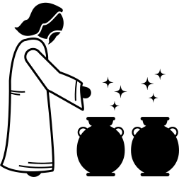
We can learn from that. Jesus wants to help us, but He wants to help us in the best way, not just any way. Sometimes people ask God for help. They might ask God to help them with school, or to make a problem go away. However, God has a bigger plan and He doesn't just do miracles any time we ask. Sometimes the things we ask for don't fit into His plan, so we should not tell God what to do. We should be like those servants though, and do whatever God says. Then, we will see God do amazing things. He will also help us in little ways. We’ll be able to join Him in His work, and we’ll help other people in big ways and in small ways.

Slide 19
Discussion Questions
If you were to ask God for one thing, what would it be?
What is something that God can give you that lasts forever?

Slide 20
Conclusion
01
  Our big question was: what is the first thing we should know about God?
  Our big answer was: we should know that God is really good for us.
We all have needs, but
02
God meets our needs in the best way.

Slide 21
Thank you!

