Slide 1


Getting Things Done

Slide 2


Slide 3


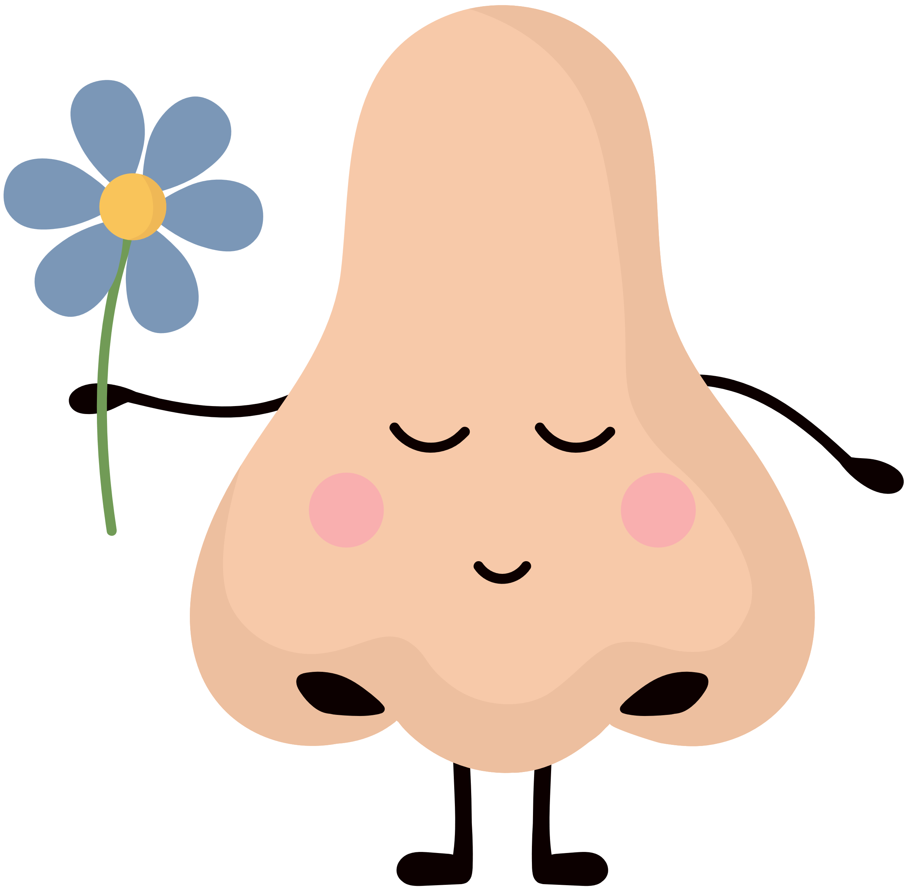

Nose Dive

Slide 4


We’ve all had days when we felt like we didn’t do anything. Some days can feel boring or even frustrating. But, we’ve all had good days too. Some days, we get so many things done, and we look back and we think, “wow that was a great day.”

Slide 5


And, if you follow Jesus, it's extra important that we are good at getting things done -- because people need us. And, we can help a lot of people if we know how to get things done.

Slide 6

Ephesians 5:15-16 (CEV)
Act like people with good sense and not like fools. These are evil times, so make every minute count.

Slide 7
how can we get a lot done?
we should make a plan
we should try our best

Slide 8
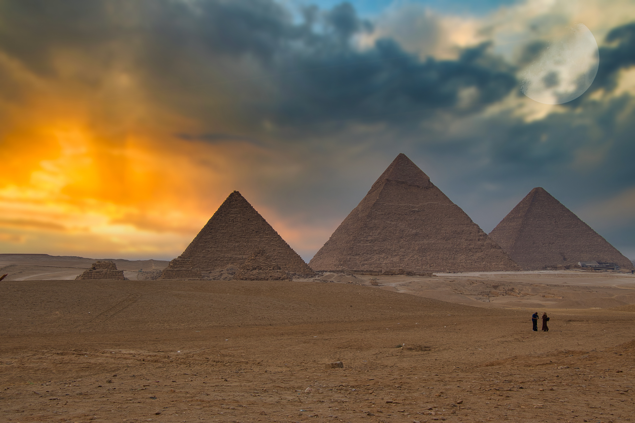
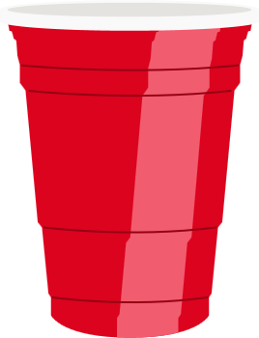










Slide 9


Sometimes a good plan makes a big difference.

Slide 10
Proverbs 21:5 (CEV)
If you plan and work hard, you will have plenty; if you hurry to get rich, you will end up poor.

Slide 11

This verse teaches us to plan and work hard. If we plan and work hard, we will have everything we need. But, some people don't want to make a plan. They feel like they have no time to plan. But, then they make a lot of mistakes and they end up in trouble, because they didn’t know what they were doing.

Slide 12


stop and think about a plan. Every morning, you can think of five things that you want to do. Once you think of those five things, the rest of your day can become like an adventure, and you can have fun racing to get those things done.

Slide 13

And, if you know how to write down your plan, that's even better! Scientists have found out that when people write down their plans, they're much better at getting things done. So, whenever you get a chance, write down the things that you want to do.

Slide 14




WHAT ARE FIVE THINGS YOU WOULD LIKE TO DO BEFORE TOMORROW NIGHT?

Slide 16
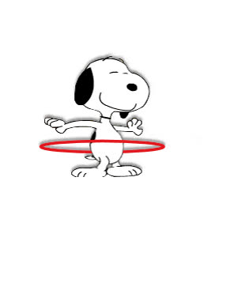







Slide 17
We don't know exactly how to finish the challenge, and sometimes we might feel a bit stuck. But, if we keep trying, we'll get it eventually.

Slide 18
Proverbs 14:23 (ICB)
Those who work hard make a profit. But those who only talk will be poor.

Slide 19


When we work hard and do our best, that’s when we learn the most, and that’s when we get better. And, when we get better at our work, we can help other people.

Slide 20

But, there are things that are even more important than money.

Slide 21
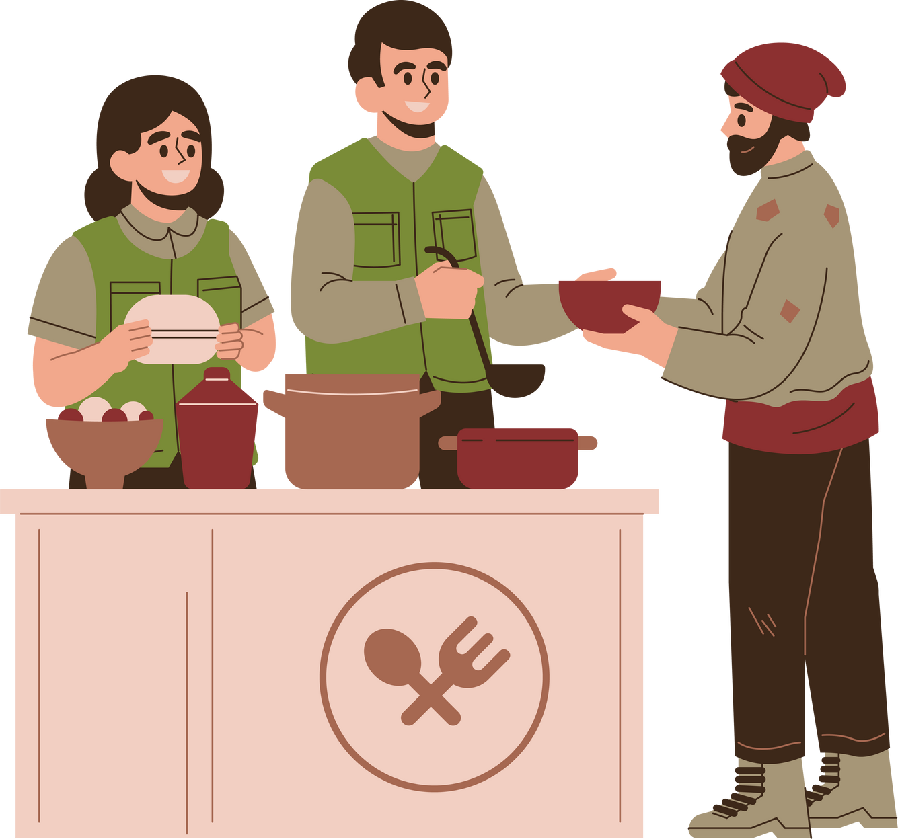
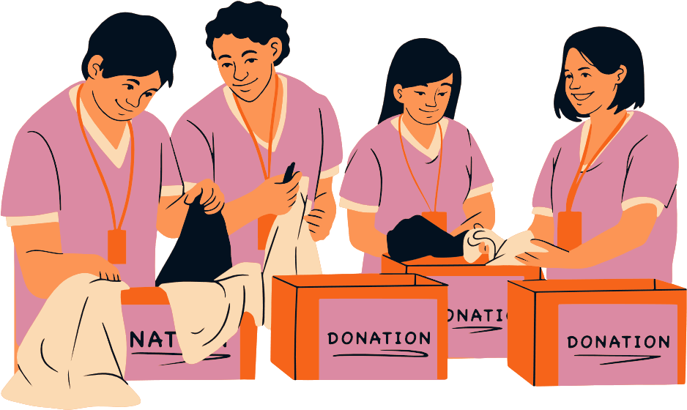
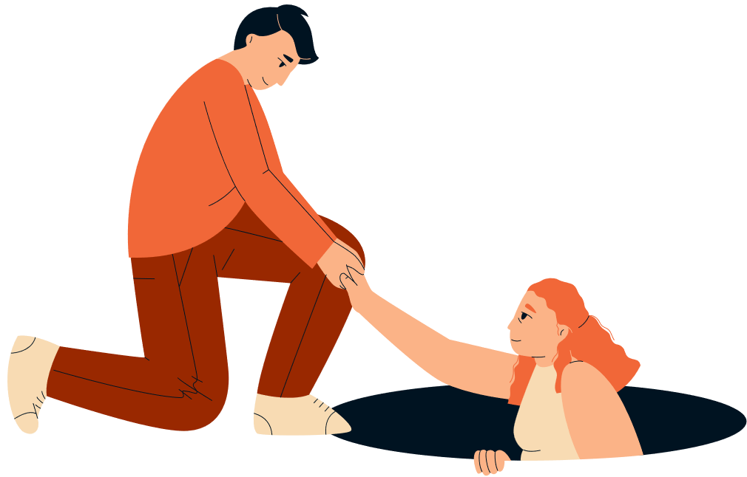
When we do our best work for people, we are actually serving God.

Slide 22
Why would a person want to be lazy?
What's so great about working hard?

Slide 23
how can we get a lot done?
we should make a plan
we should try our best

Slide 24











