Slide 1












THE HOLY SPIRIT

Slide 2





HOW WAS YOUR WEEK?

Slide 3


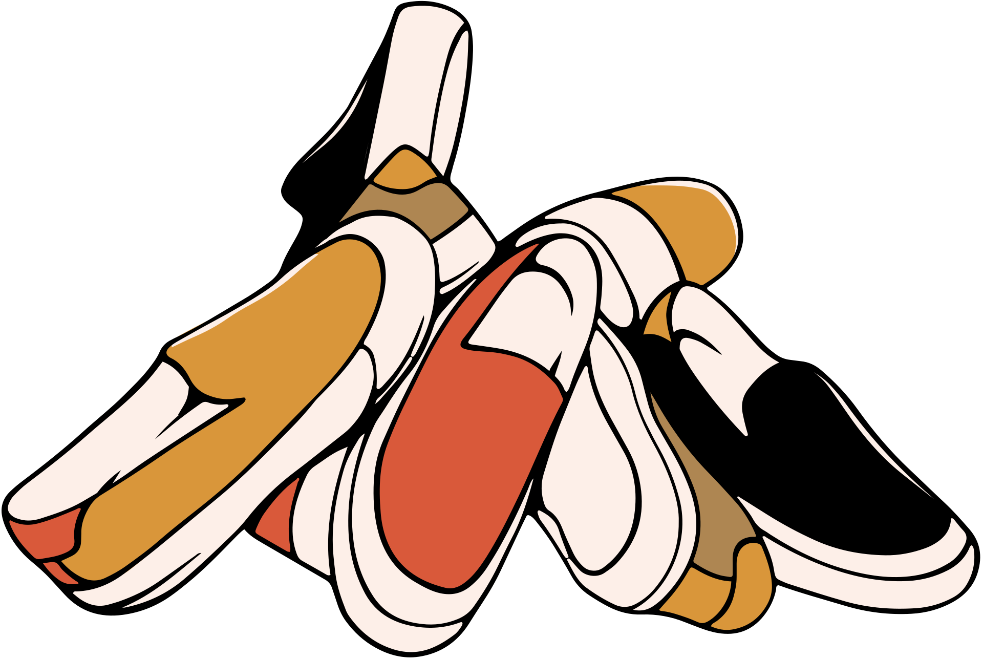
Shoe race

Slide 4


Why did we play this game?
Two shoes is way better than one shoe!
Have you ever tried hopping on one foot? It's way harder than walking!
You had to make sure to grab your own shoe. If you grabbed the right shoe, you will be able to go places and do things that you could never do with just one shoe.

Slide 5




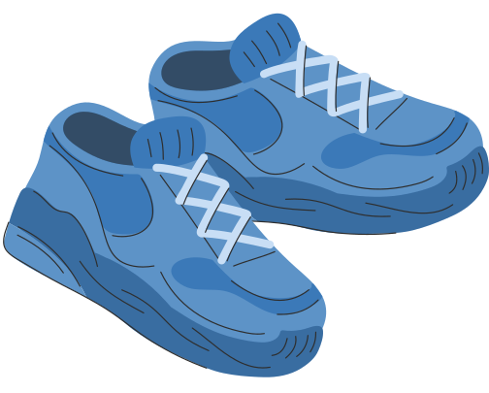

How does this connect to our life?
02
Each of us is like one shoe. One shoe is good, but it's not supposed to be alone. The Bible tells us who the other shoeis. It's God, the Holy Spirit! So, today's story is about the Holy Spirit and what He does for us.

Slide 6




Q: What does the Holy Spirit want to do with us
He wants us to love people in a BIG way
The Holy Spirit wants to give us power to talk about Jesus
1.
The Holy Spirit wants to give us power to love each other
2.

Slide 7

God’s story: Acts

Slide 8




  The Holy Spirit wants to give us power to talk about Jesus

Slide 9





Drawing with crayons

Slide 10


Why did we play this game?
This game teaches us that we can’t do everything! If we only have 2 crayons, we can’t draw everything perfectly.

Slide 11
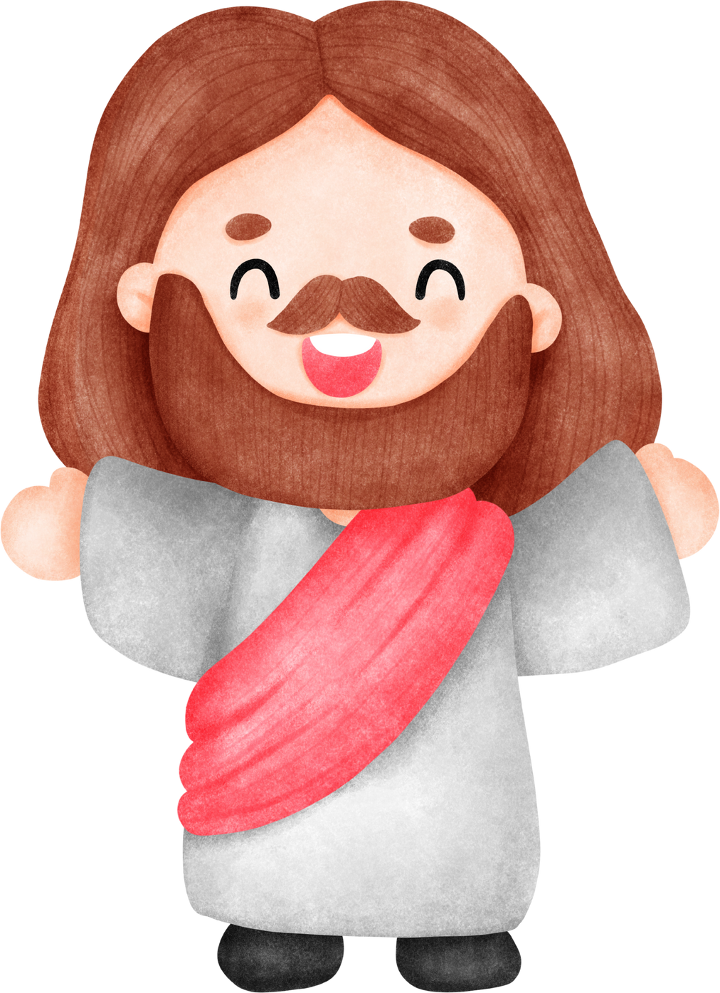

Why did we play this game?
If we live with the Holy Spirit, it is like having someone with the whole box of crayons when we had nothing to draw with. He will draw with you so you can make a great picture! That’s what its like when we do God’s work

Slide 12
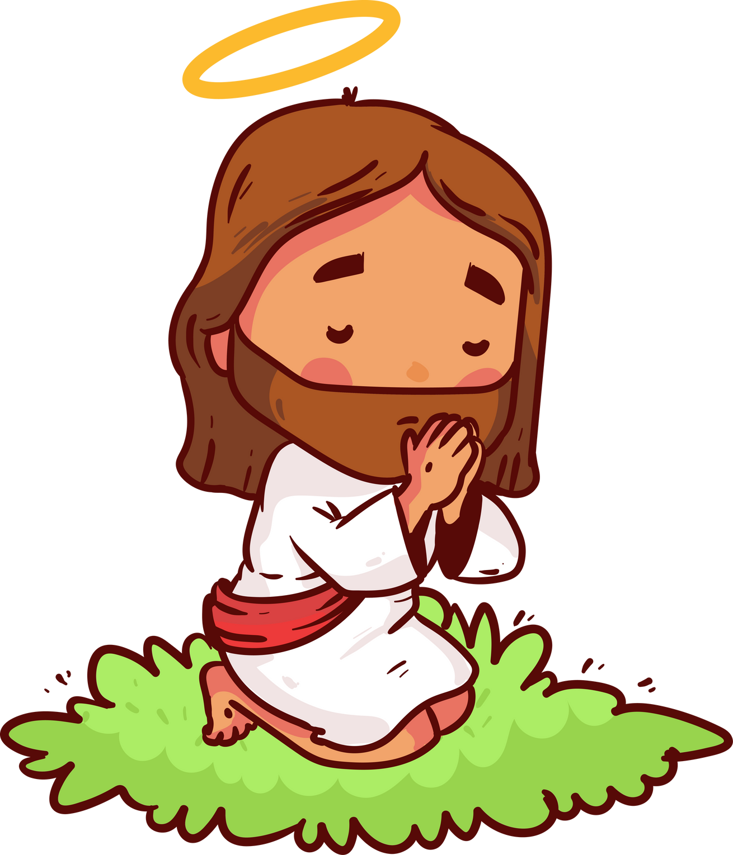
Acts 4:31-33
31 After they had prayed, the place where they were meeting was shaken. They were all filled with the Holy Spirit, and they spoke God’s word without fear.

Slide 13

Acts 4:31-33
32 The group of believers were joined in their hearts, and they had the same spirit. No person in the group said that the things he had were his own. Instead, they shared everything.

Slide 14
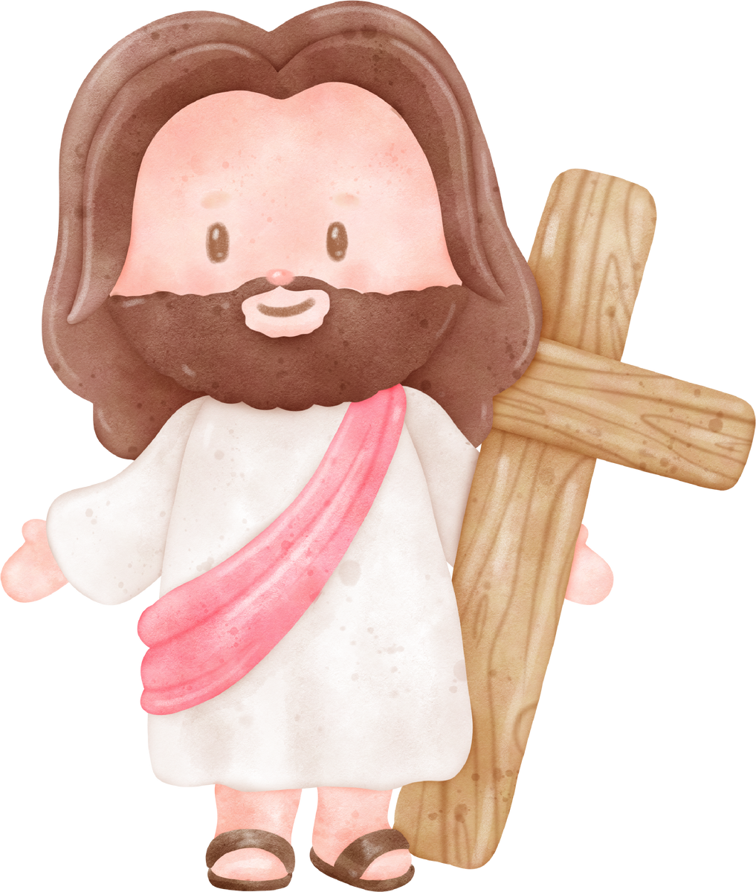
Acts 4:31-33
33 With great power the apostles were telling people that the Lord Jesus was truly raised from death. And God blessed all the believers very much.

Slide 15




What did Christians do back then?
When they were in trouble, they PRAYED!
Then God would show up! People would say they were all filled with the HOLY SPIRIT

Slide 16



What does it mean to be filled with the Holy Spirit?
MILK TO CHOCOLATE MILK

Slide 17
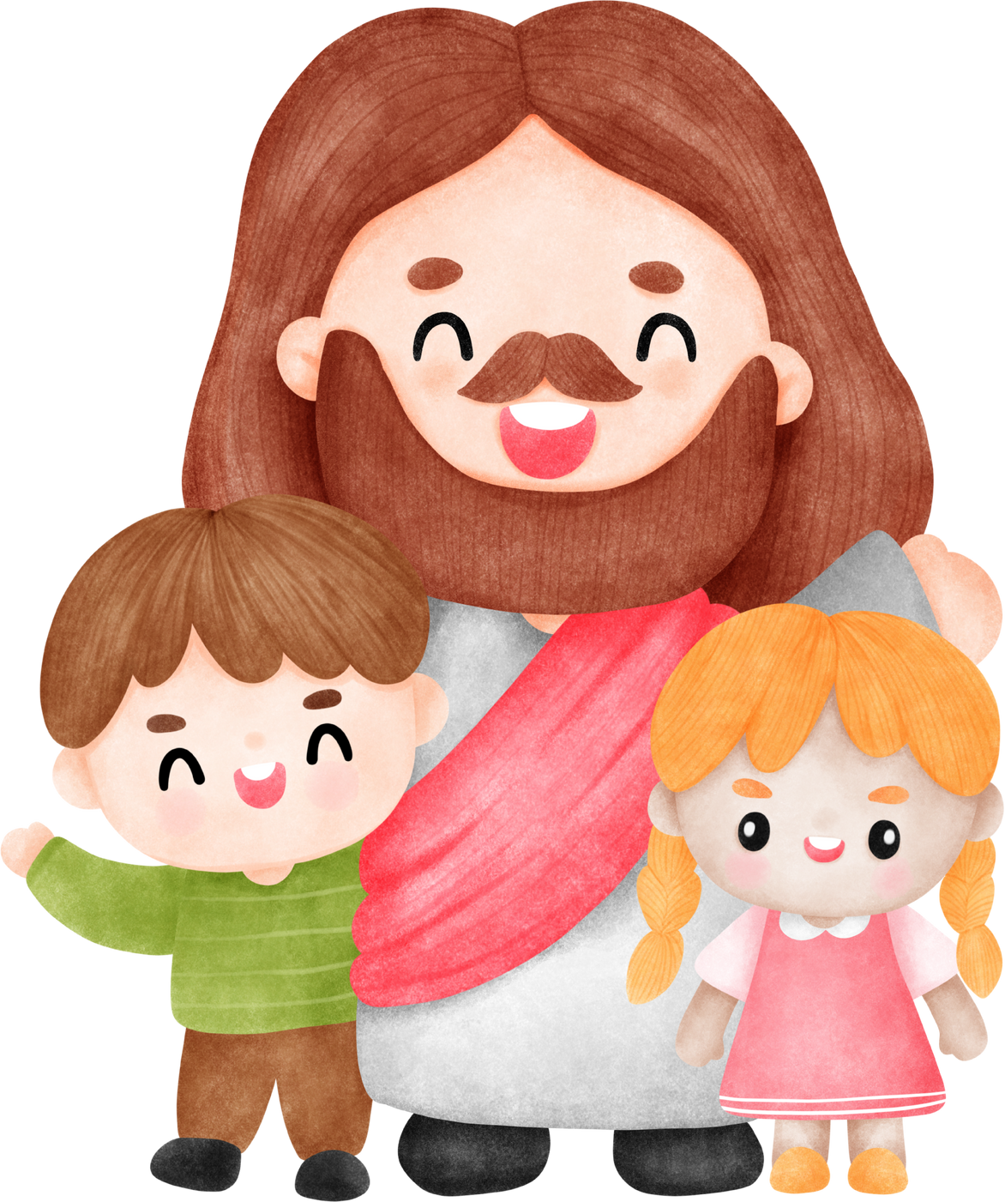


Invite the holy spirit
The Bible says that God’s Holy Spirit lives in YOU! But we need to invite him in every part of our life. We need to let God do whatever he wants. He knows what is best for us! He will make everything better!

Slide 18

THe power of the holy spirit
The Holy Spirit made them brave and powerful so they could tell everyone about Jesus. And, He wants to help us in the same way.

Slide 19


Lets make our milk into chocolate milk!
remember to stir for the holy spirit

Slide 20
  What is a part of your life where you want more of God?

Slide 21

2. The holy spirit wants to give us power to love each other

Slide 22
ROLL ROLL ROLL!

Slide 23

Why did we play this game?
You all have to work together! If your teammates were fast, your whole team is fast. If your teammate is slow, your whole team is slow.
What can you do to help?

Slide 24


How can we learn from the game
You can give advice and help each other during the game any way that you can!
God made us to be on ONE team! So we much take care of each other

Slide 25

Acts 4:32-37
32 The group of believers were joined in their hearts, and they had the same spirit. No person in the group said that the things he had were his own. Instead, they shared everything.

Slide 26

Acts 4:32-37
36 One of the believers was named Joseph. The apostles called him Barnabas. (This name means “one who encourages.”) He was a Levite, born in Cyprus.

Slide 27

Acts 4:32-37
37 Joseph owned a field. He sold it, brought the money, and gave it to the apostles.

Slide 28
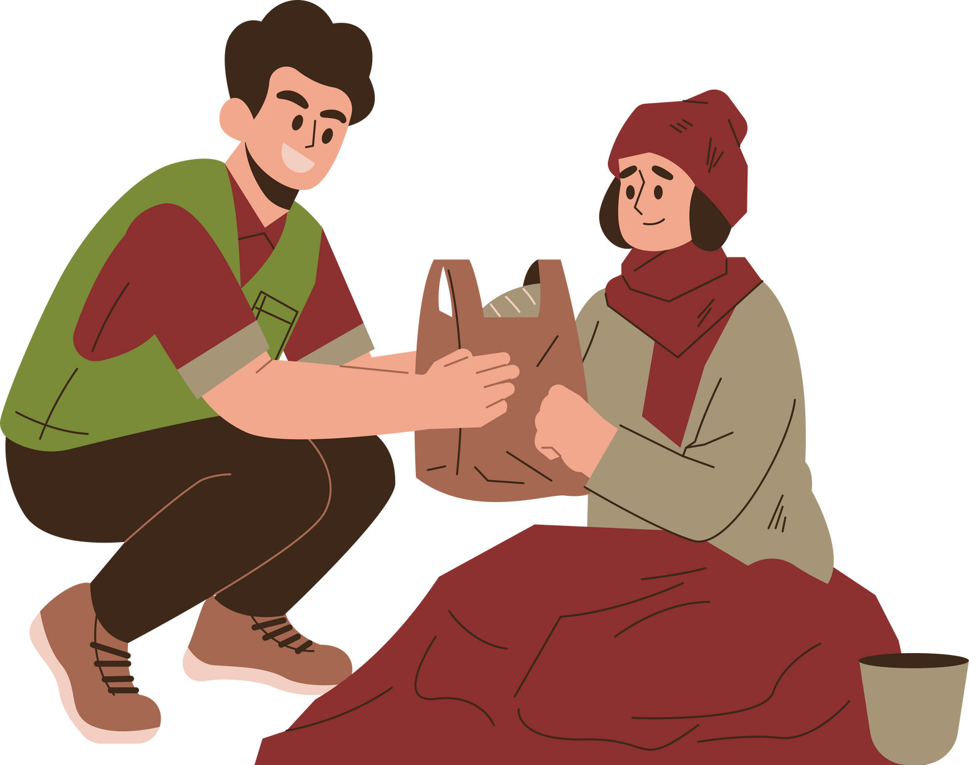

FIRST CHRISTIANS
The first Christians had to share because a lot of them were really poor. They were so poor that many of them were hungry because they couldn't buy food to eat.

Slide 29
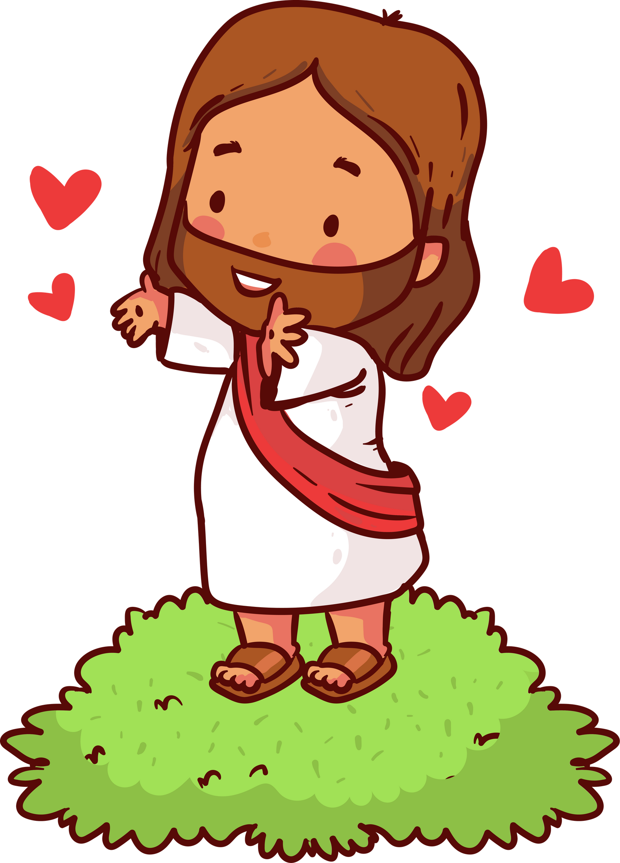
They had the holy spirit
The Holy Spirit was working in their hearts. The Holy Spirit gave them so much love for each other that they took care of each other.They shared everything!

Slide 30

How can we learn from this
The Bible teaches us to LOVE each other and share with each other! We can share and help everyone around us! The more we have, the more we can share! That is what the Holy Spirit wants! If you let the Holy Spirit into every part of your life, you will become an awesome friend and the Holy Spirit will be happy!

Slide 31
2. What is something you can share with your friends?

Slide 32
Q: What does the Holy Spirit want to do with us
He wants us to love people in a BIG way
The Holy Spirit wants to give us power to talk about Jesus
1.
The Holy Spirit wants to give us power to love each other
2.

Slide 33

BAKING TIME!

