Slide 1








Welcome

Slide 2


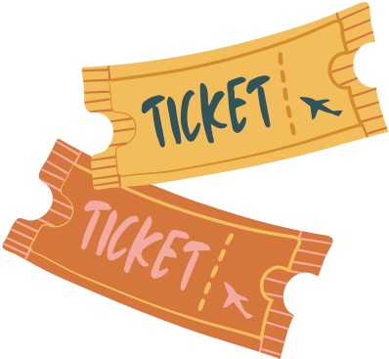
Are you ready?

Slide 3





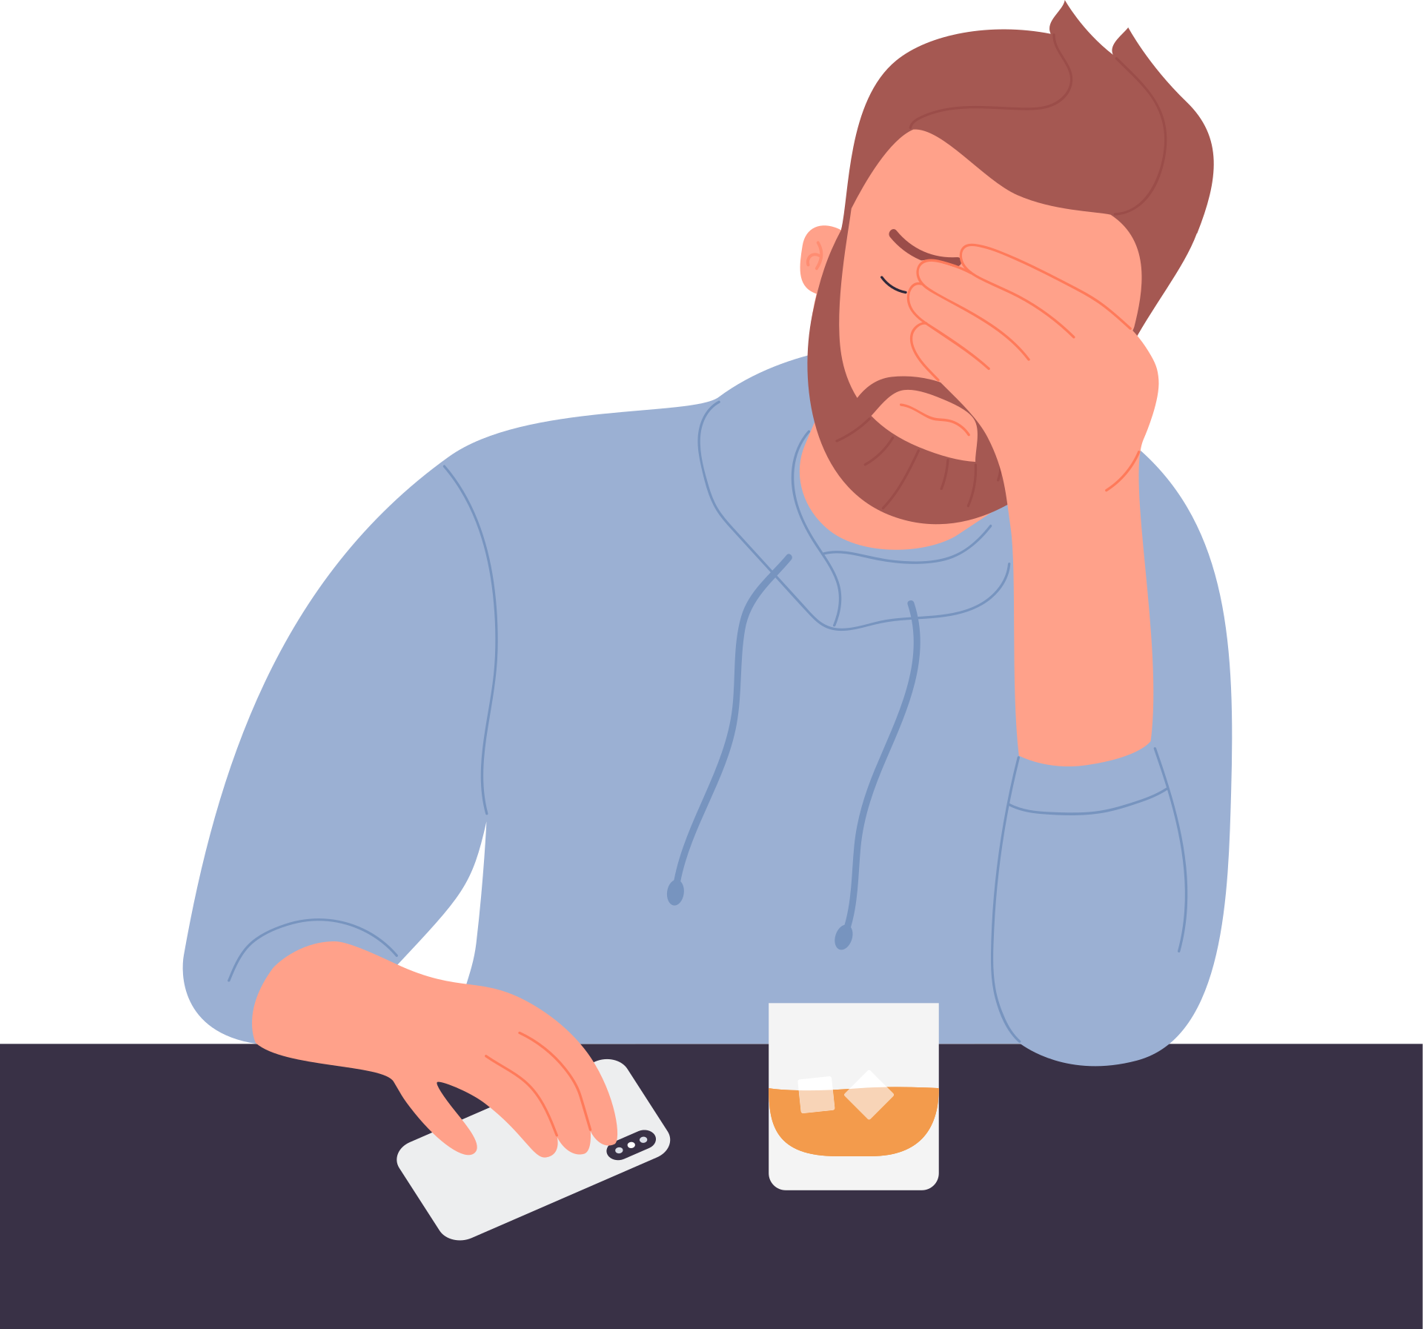




We started with a raffle because it helps us understand the idea of disappointment.

Slide 4




Disappointment is a part of life

Slide 5




BIG IDEA
There are two things we can do when we are disappointed:
We can remember God's promise
We can wait for God to keep his promise.
1
2

Slide 6



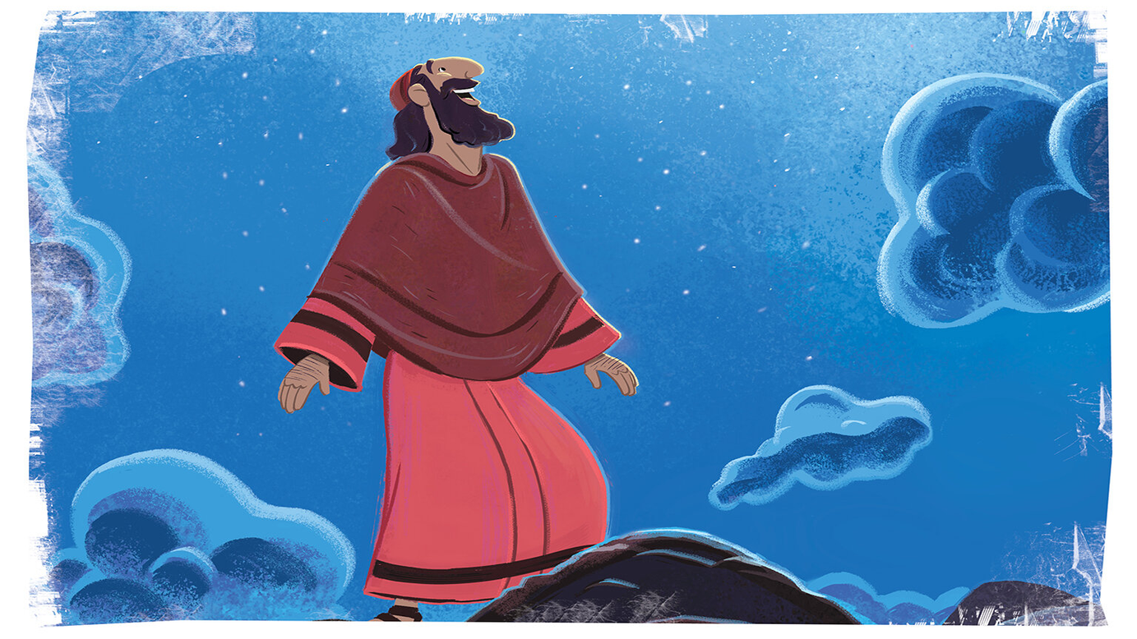
God’s Covenant with Abram

Slide 7
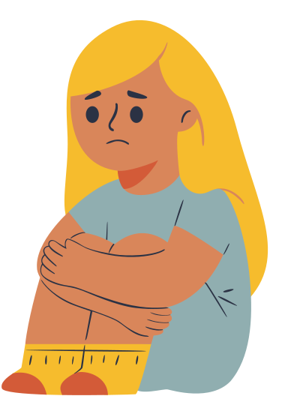
1.When we are disappointed, we can remember God's promise.

Slide 8


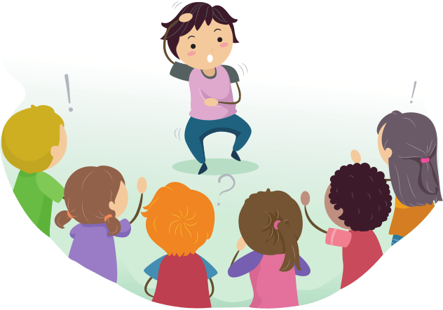



Group Charades

Slide 9

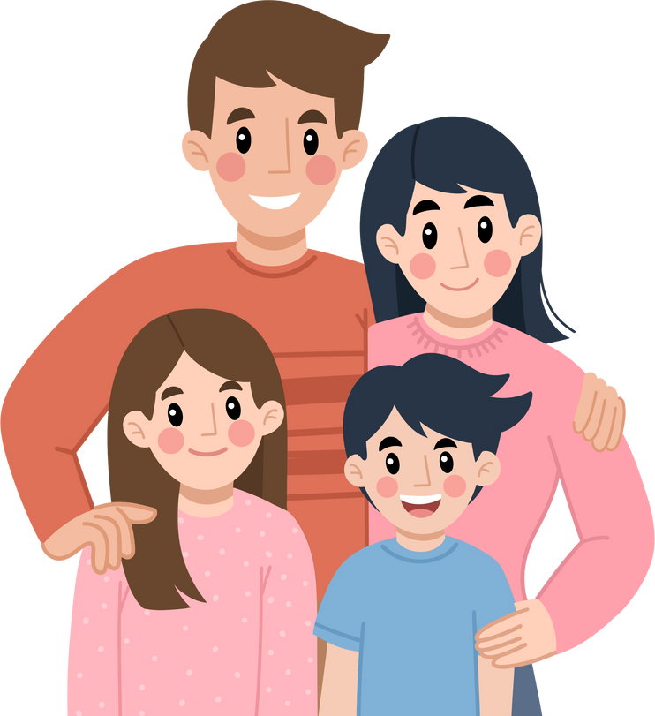


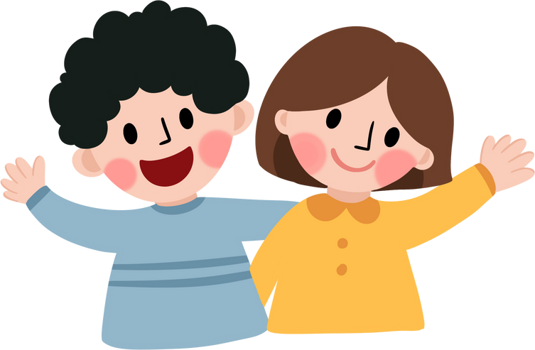
You Need Other People
In our Bible story, Abram didn't want to be by himself, but he wanted children, and he wanted a family.

Slide 10
Genesis 15:1-6
1 Later the Lord spoke to Abram in a vision, “Abram, don't be afraid! I will protect you and reward you greatly.”
2 But Abram answered, “Lord All-Powerful, you have given me everything I could ask for, except children. And when I die, Eliezer of Damascus will get all I own. 3 You have not given me any children, and this servant of mine will inherit everything.”

Slide 11
Genesis 15:4-6
4 The Lord replied, “No, he won't! You will have a son of your own, and everything you have will be his.” 5 Then the Lord took Abram outside and said, “Look at the sky and see if you can count the stars. That's how many descendants you will have.” 6 Abram believed the Lord, so the Lord was pleased with him and accepted him.

Slide 12
God promised Abram that he would have children, and his family would eventually be so big they would be like the stars in the sky.

Slide 13


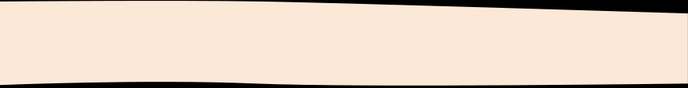

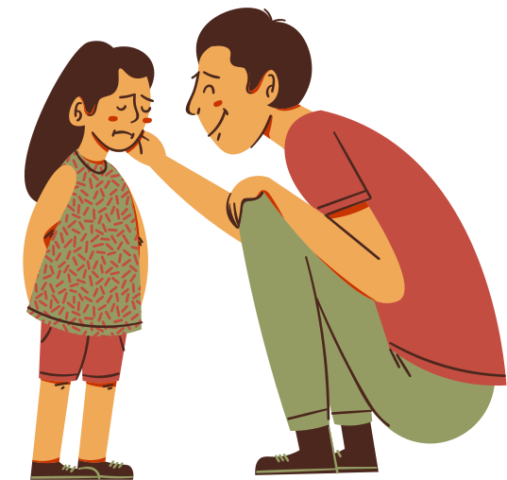


God has promised that even when bad times happen, he will always be working for our good.
These are amazing promises. When we remember his promise and trust him, that's the attitude that God loves.

Slide 14
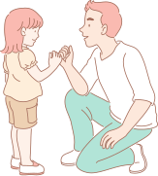
What is something that God has promised you?

Slide 15
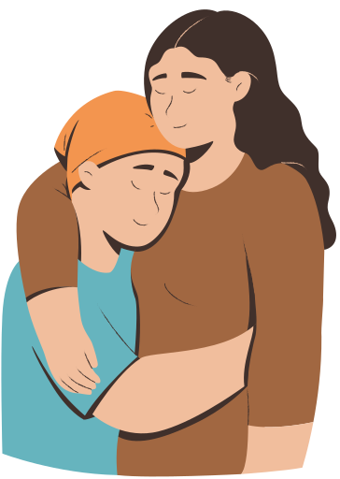
2. When we are disappointed, we can wait for God to keep his promise.

Slide 16

Blind Man’s Bluff

Slide 17
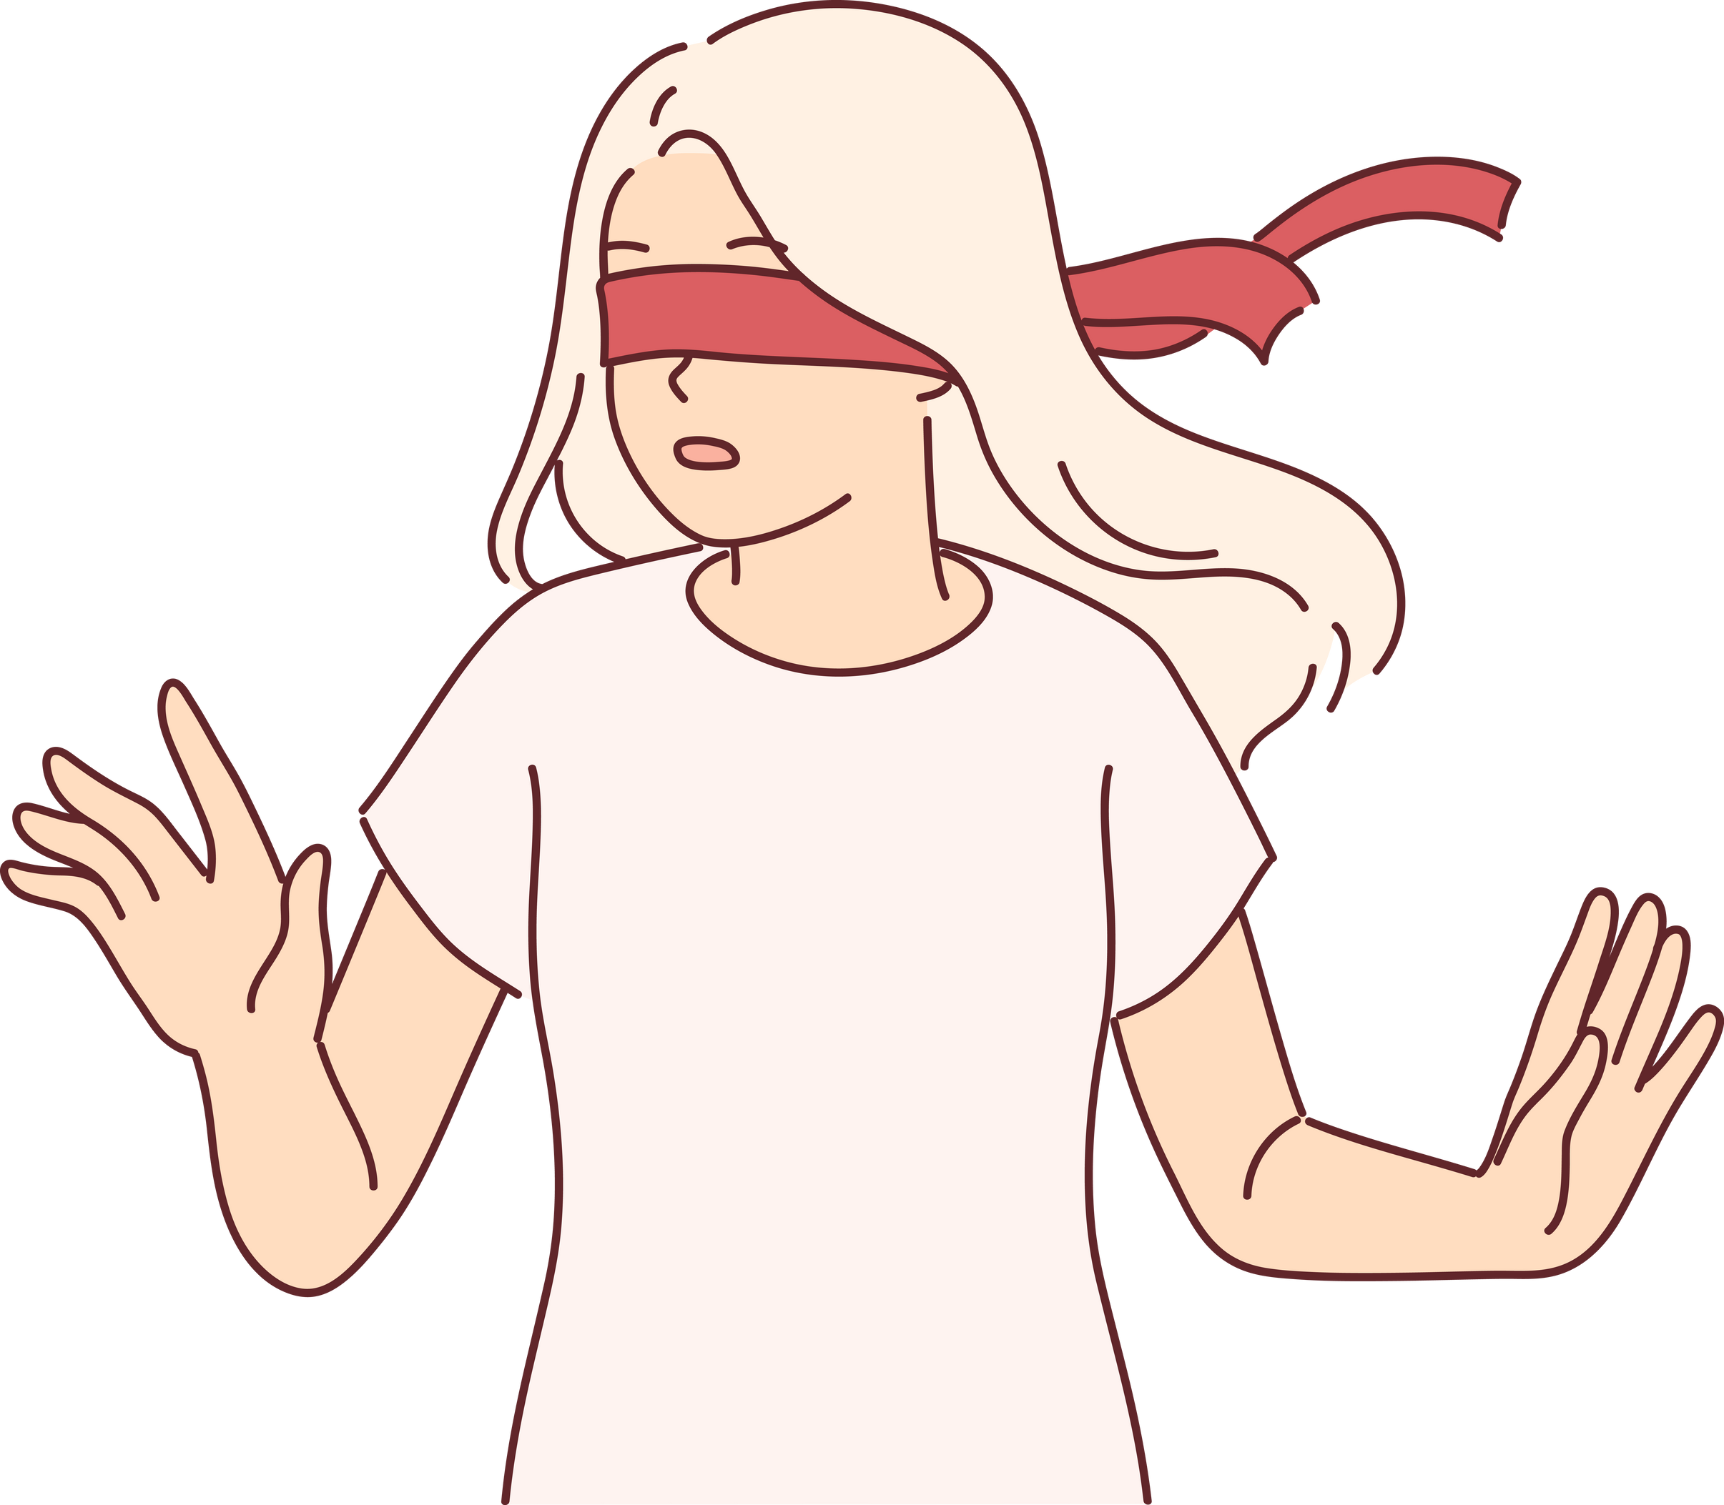
  We played this game because when you're “it,” you can't see, and it can feel really difficult. You’re not going to be blind forever.
  That's what it's like being a Christian. Sometimes we have to wait. In our Bible story, Abram had to wait.

Slide 18
Let’s watch our video again

Slide 19
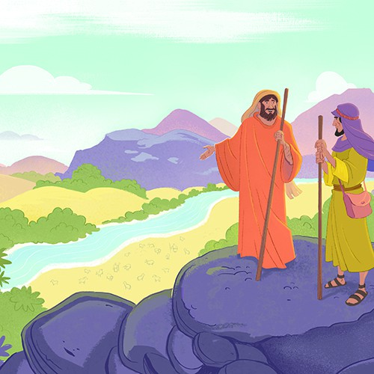
Genesis 15:7-9
7 The Lord said to Abram, “I brought you here from Ur in Chaldea, and I gave you this land.”
8 Abram asked, “Lord God, how can I know the land will be mine?”
9 Then the Lord told him, “Bring me a three-year-old cow, a three-year-old female goat, a three-year-old ram, a dove, and a young pigeon.”

Slide 20

10 Abram obeyed the Lord. Then he cut the animals in half and laid the two halves of each animal opposite each other on the ground. But he did not cut the doves and pigeons in half. 11 And when birds came down to eat the animals, Abram chased them away.
Genesis 15:10-11

Slide 21
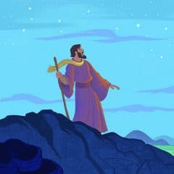
Genesis 15:12-15
12 As the sun was setting, Abram fell into a deep sleep, and everything became dark and frightening. 13-15 Then the Lord said:
Abram, you will live to an old age and die in peace.
But I solemnly promise that your descendants will live as foreigners in a land that doesn't belong to them. They will be forced into slavery and abused for 400 years. But I will terribly punish the nation that enslaves them, and they will leave with many possessions.

Slide 22
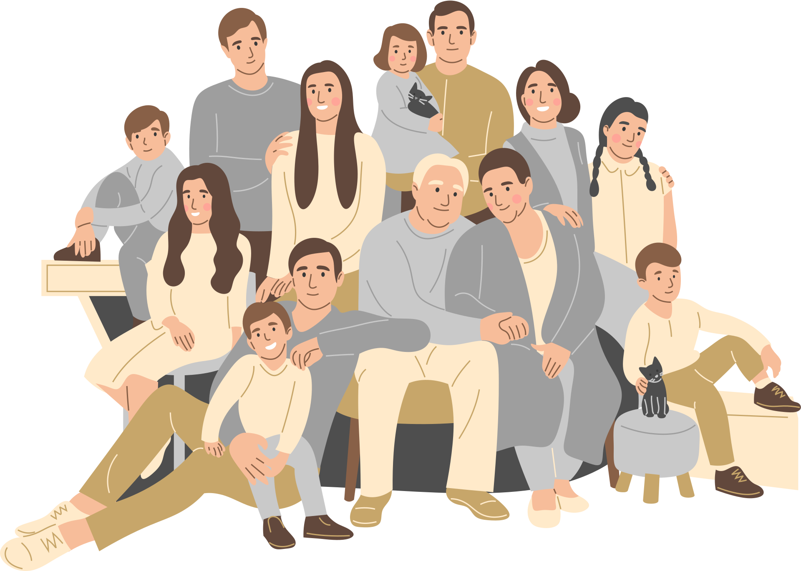
Genesis 15:16-17
16 Four generations later, your descendants will return here and take this land, because only then will the people who live here be so sinful that they deserve to be punished.
17 Sometime after sunset, when it was very dark, a smoking cooking pot and a flaming fire passed between the two halves of each animal.

Slide 23


  There's the special kind of dream that’s a message from God. Abram had one of those special dreams.
  In his dream, God told Abram what would happen in the future. Abram's family would have to go through very difficult times.
  But God had made them a promise and he would keep it.

Slide 24
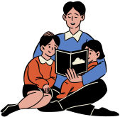
There was a reason why God kept Abram waiting until Abram fell asleep. It was because Abram would tell this story to his children, and this story would be passed on to all of his grandchildren and great-grandchildren.

Slide 25

Conclusion
The Bible tells us we are children of Abram too, if we are Christians. Sometimes God makes us wait for a really long time, but we can remember that God has a good reason to keep us waiting. Eventually He will give us what He promised, and all of our waiting will be worth it.

Slide 26
BIG IDEA
There are two things we can do when we are disappointed:
1
We can remember God's promise
2
We can wait for God to keep his promise.

Slide 27

Time for Hot Chocolate!

