Slide 1


WELCOME TO
KIDS CLUB!

Slide 2




HOW WAS YOUR WEEK?

Slide 3

WHAT DID WE LEARN LAST WEEK

Slide 4


WHERE CAN WE FIND OUR
BIGGEST MISTAKES
  Our THOUGHTS
  Our WORDS
  Our ACTIONS

Slide 5
DEAL OR
NO DEAL
CLICK HERE: Deal or No Deal

Slide 6

WHY DID WE PLAY THE GAME?
We played this game because it's about finding a great prize. Some prizes were super awesome, and some prizes were super disappointing. And, life is like that too. Sometimes we have choices to make, and if we make the right choice, it will be super awesome.

Slide 7

WHY DID WE PLAY THE GAME?
But, if we make the wrong choice, it will be super disappointing. Now, in the game, there was no way to know if a suitcase was good or bad. We just had to guess. But in real life, when we’re making real choices, we don't just have to guess– because the Bible tells us how to make great choices!

Slide 8




FINDING THE RIGHT PERSON TO MARRY

Slide 9



Some of you might think that is a long time away, and you are right! But guess what? All of us are already thinking about marriage! Just about all of us watch TV and movies. We get all kinds of ideas for who makes a great husband or wife. But, most of those movies and TV shows are giving us the wrong ideas!

Slide 10

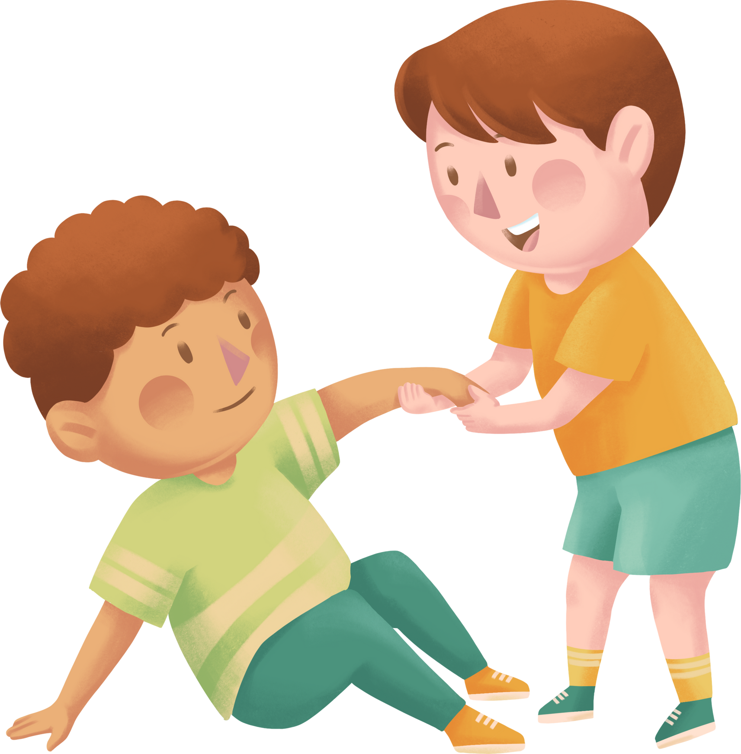
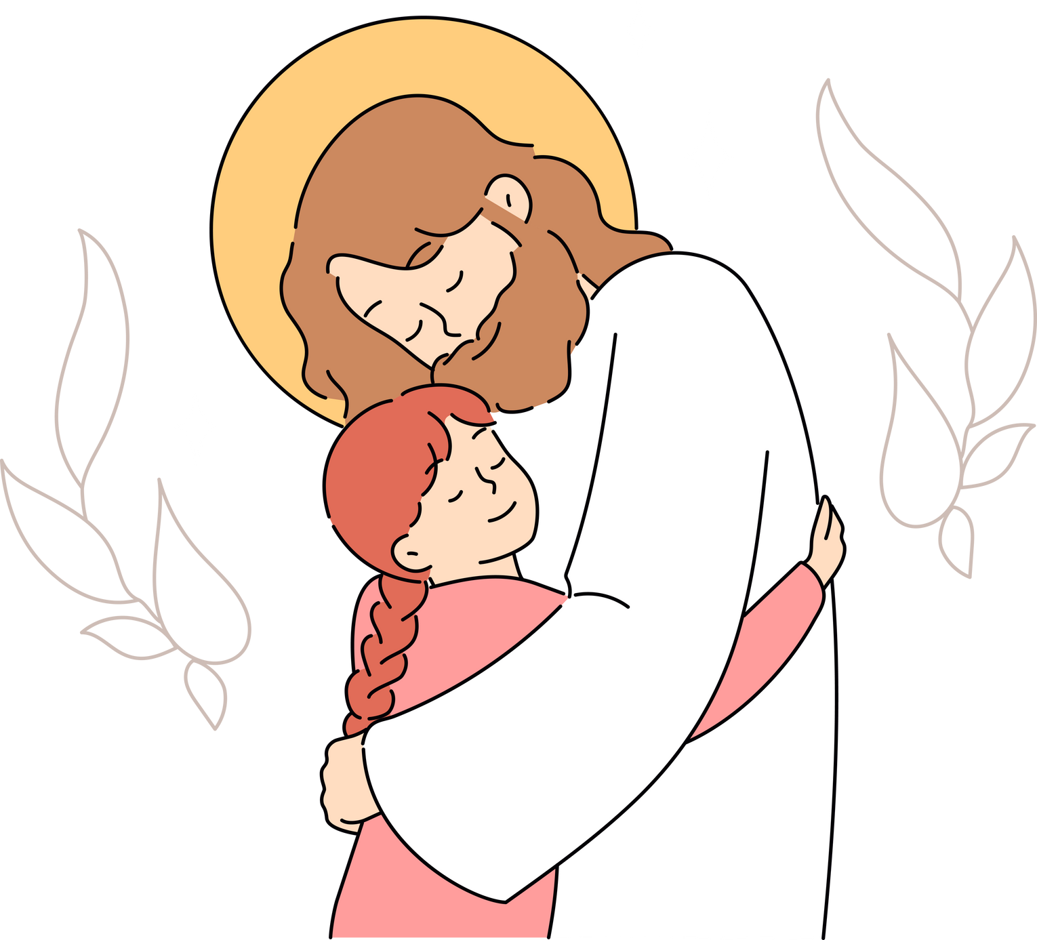
HOW CAN WE FIND THE RIGHT PERSON TO MARRY
  We should find someone who WORKS hard
  We should find someone who SERVES people
  We should find someone who LOVES God

Slide 11

  WE SHOULD LOOK FOR SOMEONE WHO WORKS HARD

Slide 12

KEEPY UPPY

Slide 13

WHY DID WE PLAY THE GAME?
We played this game because it makes us depend on each other. We need other people to help us keep all the balloons up! If our friends get lazy or distracted, they'll let the balloon drop. But, if they try their best, you can keep a lot of balloons together. We want to be partners with people who try their best. So, the Bible encourages us to find someone like that.

Slide 14

BIBLE VERSE
10 A truly good wife is the most precious treasure a man can find! 11 Her husband depends on her, and she never lets him down.
Proverbs 31:10-11
Proverbs 31:15 - 18

Slide 15
BIBLE VERSE
15 She gets up before daylight to prepare food for her family and for her servants.
Proverbs 31:10-11
Proverbs 31:15 - 18

Slide 16
16 She knows how to buy land and how to plant a vineyard, 17 and she always works hard.
BIBLE VERSE
Proverbs 31:10-11
Proverbs 31:15 - 18

Slide 17
BIBLE VERSE
18 She knows when to buy or sell, and she stays busy until late at night.
Proverbs 31:10-11
Proverbs 31:15 - 18

Slide 18

WHAT HAPPENED IN THE BIBLE VERSE
So, here is the first thing we learn about a great wife. She works hard and tries her best, and people can depend on her. Now, do you think men need to work hard too?

Slide 19

SHOULD MEN WORK HARD TOO?
Yes! The rest of the book of Proverbs teaches men to work hard. And, when we read the rest of the book, we can see, this whole lesson is for both men AND women.
PROVERBS

Slide 20

HOW CAN WE APPLY THIS TO OUR LIFE
So, if you ever want to find someone to marry, you'll want to find someone who works hard and gets things done. You'll need to work hard too. Hard working people like other hard working people.

Slide 21
PAIR AND SHARE
CAN YOU THINK OF SOMEONE WHO ALWAYS TRIES THEIR BEST

Slide 22
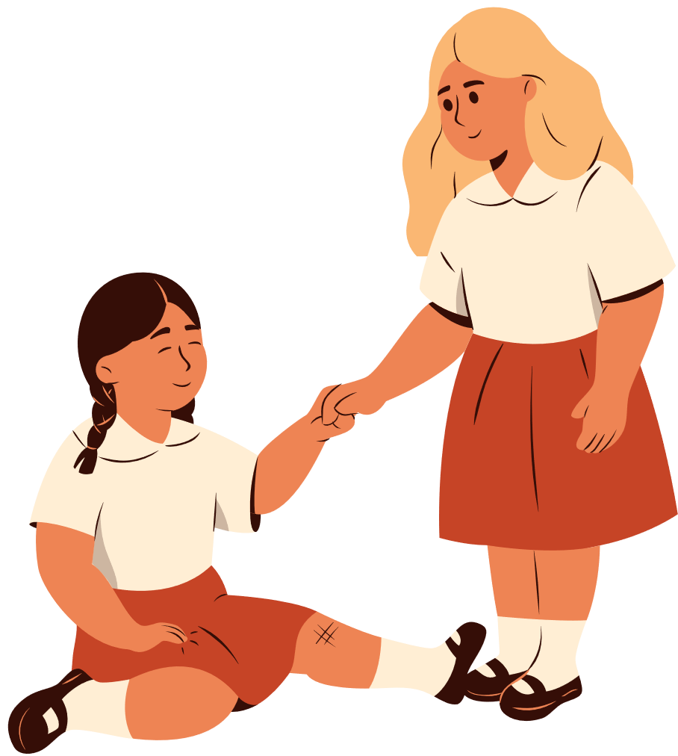
2. FIND SOMEONE WHO SERVES PEOPLE

Slide 23

HUMAN TIC TAC TOE

Slide 24

WHY DID WE PLAY THE GAME?
We played this game because it's about being part of something bigger. None of us can win by ourselves. But, we need to do our best for our team, and we need to make things easier for our friends. And, real life is like that too.

Slide 25
BIBLE VERSE
19 She spins her own cloth, 20 and she helps the poor and the needy.
Proverbs 31:19-23

Slide 26
BIBLE VERSE
21 Her family has warm clothing, and so she doesn’t worry when it snows.
Proverbs 31:19-23

Slide 27
BIBLE VERSE
22 She does her own sewing, and everything she wears is beautiful
Proverbs 31:19-23

Slide 28
BIBLE VERSE
23 Her husband is a well-known and respected leader in the city.
Proverbs 31:19-23

Slide 29

WHAT HAPPENED IN THE BIBLE VERSE
3
The woman in our passage serves everyone. She serves the poor, and she serves her family. She also takes care of herself. And, she also helps her whole city. The Bible says her husband is a leader in the city.

Slide 30

WHAT HAPPENED IN THE BIBLE VERSE
3
Back in Bible times, the leaders of the city didn't earn any money. So, the woman in our Bible passage did her job so that her husband could serve everyone in the city. He couldn’t do his job without her. So, when the woman did her job, she was really serving everyone.

Slide 31

HOW CAN WE APPLY THIS TO OUR LIFE
Jesus told us, the greatest people are the people who serve everyone. So, if you want to marry someone great, you should find someone who serves.

Slide 32
PAIR AND SHARE
CAN YOU THINK OF A PERSON WHO HELPS OTHER PEOPLE

Slide 33
3. WE SHOULD LOOK FOR SOMEONE WHO
LOVES GOD

Slide 34

THREE LEGGED
RACE

Slide 35

WHY DID WE PLAY THE GAME?
This game was hard because you were stuck to them and you had to work together in order to win. But, can you imagine being partners with someone who didn't want to go to the same place? One person wants to go left, and the other person wants to go right. That would be really frustrating!

Slide 36

MARRIAGE
Marriage is frustrating for everyone, because anyone you marry will be different from you. But it's important to agree on the most important ideas, or else it will be extra frustrating.

Slide 37
BIBLE VERSE
Charm can be deceiving, and beauty fades away, but a woman who honors the Lord deserves to be praised.
Proverbs 31:30

Slide 38
WHAT HAPPENED IN THE BIBLE VERSE
3
The most important thing is, they need to honor the Lord. Some people are really good looking, but that's not as important. And some people are really charming. “Charming” means they've got a cool personality so everyone likes them. But, a cool personality is not as important.
People become less beautiful when they're old, and they become less cool when they're really old. But, a person who honors the Lord becomes more and more awesome.

Slide 39
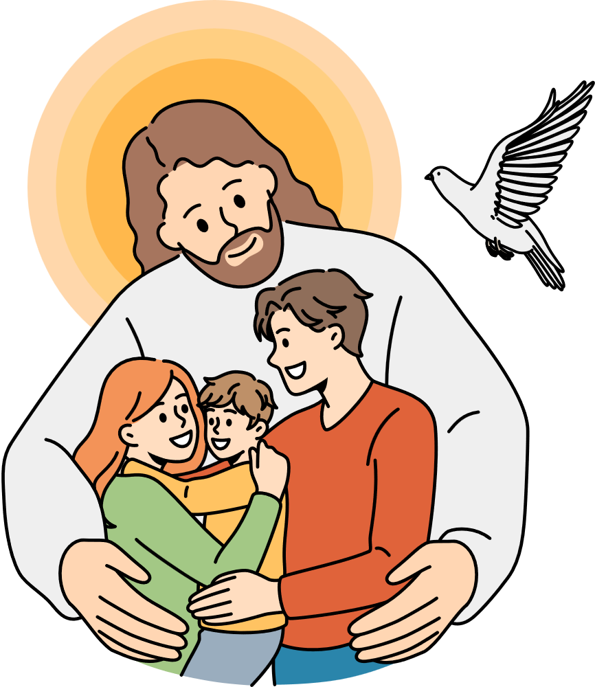
HOW CAN WE APPLY THIS TO OUR LIFE
If you find a person who really loves God, you can count on them to become amazing. They'll become kind, and wise, and powerful. They'll take care of you, and they'll respect you. And, if you can honor the Lord too, you'll have the greatest life together.

Slide 40
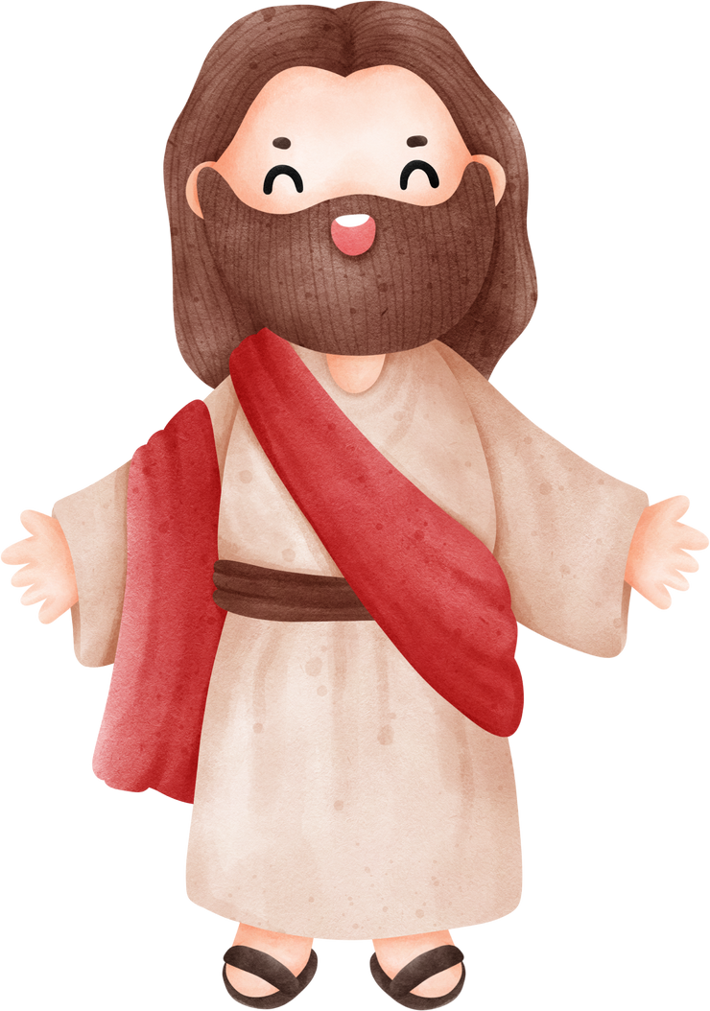
A person who honors the Lord will become like Jesus. What's your favorite thing about Jesus?

Slide 41
HOW CAN WE FIND THE RIGHT PERSON TO MARRY
  We should find someone who WORKS hard
  We should find someone who SERVES people
  We should find someone who LOVES God

Slide 42

Hot Chocolate!

Slide 43

ICe cream and rootbeer floats

