Slide 1


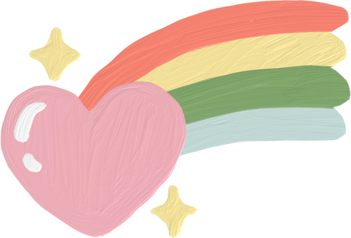
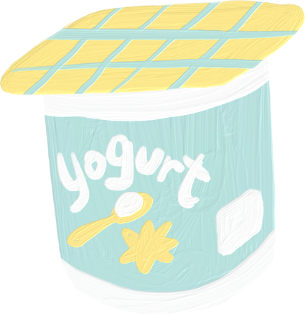
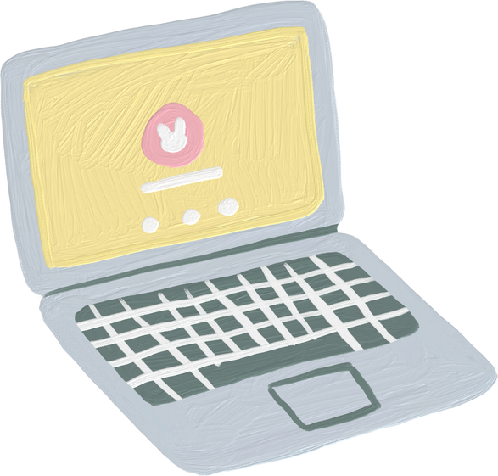

Being Christian is Difficult

Slide 2

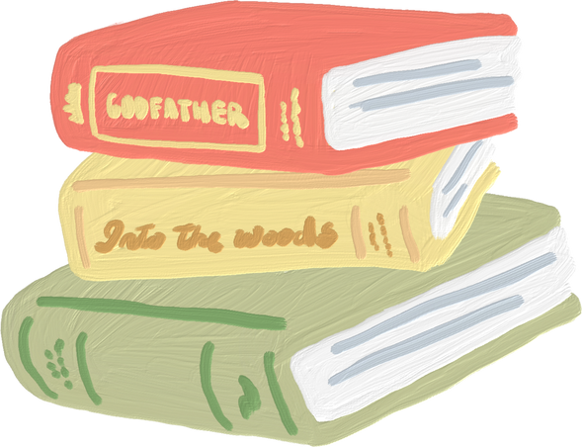

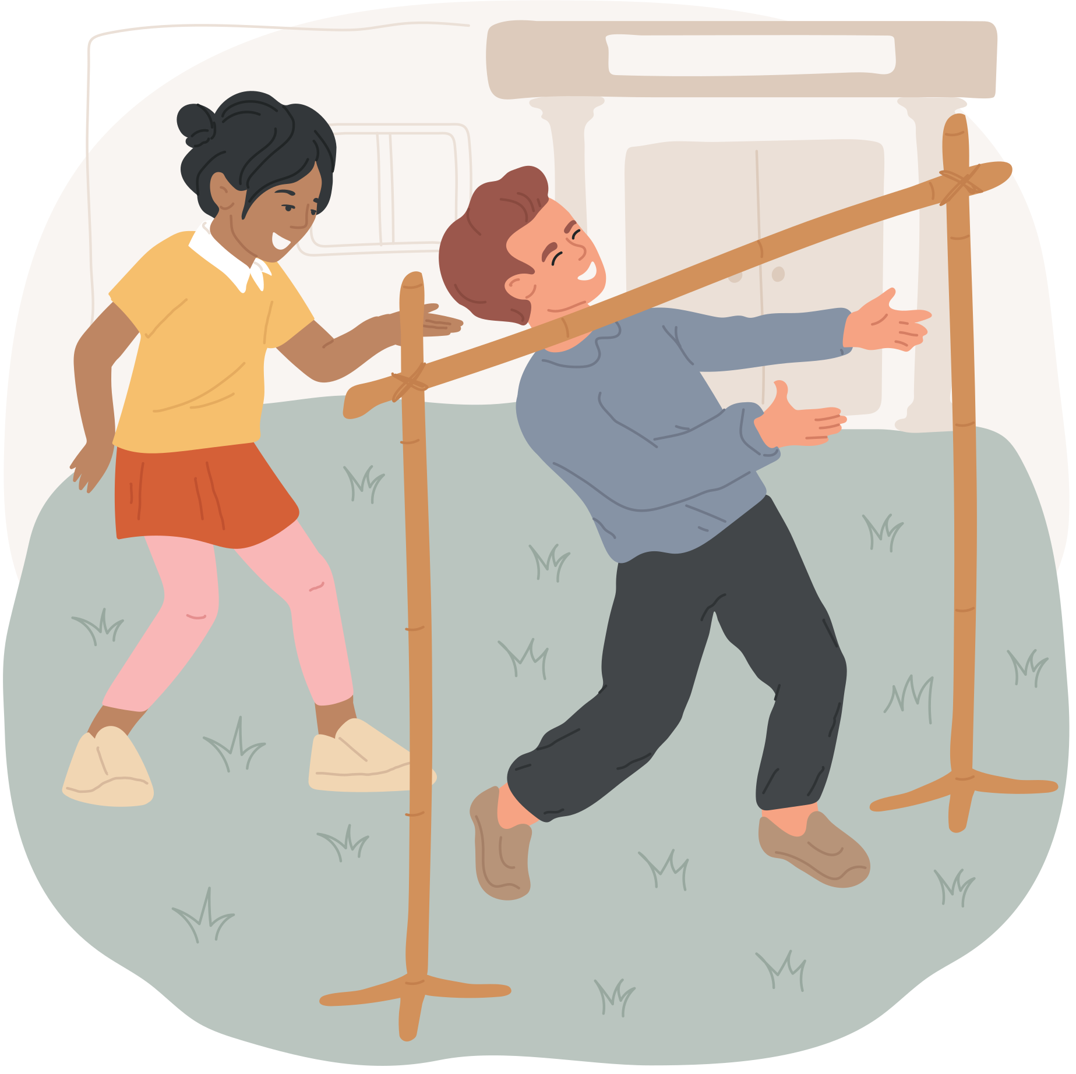
INTRO ACTIVITY
Limbo

Slide 3
LET'S DISCUSS!
  We played this game because it's hard! At least at the end, it gets hard. However, the game wouldn't be very fun if it were too easy.
  At the end of the game, we can only win if we're doing our best and we can get our body to do something really hard.

Slide 4

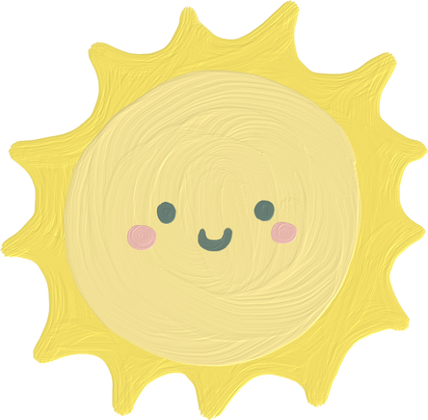


Being a Christian is a bit like that. The Bible tells us it's hard to be a Christian. It’s supposed to be hard. Some people think it should be easy to be a Christian, and then when it gets hard they're surprised and they’re not prepared. But if we expect it to be hard, then we can be prepared. It's like if you're expecting the weather to be cold outside, you'll put on your jacket and your gloves to keep you warm. So, it's good to prepare for trouble as a Christian.

Slide 5

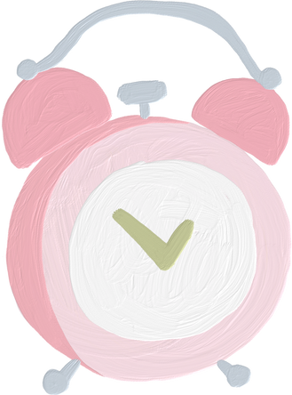

WHY IS IT HARD TO BE A CHRISTIAN?

Slide 6




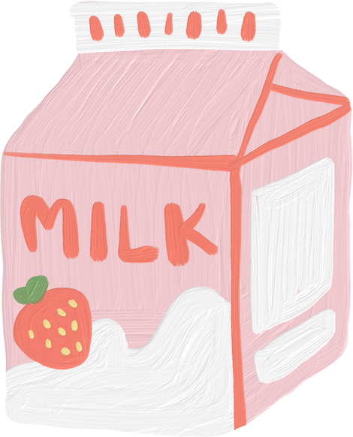
THE TWO REASONS WHY:
God wants our best gift, &
We need to train an animal

Slide 7
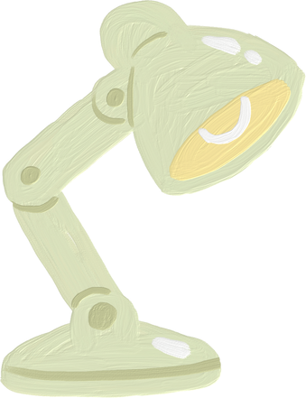
BIBLE STORY
Cain & Able

Slide 8
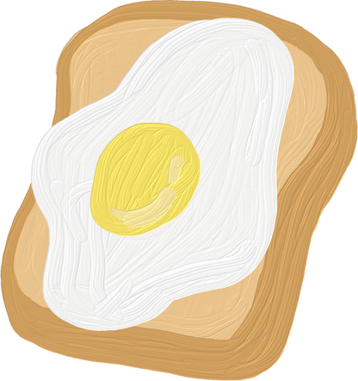

God wants our best gift.

Slide 9
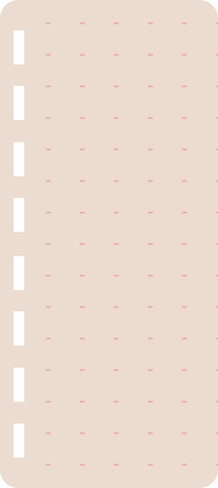



GAME:
Baby rattle

Slide 10
INSTRUCTIONS
We will have two teams, and each team will have one rattle. One person from your team will take a turn shaking the rattle until the top part is empty. Then they'll pass it to the next person, and they'll turn it over, and do the same thing. Once everyone in your team has finished, you are done, and you win.

Slide 11
DEBRIEF
  We played this game because it takes effort. We can't just shake the rattle once, but we must keep working until it's done.
  That’s what it’s like to be a Christian. We need to try our best for God; it really matters if we try our best.
That's what we learn from our Bible story.

Slide 12

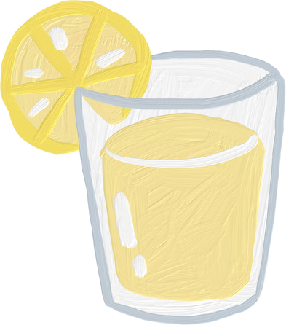
  Suck up the smarties with a straw and move them from one bowl to the other bowl.
  Once they’ve finished moving all the Smarties to the other bowl, the next person on your team will take a turn, and they’ll move all the Smarties back. Everyone on your team will have a turn moving the Smarties. When you all finish, you win!
GAME OPTION 2

Slide 13
DEBRIEF
  We played this game because it takes effort. We can't just suck up one Smartie and be done. We need to keep working at it until it's done.
  That’s what it’s like to be a Christian. We need to try our best for God, and it really matters that we try our best.
  That's what we learn from our Bible story.

Slide 14

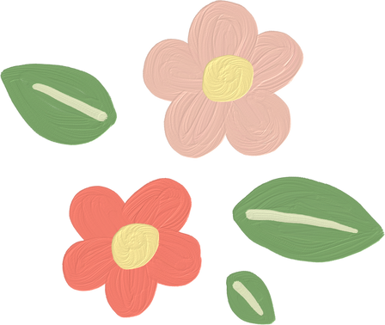
BIBLE REFERENCE
Adam and Eve had a son. Then Eve said, “I'll name him Cain because I got him with the help of the Lord.” 2 Later she had another son and named him Abel.
Abel became a sheep farmer, but Cain farmed the land. 3 One day, Cain gave part of his harvest to the Lord, 4 and Abel also gave an offering to the Lord. He killed the first-born lamb from one of his sheep and gave the Lord the best parts of it. The Lord was pleased with Abel and his offering, 5 but not with Cain and his offering. This made Cain so angry that he could not hide his feelings.
Genesis 4: 1-7 (CEV)

Slide 15
APPLICATION
  We need to learn from that, because every day, we have the same choice as Cain and Abel. Everyday God is with us, and we get to give a tribute to our king.
  We can all be like Abel. We can do our best for God because we love him. And God will be happy with us. God doesn’t need our gift. But he will be happy because we love him and trust him. And we will see that God loves us even more than we love him. And God helps us even more than we help him.
  But, what if we feel like Cain? What if we don’t love God and we don’t trust him? Well, we can learn from our Bible story. Cain was headed toward a lot of trouble, but God showed him a better way.

Slide 16
LET’S DISCUSS!
What is a gift that you can give to God?

Slide 17
2. We need to train an animal.

Slide 18
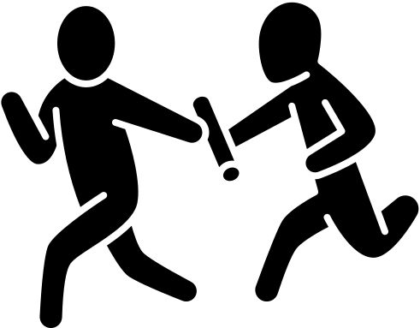
GAME:
Bean Bag Relay

Slide 19
DEBRIEF
  We played this game because it's about keeping our body in control. We can't just let our body do whatever it wants, but we need to really try to keep it steady.
  As Christians, we can't just do whatever we feel like. We need to keep ourselves under control.

Slide 20

BIBLE REFERENCE
The Lord looked with favor on Abel and his offering, 5 but on Cain and his offering he did not look with favor. So Cain was very angry, and his face was downcast.
6 Then the Lord said to Cain, “Why are you angry? Why is your face downcast? 7 If you do what is right, will you not be accepted? But if you do not do what is right, sin is crouching at your door; it desires to have you, but you must rule over it.”
Genesis 4:4b-7

Slide 21
  The good news is, we can train an animal. You also need to reward it for being good, and you need to have consequences for being bad. If we keep training it like that, the dog will build good habits, and it will be a lot easier to live with.
  Actually, we can train ourselves like dogs too. We can practice doing the right thing. We can have a schedule, we can reward ourselves for being good, and we can have consequences for being bad. Over time, we will build good habits, and it will be a lot easier to be good. That's how we keep ourselves under control.
  But it starts with a choice. Will we trust God when he tells us the right thing to do? And will we love him enough to try? If we make the right choice in our heart, we will be like Abel, and God will be very happy with us.

Slide 22
LET’S DISCUSS!
Why should we trust God?

Slide 23

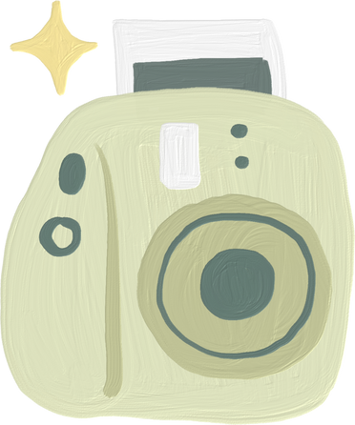

CONCLUSION
Why is it hard to be a Christian?
God wants our best gift
2. We need to train an animal (which is ourselves).

Slide 24
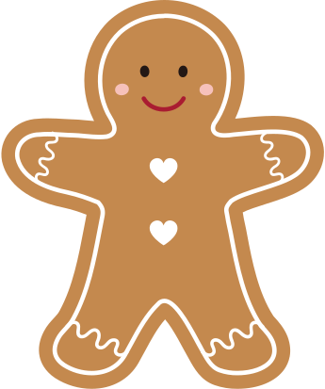
MAIN
ACTIVITY

