Slide 1










Being God’s Friend

Slide 2
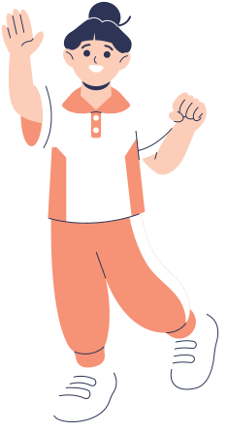
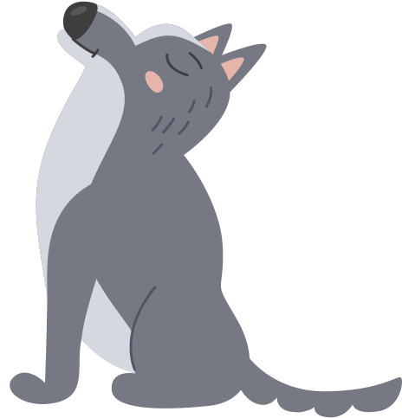

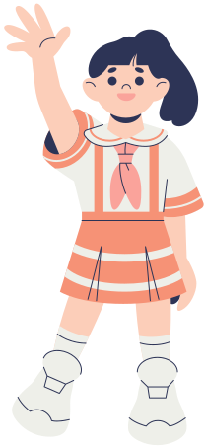

Intro Game:
What’s the time, Mr. Wolf?

Slide 3






Debrief:
We played this game because it's a bit like life. We all want to do well and win. But a lot of people get into trouble, and their story doesn't end well.

Slide 4





Question for today:
How can we make sure our story ends well?

Slide 5
Big Idea:
Our big idea today is, our story will end well if we HEAR from God and DO what he says.

Slide 6



Watch
this Video
We will learn this from the story of Noah. Let's watch the cartoon version of the story first.
Notes:
https://www.youtube.com/watch?v=qzYjy6lhRag&ab_channel=SaddlebackKids

Slide 7







Understanding the Lesson
Point 1:
Our first point is, we need to HEAR from God.

Slide 8



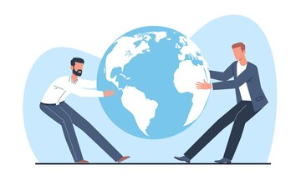


Bible Reference
5 The Lord saw how bad the people on earth were and that everything they thought and planned was evil.
Genesis 6:5-14 (CEV)

Slide 9
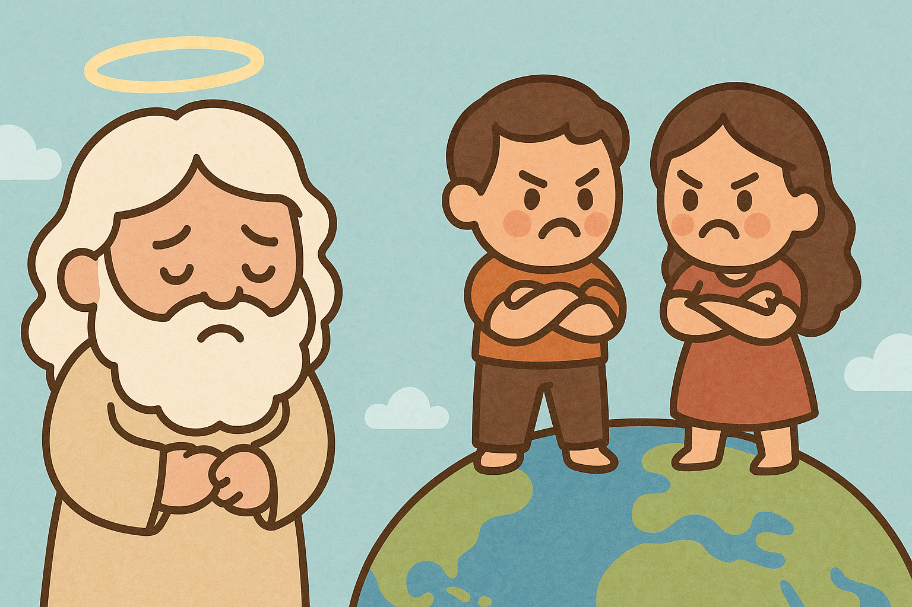
6 He was sorry that he had made them, 7 and he said, “I'm going to destroy every person on earth! I'll even wipe out animals, birds, and reptiles. I'm sorry I ever made them.”
Genesis 6:5-14 (CEV)

Slide 10
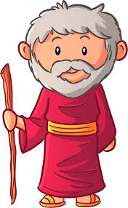
Bible Reference
8 But the Lord was pleased with Noah, 9 and this is the story about him. Noah was the only person who lived right and obeyed God. 10 He had three sons: Shem, Ham, and Japheth.
Genesis 6:5-14 (CEV)
Genesis 6:5-14 (CEV)

Slide 11

Bible Reference
11-12 God knew that everyone was terribly cruel and violent. 13 So he told Noah:
Cruelty and violence have spread everywhere. Now I'm going to destroy the whole earth and all its people.
Genesis 6:5-14 (CEV)

Slide 12
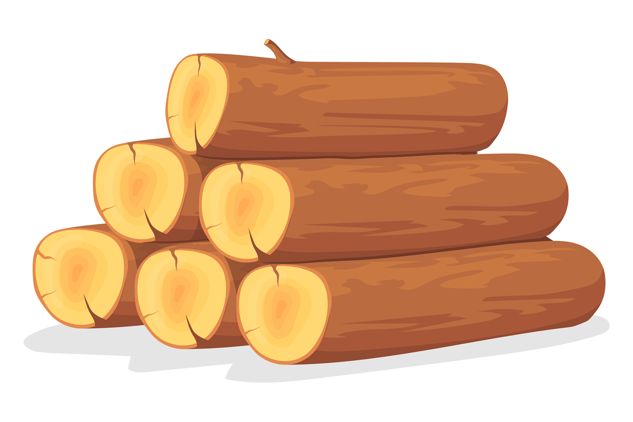
Bible Reference
14 Get some good lumber and build a boat. Put rooms in it and cover it with tar inside and out.
Genesis 6:5-14 (CEV)

Slide 13
Explanation:
If we are close to God, God will tell us things too.
Normally God uses the Bible to tell us things. He also uses all kinds of things in life to remind us of what he taught us in the Bible. It's important to know our Bible well, because it contains good news and great wisdom. But there is a lot of stuff out in the world that sounds like good news and great wisdom, but it's not.
We need to be able to tell which ideas come from God and which ideas don't.

Slide 14
Application
  If we are close to God, God will tell us things too.
  Normally God uses the Bible to tell us things.
  He also uses all kinds of things in life to remind us of what he taught us in the Bible.
  It's important to know our Bible well, because it contains good news and great wisdom.
  But there is a lot of stuff out in the world that sounds like good news and great wisdom, but it's not.
  We need to be able to tell which ideas come from God and which ideas don't.

Slide 15
Watch
this Video
There was a pastor who wrote a story one time to help us understand why it's so important to be close to God. Let’s watch the story.

Slide 16
Debrief
  In this story, the wisest of the knights was the one who went with the prince and knew the song that he played. Because he was so close to the prince, the knight could tell the difference between the real song and all the imitations out there.
  That's what it's like to walk with God. We do everything with God, and we know him so well that we can tell the difference between God’s idea and anyone else's idea.

Slide 17






Let's Discuss !
Question 1
What's something you can do to be close to God?

Slide 18

Understanding the Lesson
Point 2:
We need to DO what God says.

Slide 19


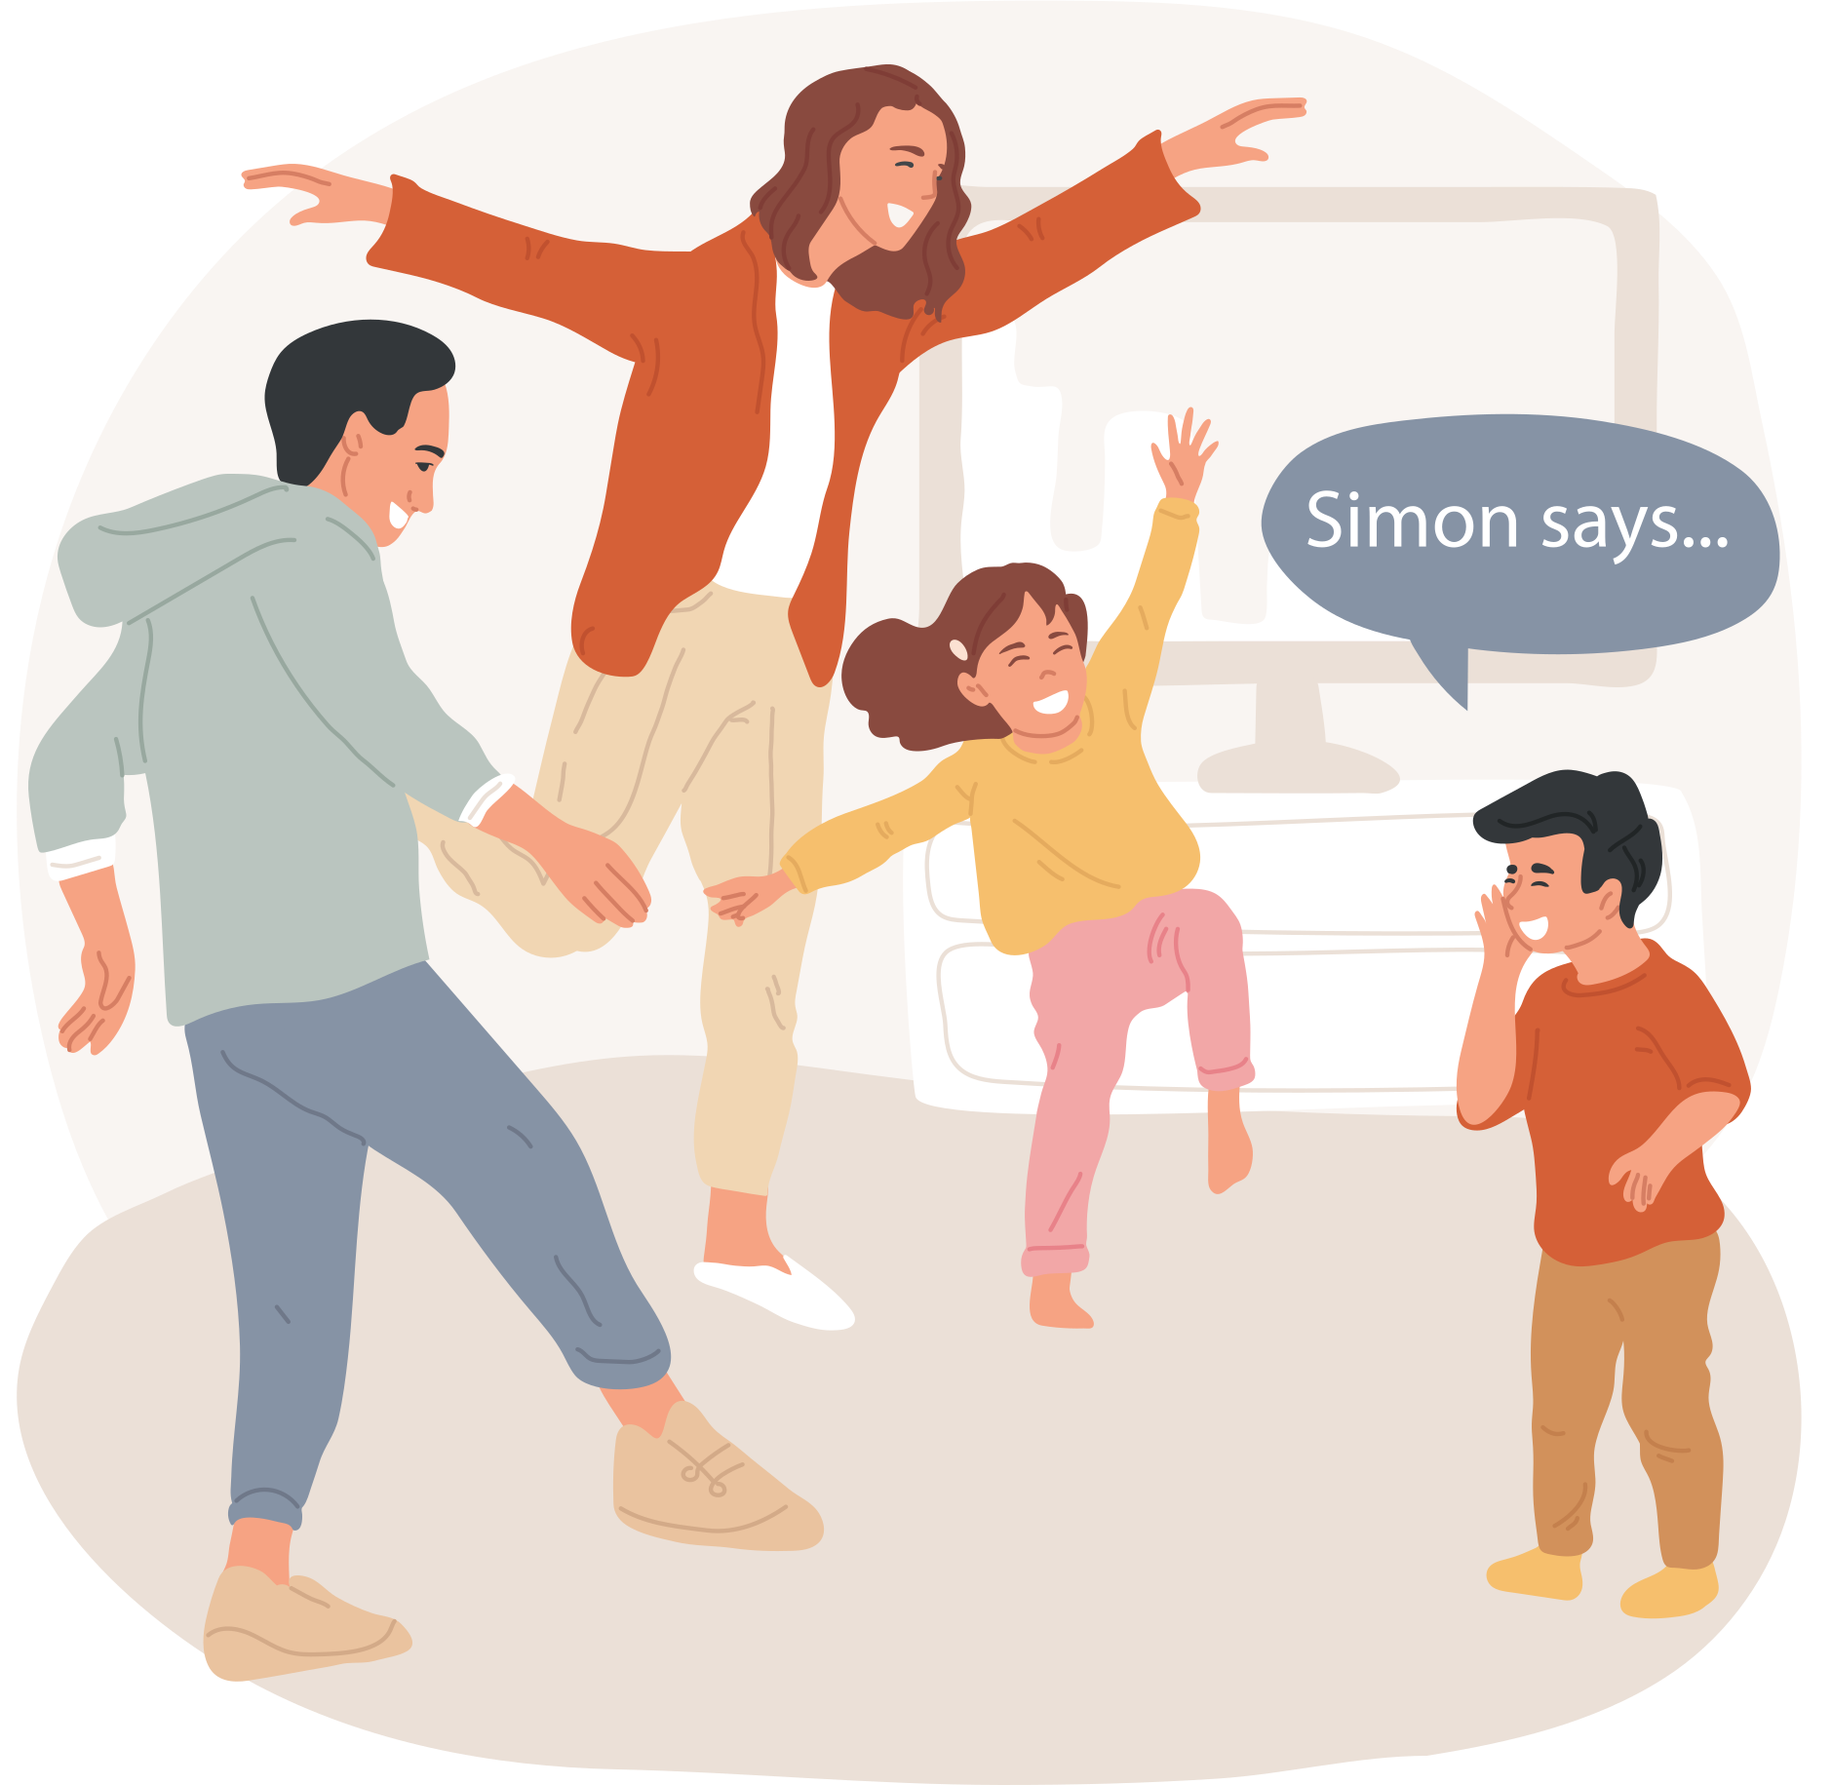

Try & Learn
Game: Simon Says

Slide 20
Debrief
We played this game because it's about doing the right things. We have to make sure that Simon said it, and then we have to do it.
Being a Christian is like that too. We need to know what God says, and then we have to do those things.

Slide 21
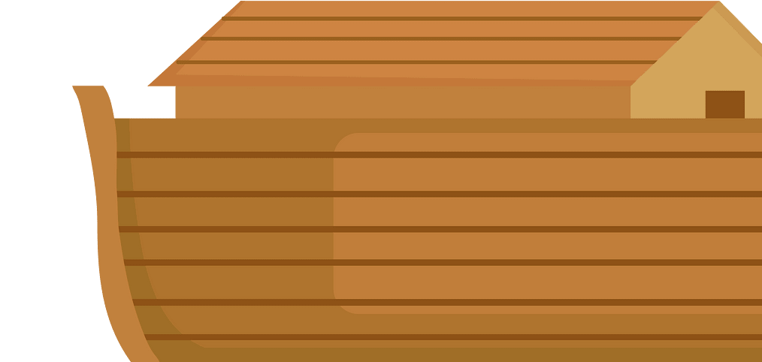
Bible Reference
14 Get some good lumber and build a boat. Put rooms in it and cover it with tar inside and out. 15 Make it 133 meters long, 22 meters wide, and 13 meters high. 16 Build a roof on the boat and leave a space of about 44 centimeters between the roof and the sides. Make the boat three stories high and put a door on one side.
Genesis 6:14-22 (CEV)

Slide 22
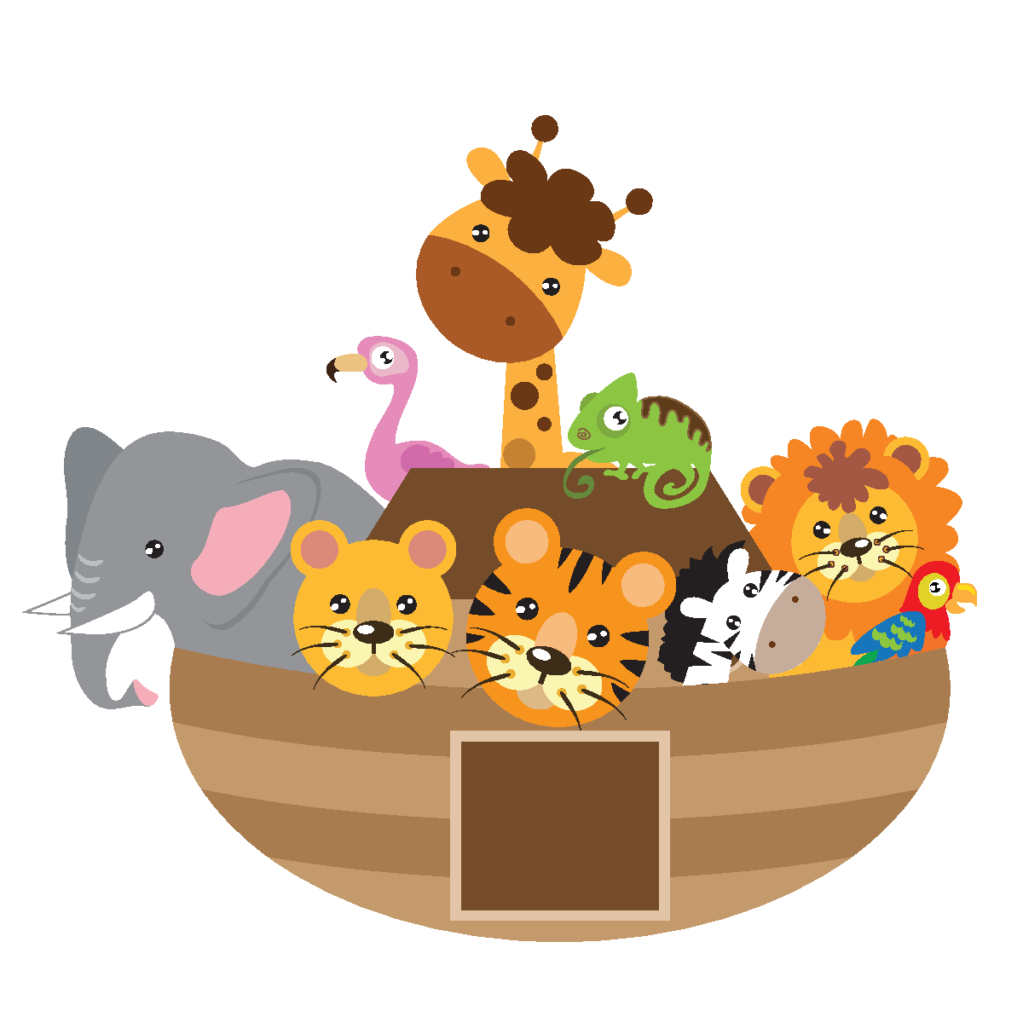
Bible Reference
19-20 Take into the boat with you a male and a female of every kind of animal and bird, as well as a male and a female of every reptile. I don't want them to be destroyed. 21 Store up enough food both for yourself and for them.
22 Noah did everything God told him to do.

Slide 23
We need to get big ideas right.
We can’t just follow what everyone says. After we get the big ideas right, we need to do the little things every day. Every day we do our best for people, we try to get a little stronger and learn a bit more, and we build good habits. Over time, we'll get a lot done.

Slide 24
Discussion Question
What's a small thing you can do every day?

Slide 25
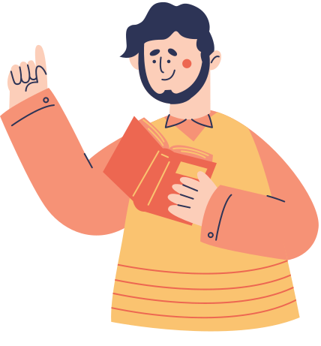
Thank you for joining
today's class
We learned how to make sure our story ends well. We need to HEAR from God and DO what he says. This means we need to spend time with God and get to know Him, and we need to get big ideas from Him. We need to do little details every day. If we do, we will be God's friends, and he will do amazing things with us.

Slide 26
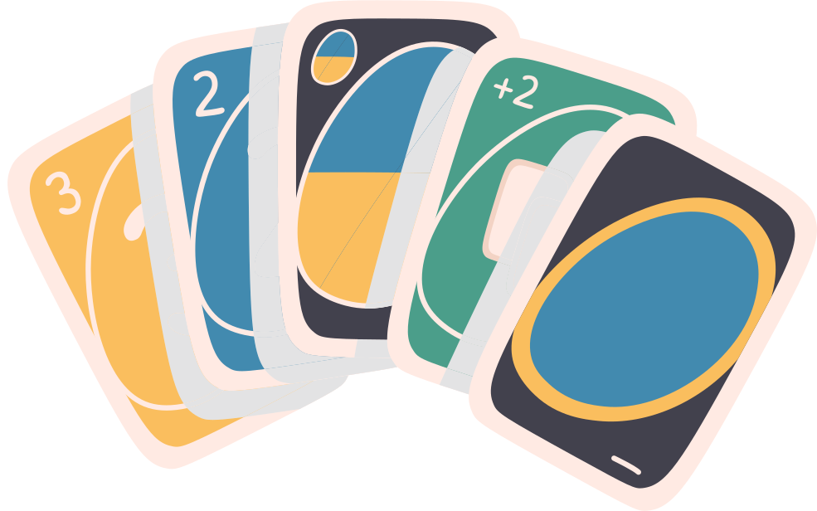
Board Games

